Slide 1
Afghanistan
Crimes of Communism

Slide 2
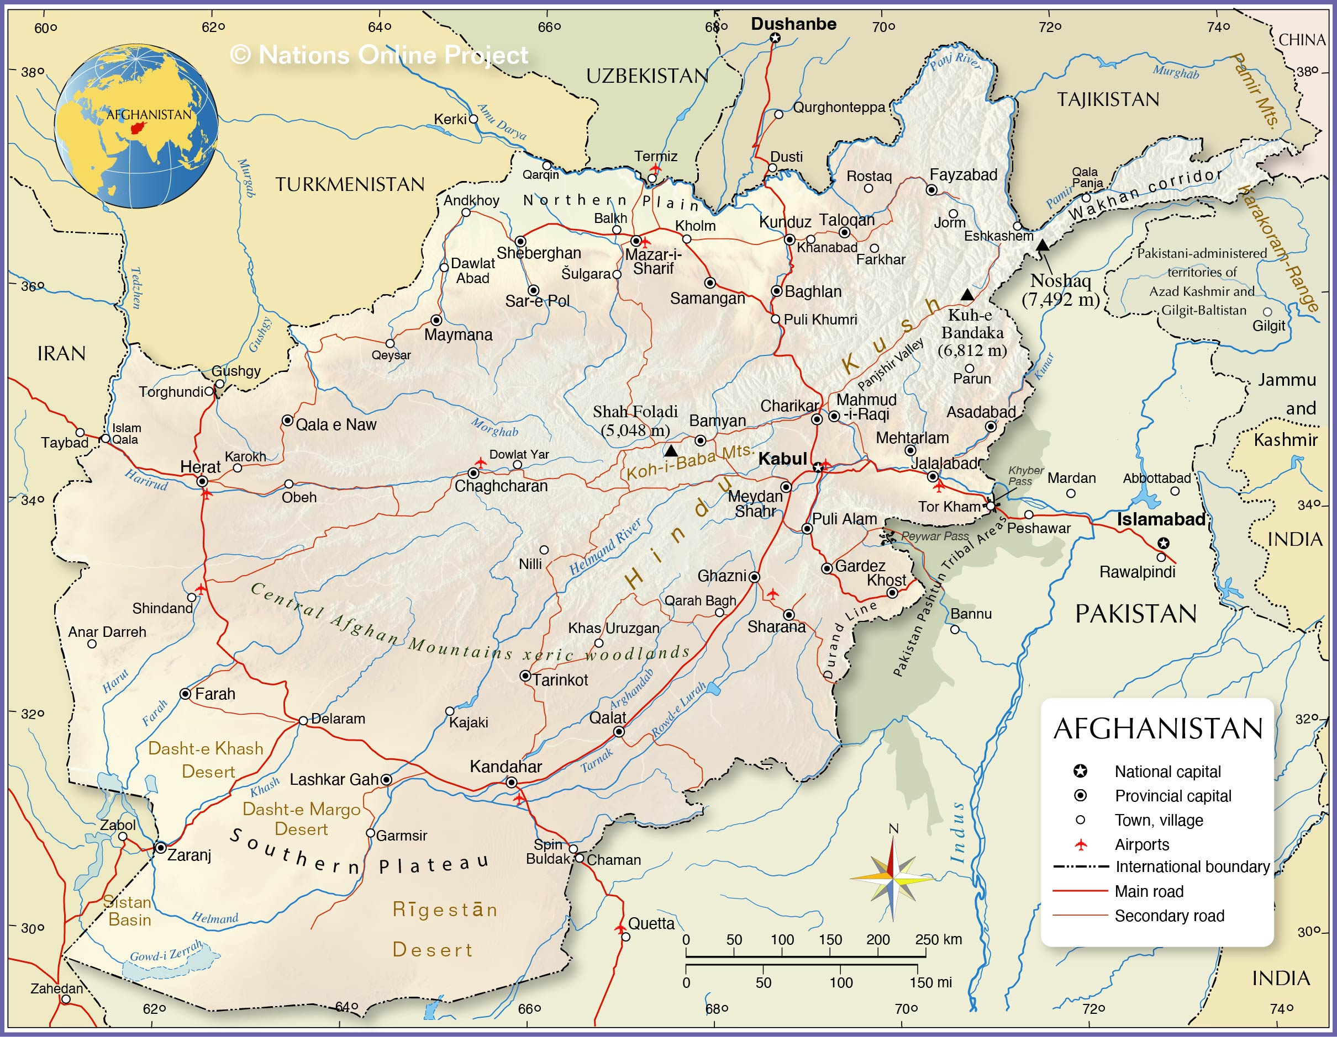
Afghanistan to 1973
Geography and social makeup
Treaties with Russia/USSR from 1921
Moves toward modernization
DPPA (PDPA)

Slide 3
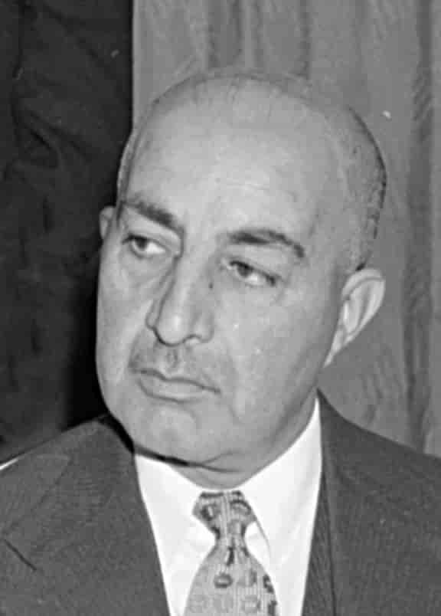
Two Coups
1973: Daoud coup
Role of Communists
1978: Communist coup
Taraki, Karmal, Amin

Slide 4
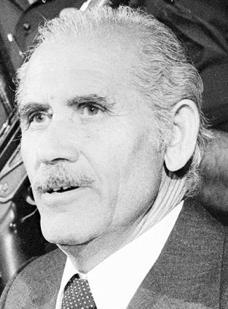
Repression and Resistance
Purges
Attacks on traditional society
Rebellion
Taraki replaced by Amin

Slide 5
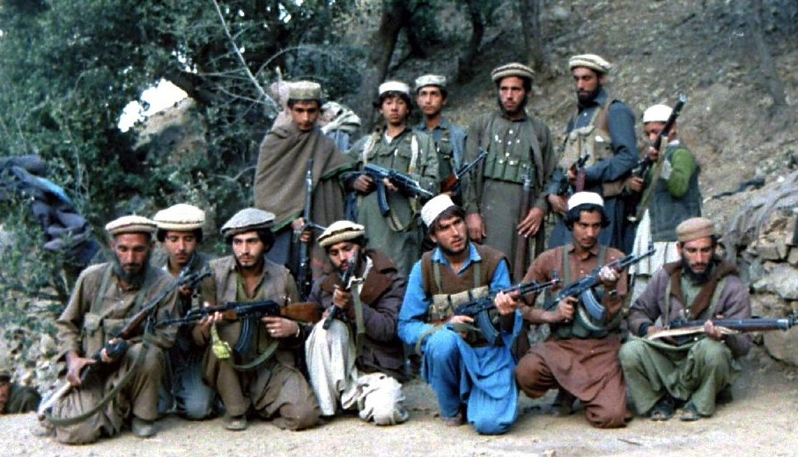
Soviet Intervention
Dec. 1979 invasion
Amin ➔ Karmal
Terror and war crimes
“The Soviet Vietnam”

Slide 6
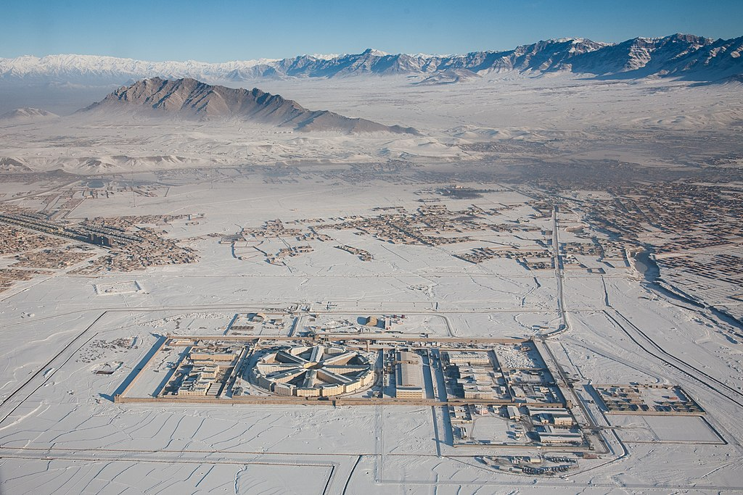
Scale of Repression
Refugees
Destruction of villages
Political terror
Child indoctrination

Slide 7
Human Toll
Soviet withdrawal
Dead and wounded
Refugees

