Slide 1
Post-Cold-War Communism
Crimes of Communism

Slide 2
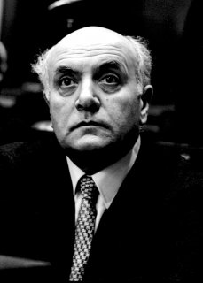
Eurocommunism
Principles
  Independence from Moscow
  Democratic
  Retains Marxist class analysis
Gateway to post-communism?
  Social democracy
  Environmentalism

Slide 3
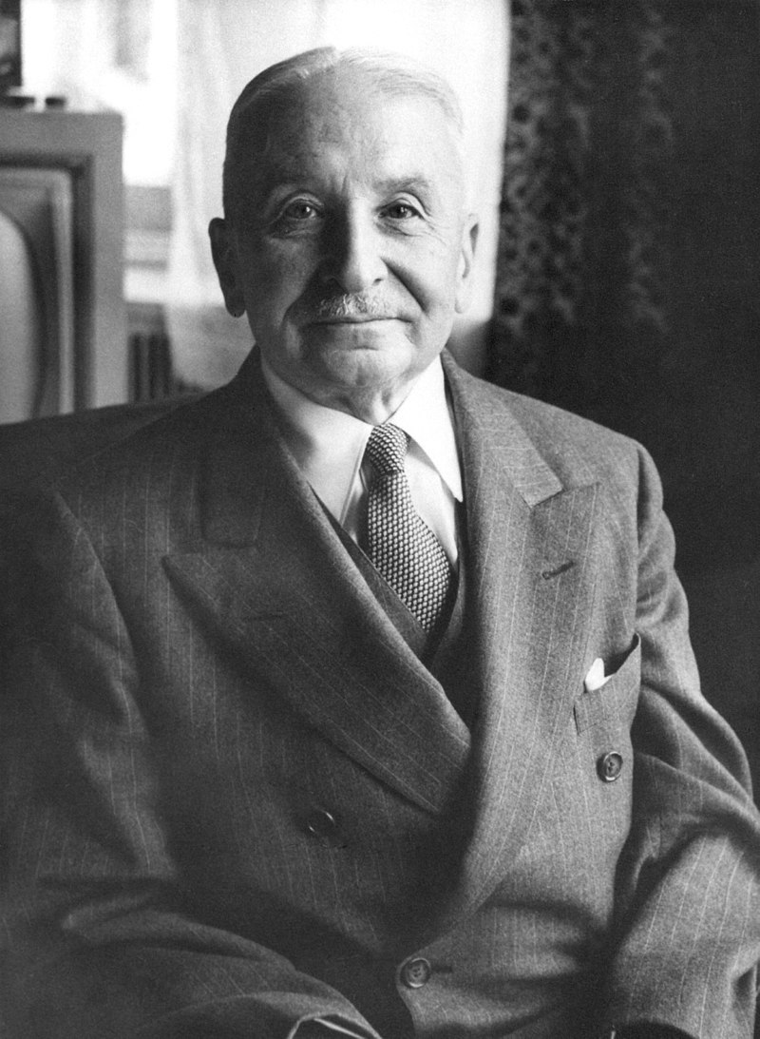
“Mises Was Right”
Socialist calculation debate is over
Socialists on the defensive
Gradual acceptance of markets in some form

Slide 4
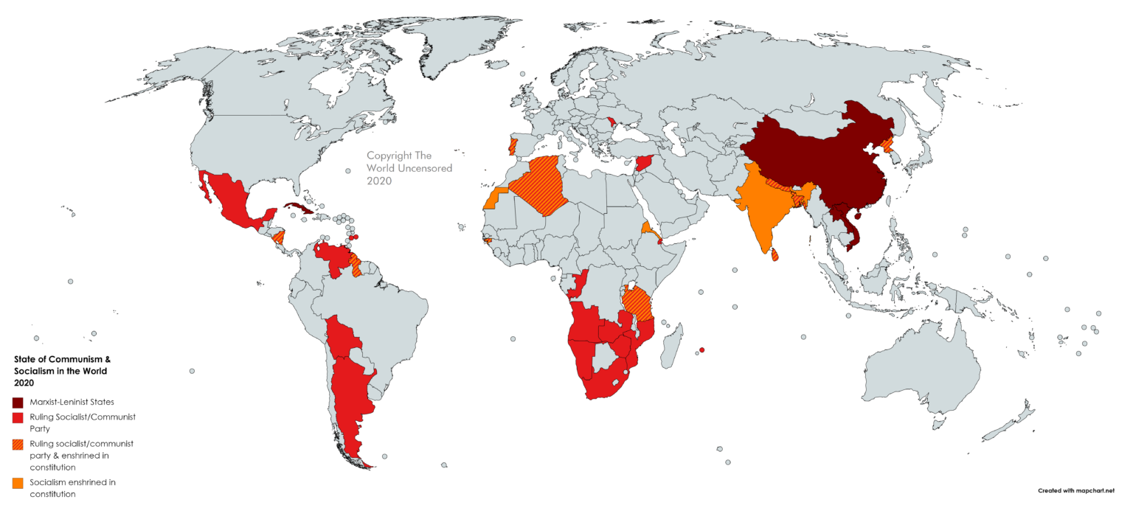
State of Communism Worldwide
Communist/Marxist parties active everywhere (success in Venezuela)
Cuba, North Korea, China, Laos, Vietnam
“Revisionist Marxist” regimes in Asia, Africa, Latin America

Slide 5
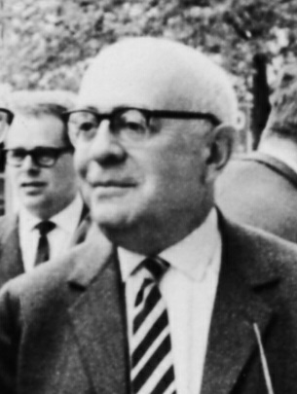
Is Wokeness Communist?
Frankfurt School and the “Long March through the Institutions”
Feminism, LGBTQ+, Critical Race Theory, etc.
Yoram Hazony on “The Challenge of Marxism”

