Slide 1
Espionage and Terrorism
Crimes of Communism

Slide 2
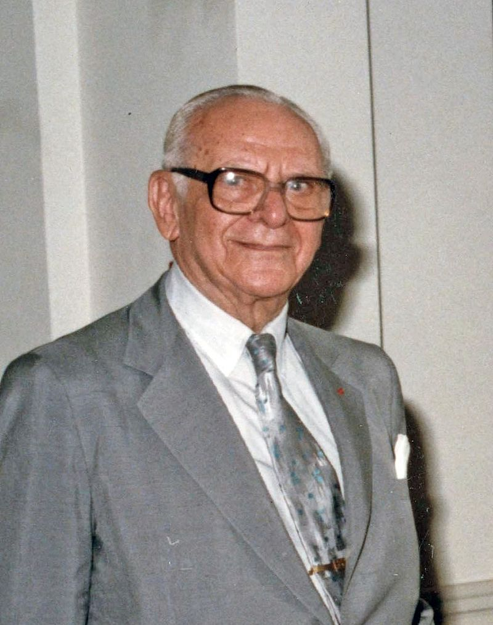
Espionage in the U.S.
Julian and Armand Hammer
NKVD and GRU presence
Role of CPUSA

Slide 3
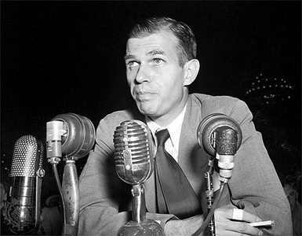
Espionage in the U.S.
Infiltration of State and Treasury Departments
Alger Hiss and Whittaker Chambers
Julius and Ethel Rosenberg
Cold War espionage

Slide 4
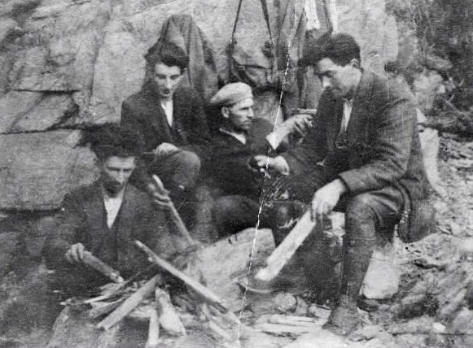
Turn toward Terrorism
Shifting Communist strategy
  Worldwide revolution
  National liberation from Axis
  Decolonization
Terrorism not a primary tactic; USSR showed some restraint
  Algeria
  IRA

Slide 5
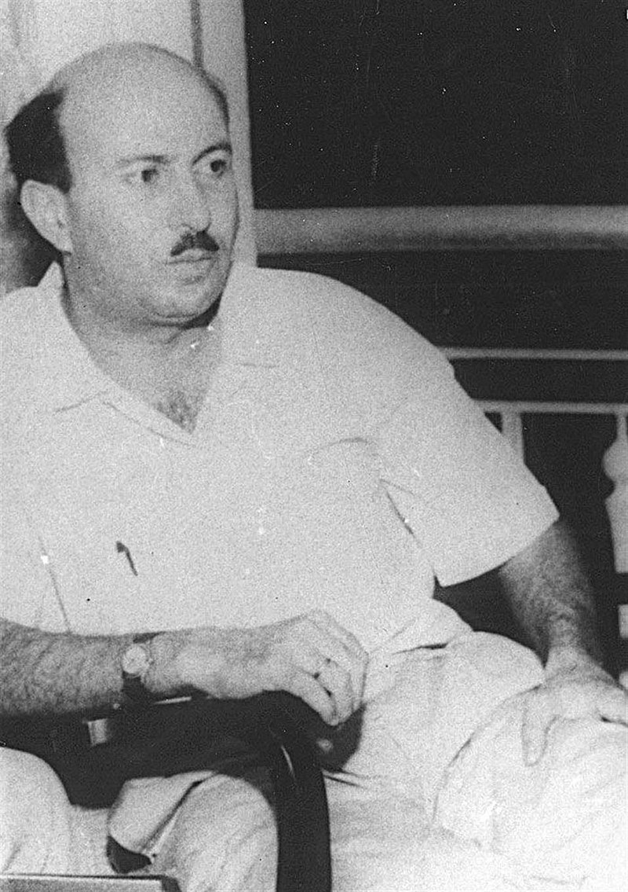
Terrorism in the Middle East
Palestinian organizations
  PLO
  PFLP
Wadie Haddad and “Carlos the Jackal”
Abu Nidal & Fatah Revolutionary Council

Slide 6
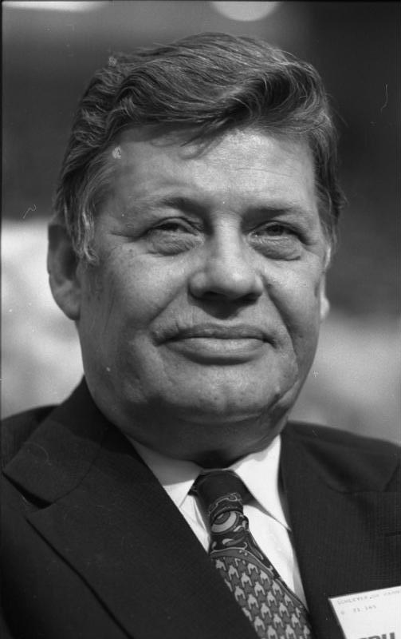
Other Terrorist Groups/Acts
Red Army Faction/Baader-Meinhof Group
Movimiento de Acción Revolucionairia (MAR)
Revolutionary Anti-Fascist Patriotic Front (FRAP)
North Korean terrorism

