Slide 1
Afrocommunism
Crimes of Communism

Slide 2
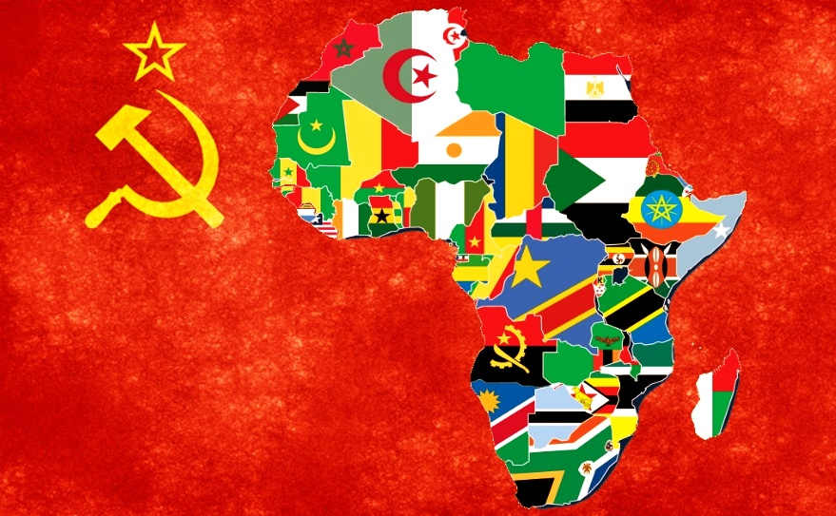
Debate over African Communism
Communist commitment by French propaganda
Several bona fide Communist groups
  MPLA
  Frelimo
  Congo Workers Party
  Ethiopian Workers Party

Slide 3
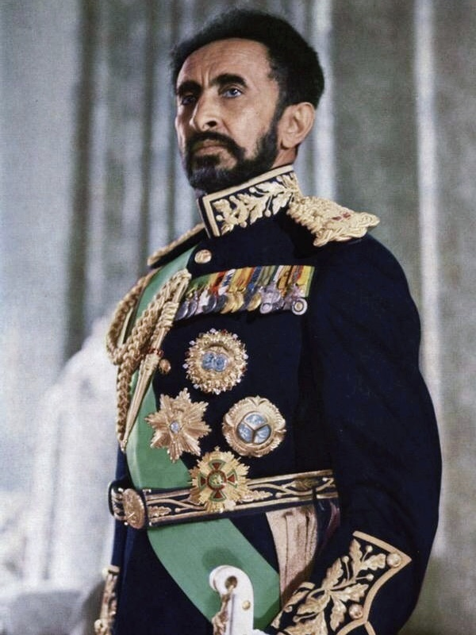
Ethiopia: Revolution
Haile Selassie I (1930-1974)
1974 coup: the Derg
Mengistu Haile Mariam (1937-)
Collectivization

Slide 4
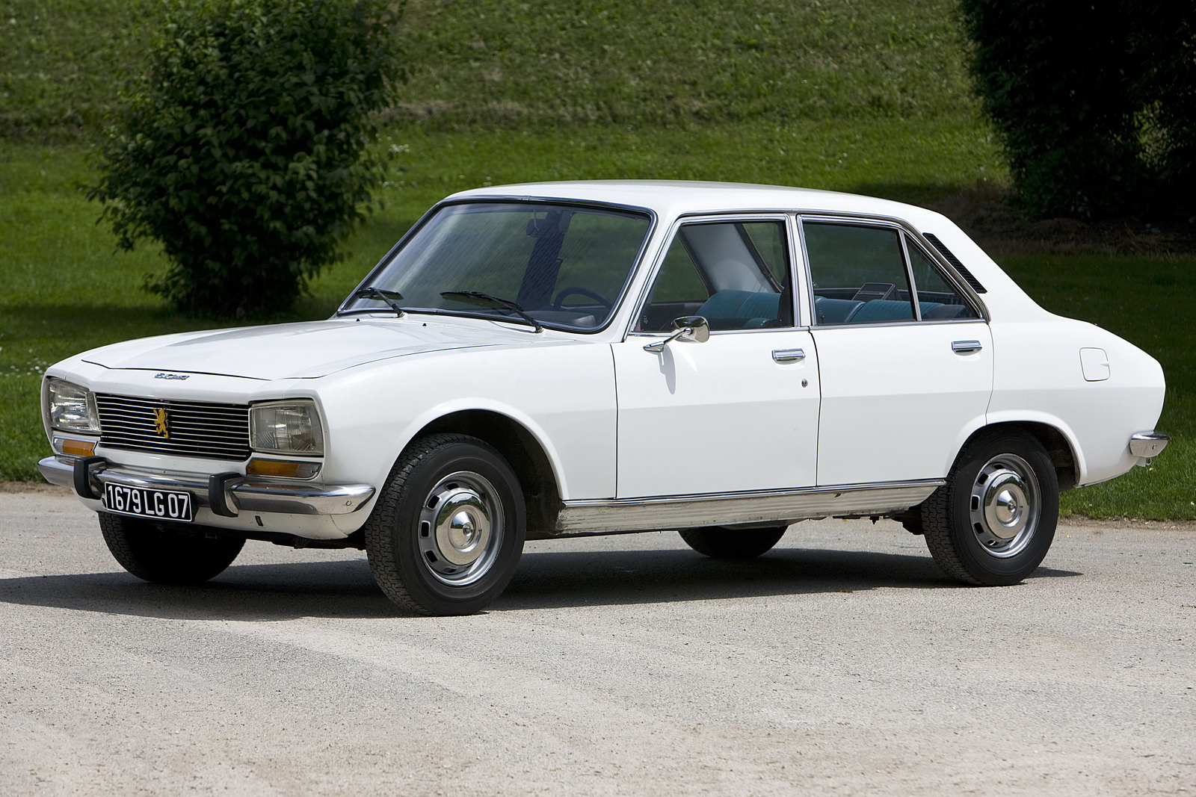
Ethiopia: Red Terror
EPRP and MEISON
Mass executions/graves
War against separatists

Slide 5
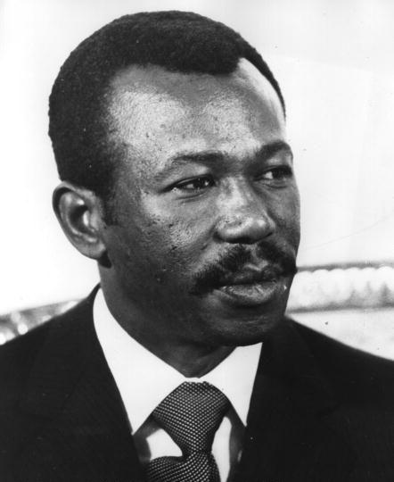
Ethiopia: Famines
Causes
Population displacement and “villagization”
End of Ethiopian communism

Slide 6
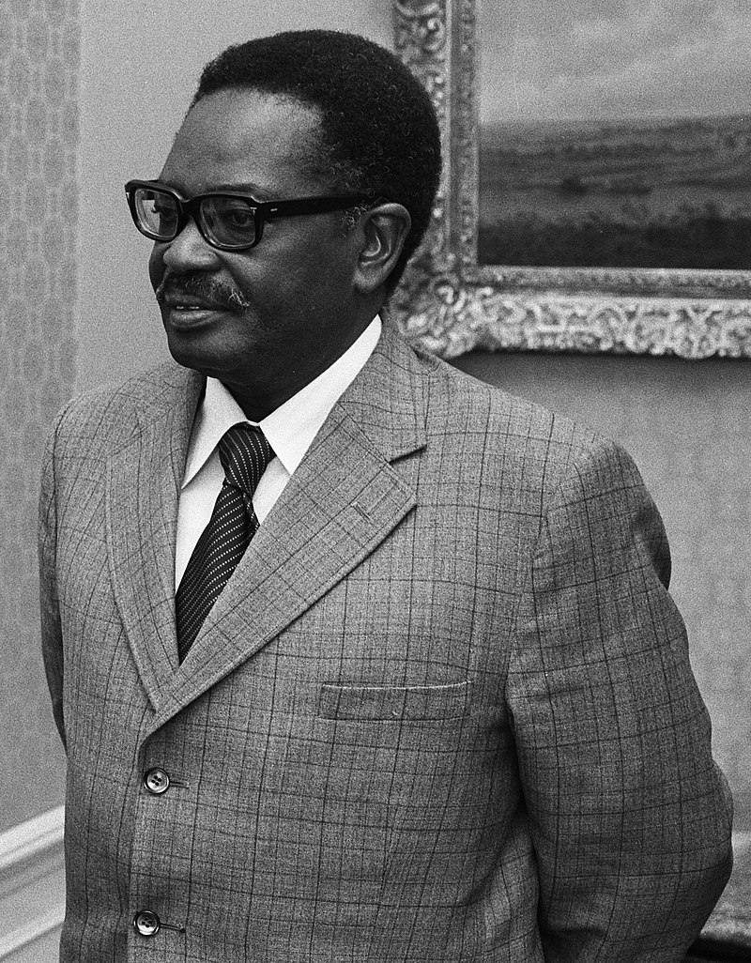
Angola
Coalition government
  MPLA
  FNLA
  UNITA
Agostinho Neto (1922-1979)
Economic collapse; civil war

Slide 7
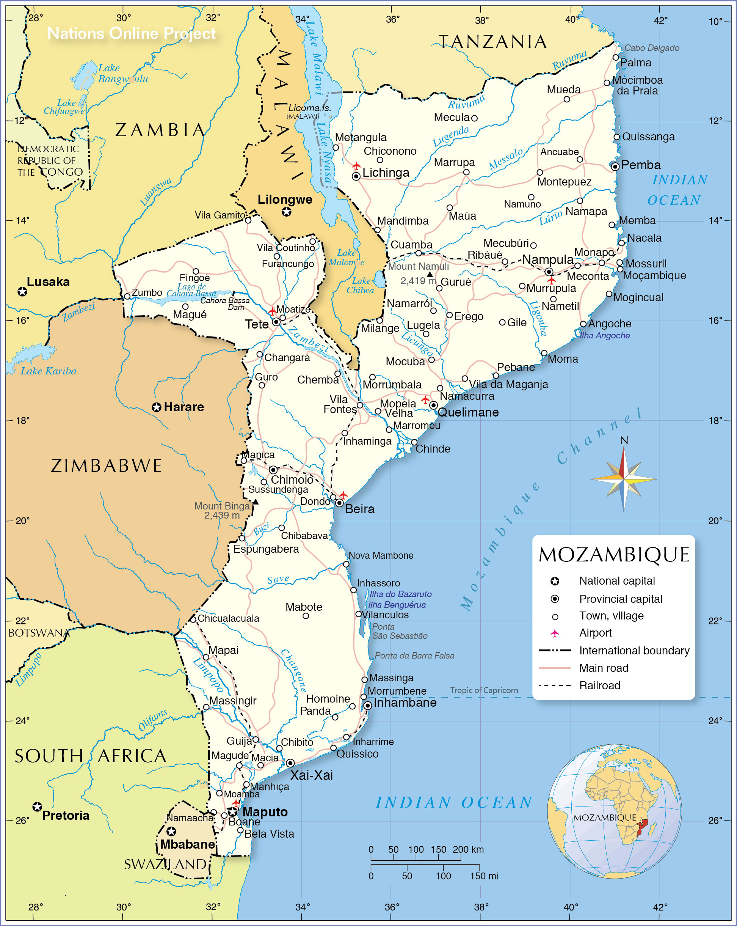
Mozambique
Frelimo and villagization
Rhodesia and Renamo
SNASP and reeducation camps

