Slide 1
Eastern Europe
Crimes of Communism

Slide 2
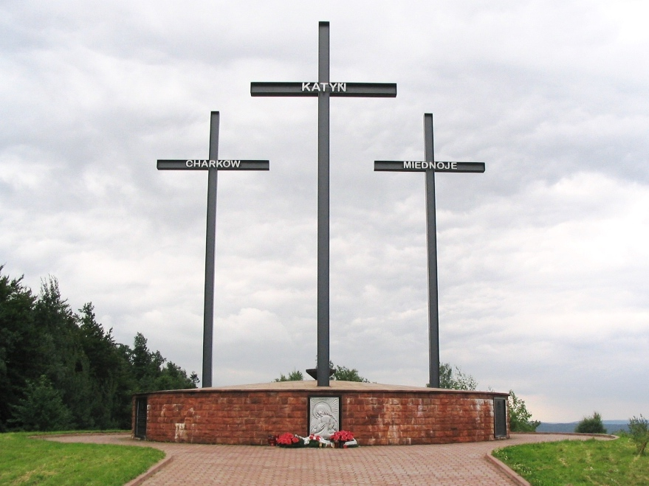
NKVD in Poland
Traditional hostility
Fate of Poles in Soviet territory before WWII
Nazi-Soviet invasion of Poland and aftermath

Slide 3
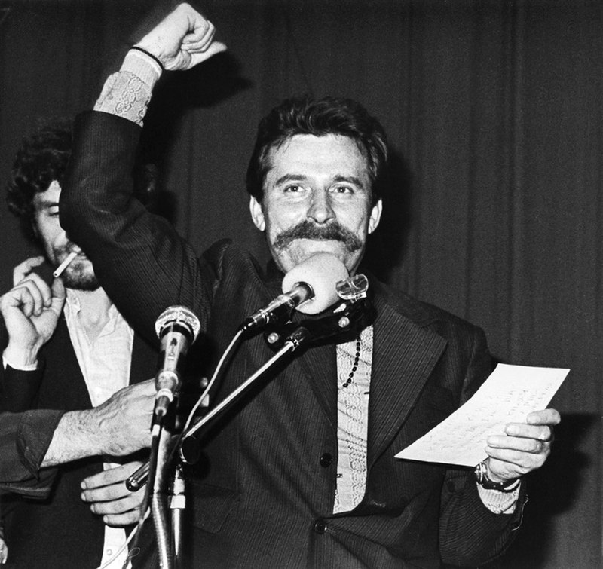
Poland under Communist Rule
The Homeland Army and the Red Army
Terror policy, 1944-1956
“Real Socialism”
Solidarity and martial law

Slide 4
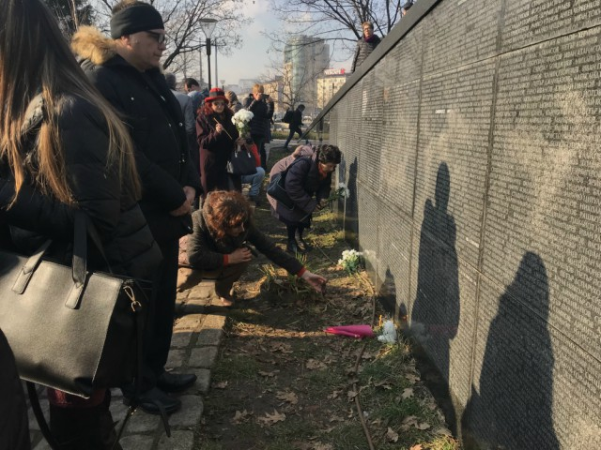
Postwar “National Cleansing”
Deportations
  Hungarians
  Germans
Bulgarian purge
Yugoslavian purge

Slide 5
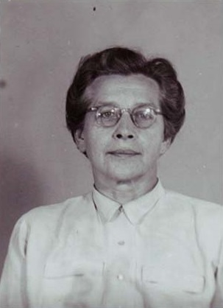
Trials of Non-Communists
Hungary and the Smallholders Party
Bulgaria: Nikolai Petkov
Czechoslovakia: Milada Horáková

Slide 6
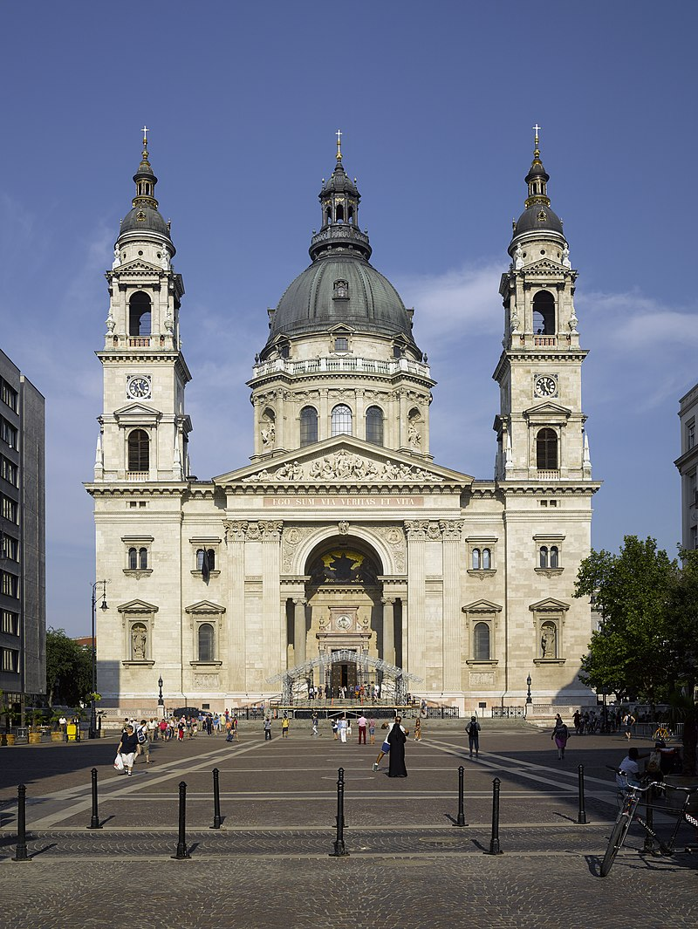
War on Civil Society
Totalitarian hatred of civil society
Sokol Club
Catholic Church

Slide 7
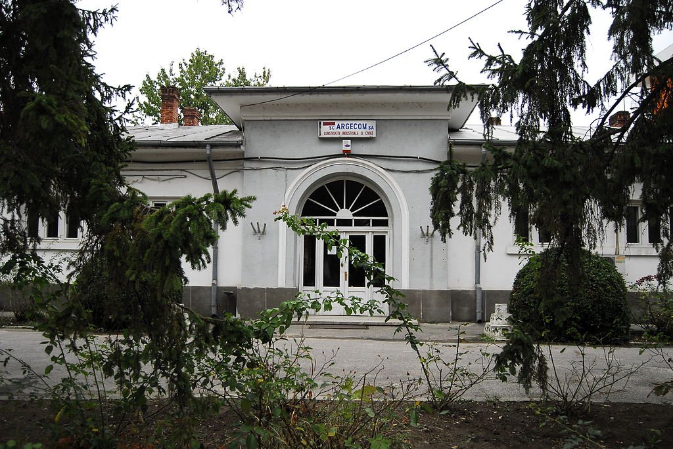
Concentration Camps
Deportations from cities to provinces
Forced labor
“Reeducation”

Slide 8
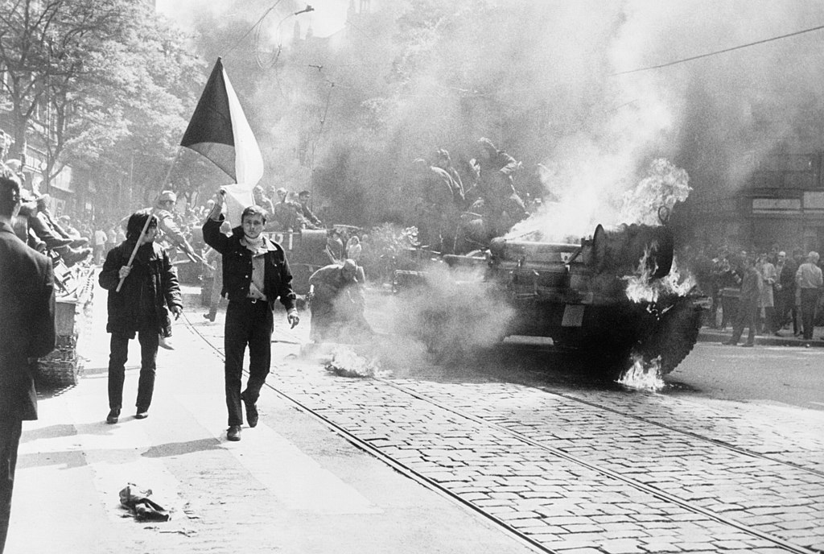
“Post-Terror” in Eastern Europe
“Sovietized” repression
De-Stalinization and limited rehabilitations
Resurgences of terror

