Slide 1
Southeast Asia
Crimes of Communism

Slide 2
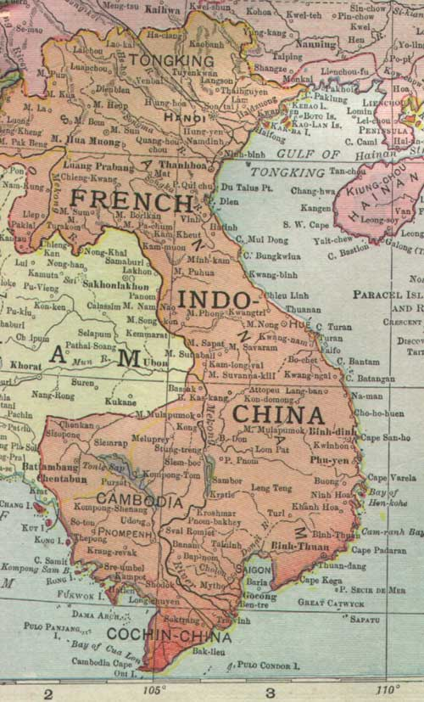
Vietnam to 1954
Indochinese Communist Party (ICP)
1945 revolution
First Indochina War (1946-1954)

Slide 3
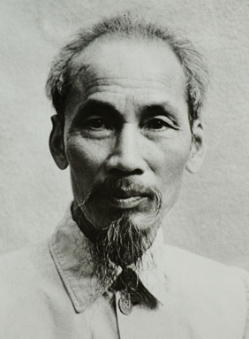
Vietnam: Copying China
Land reform
Baiting “ideological saboteurs”
Famine, too

Slide 4
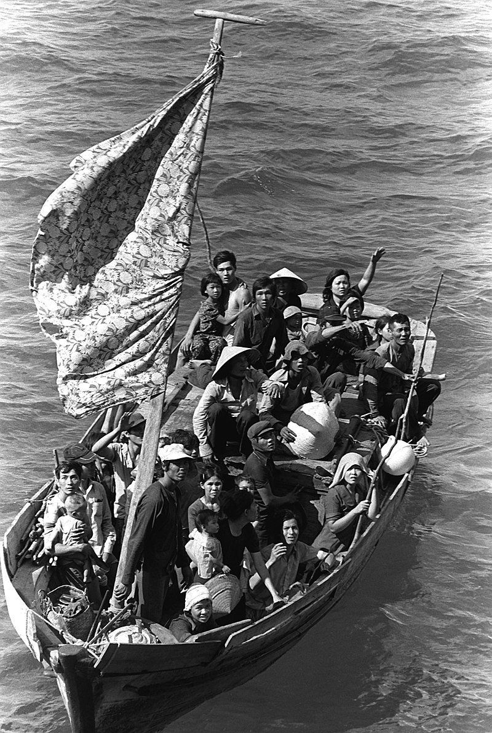
Vietnam: 1960s-1990s
Purges
Tet Offensive massacres
Reeducation
Boat people

Slide 5
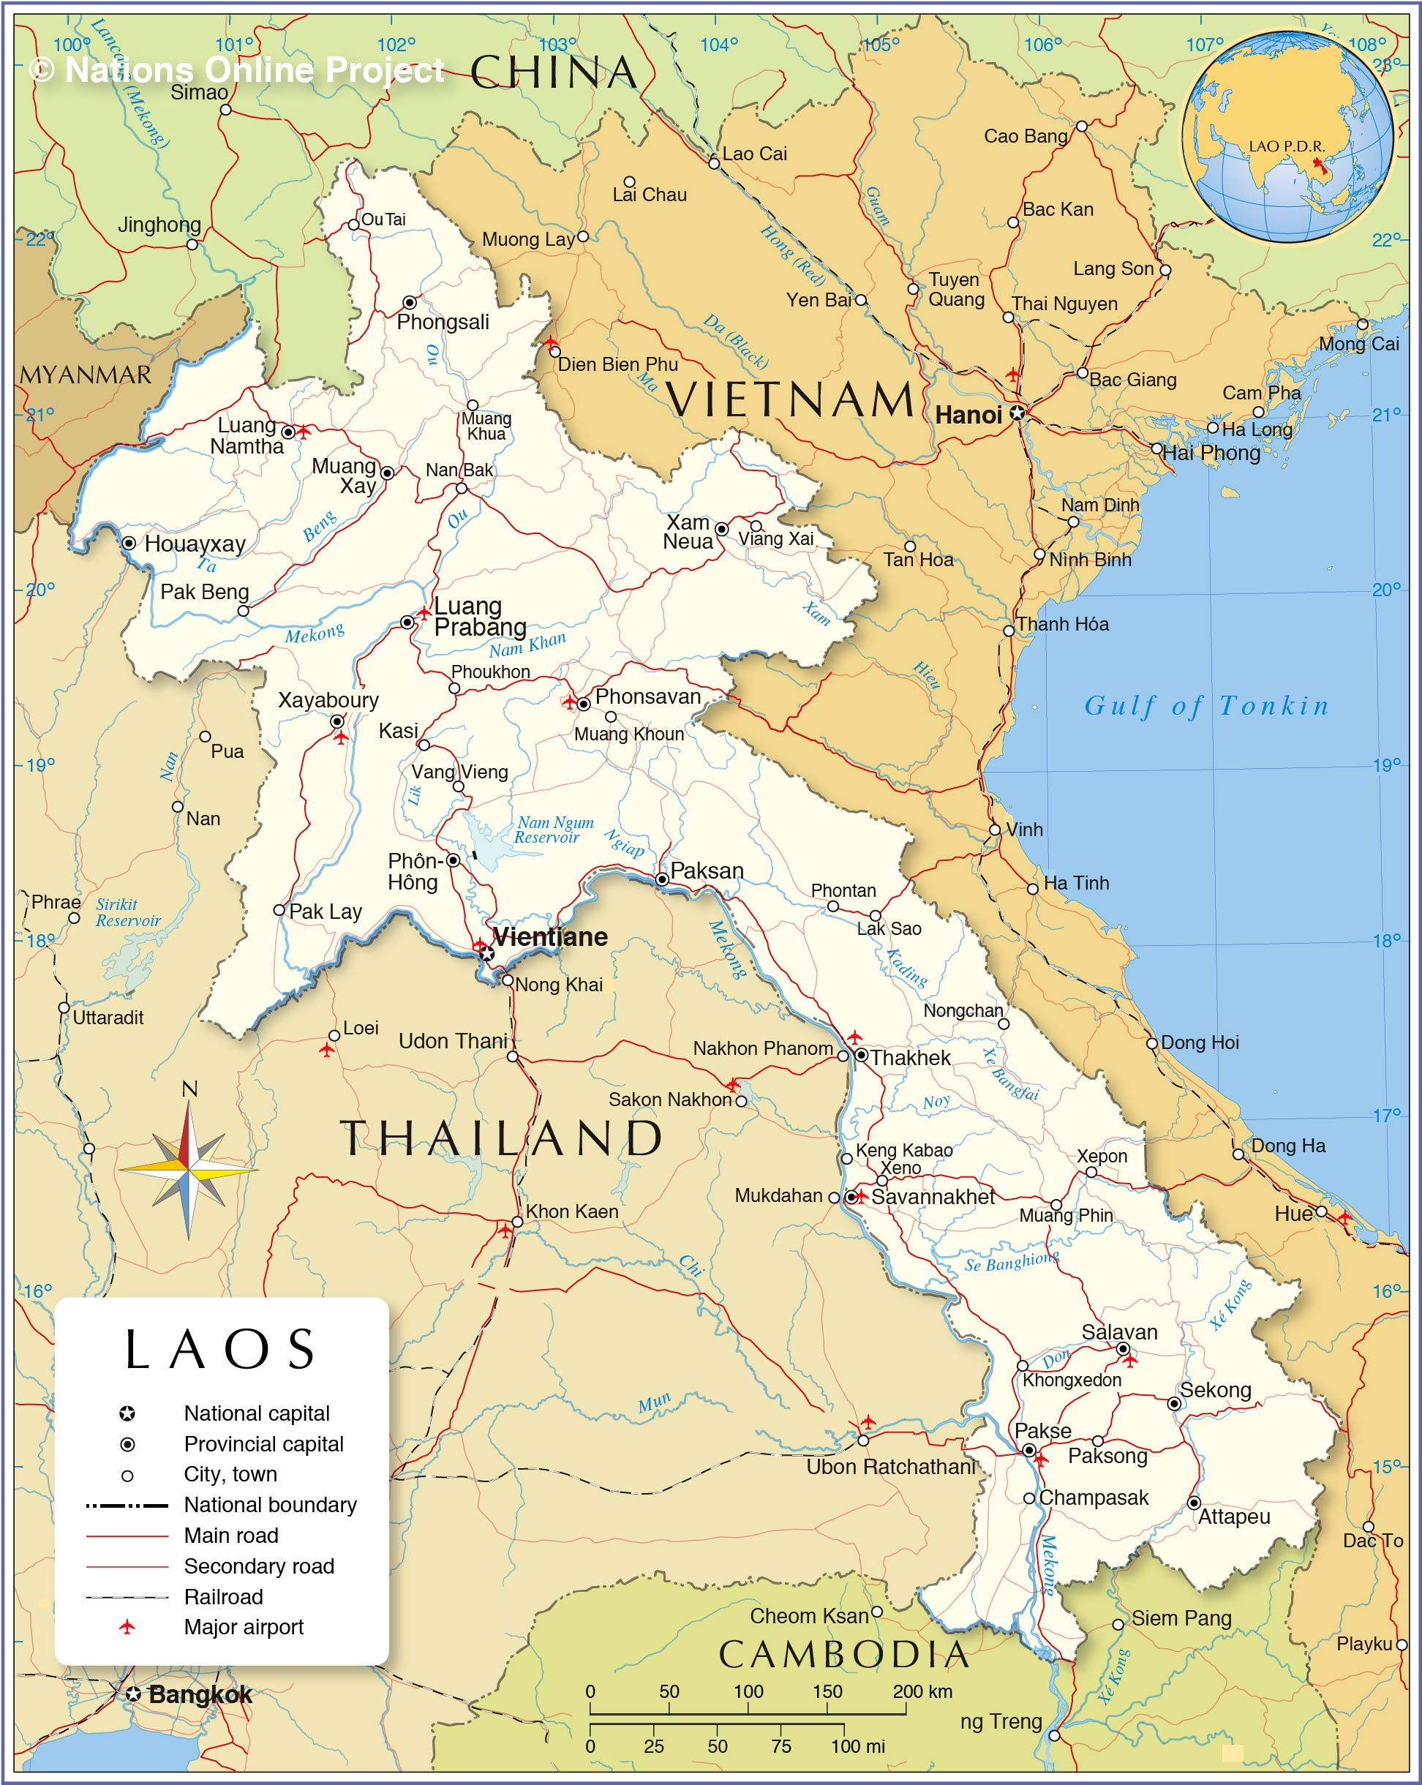
Laos in Vietnam’s Wake
Communist takeover in 1975
Hmong guerillas
Refugees

Slide 6
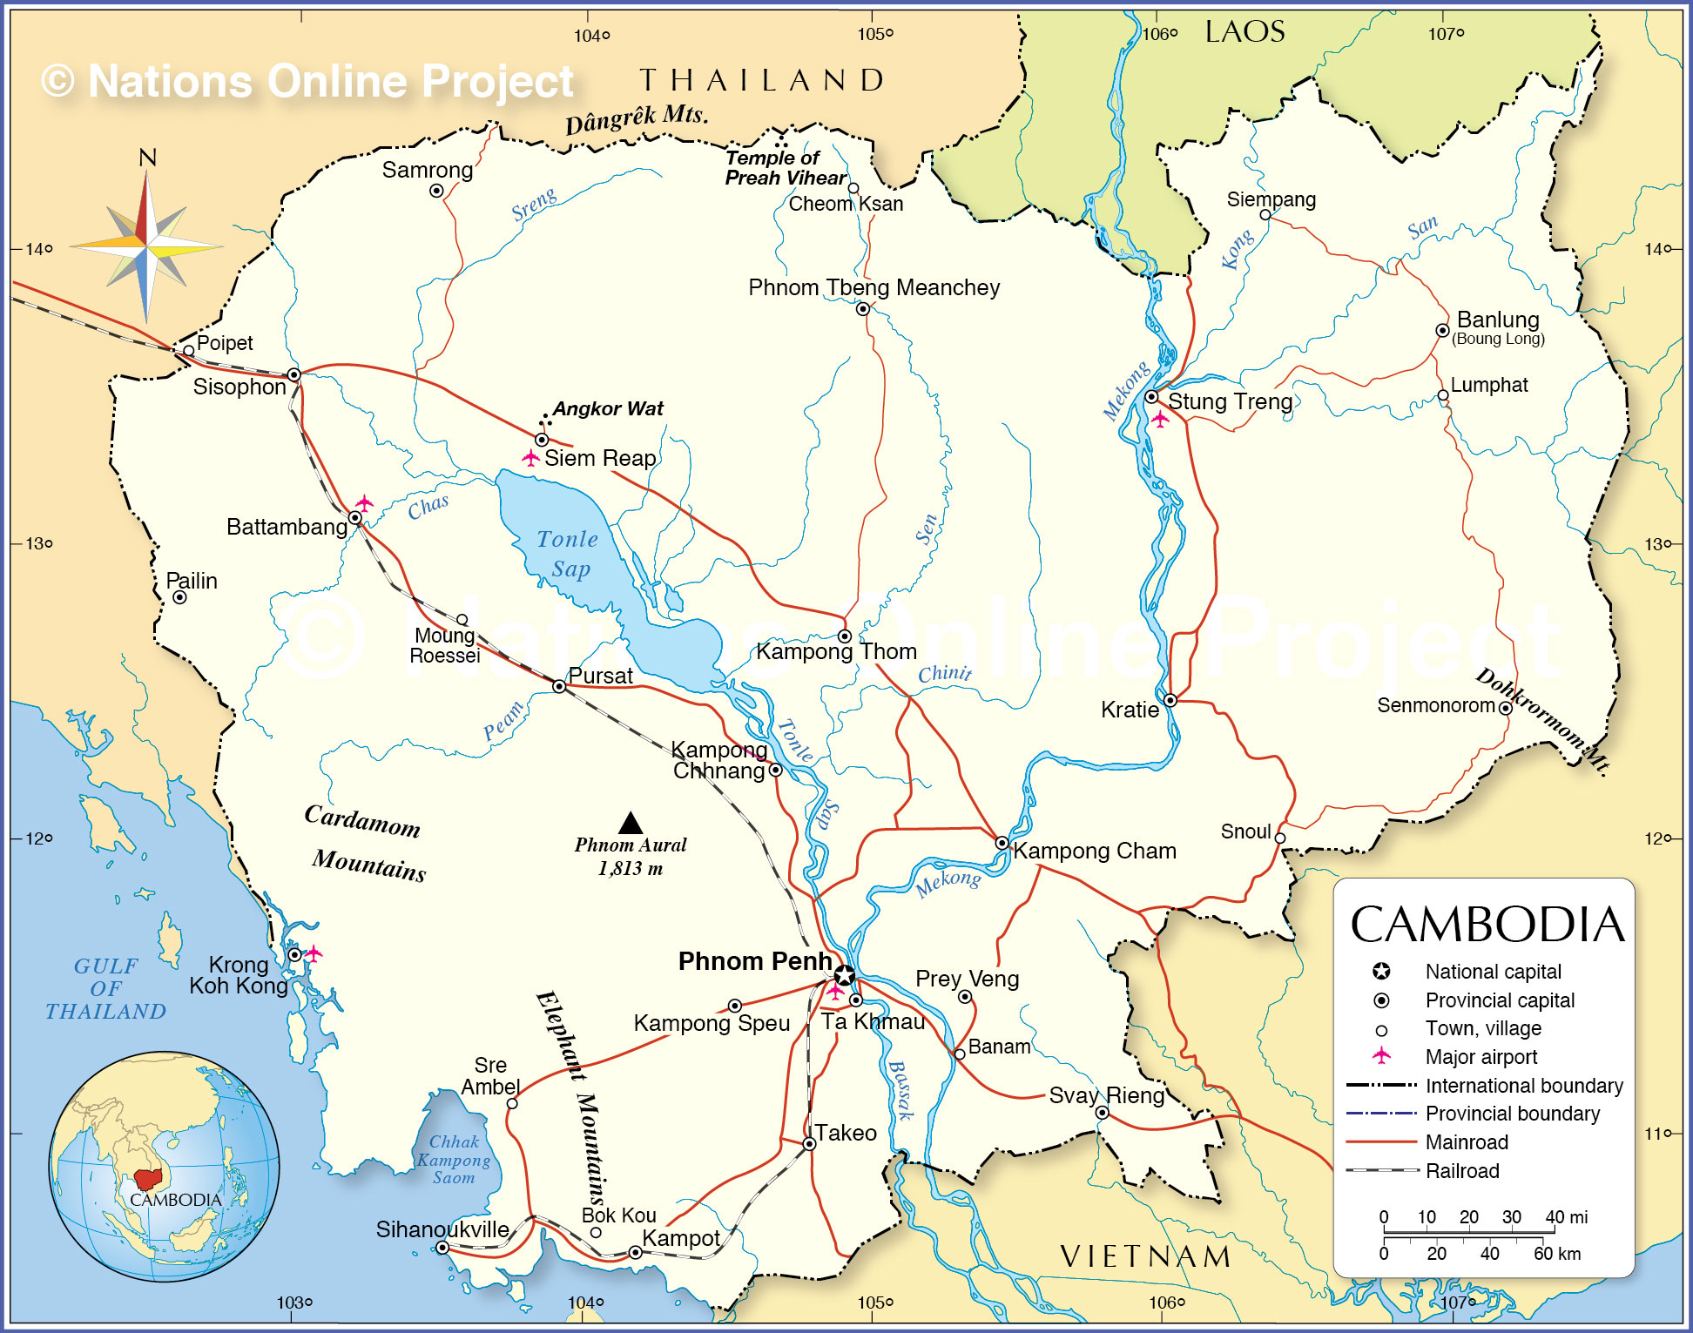
Cambodia: Civil War
Background
Khmer Republic and Prince Sihanouk
Vietnamese and American intervention
Refugees, camps, deportation

Slide 7
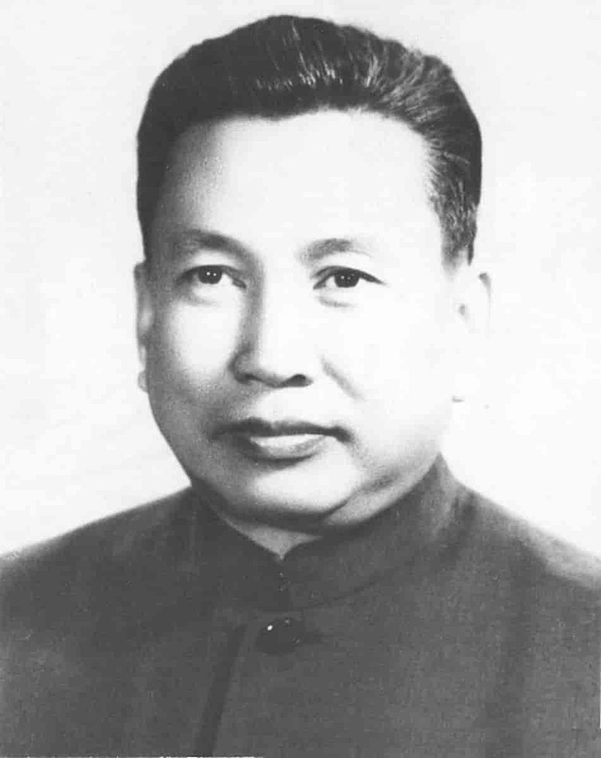
Ruralization & Segregation
Khmer Rouge (CPK) and Pol Pot
Evacuation of cities
“New People”

Slide 8
Purges & Massacres
CPK paranoia
Grass-roots liquidation
“Killing fields” in the East
Death toll

