Slide 1
North Korea
Crimes of Communism

Slide 2
Background
“Hermit kingdom”
1910-1945: Japanese control
Communist presence from 1919
Kim Il Sung

Slide 3
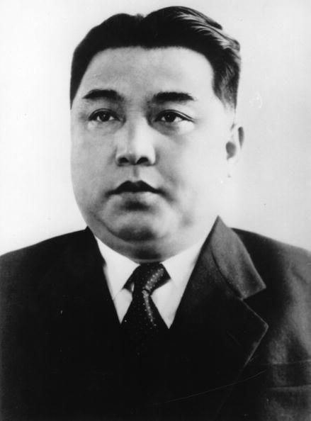
Military Death Toll
Civilian deaths
Military deaths
Deaths in detention
Continuing operations on foreign soil

Slide 4
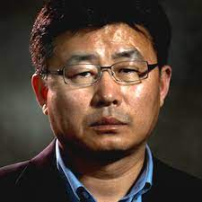
Executions, Prisons, Camps
Penal code
Party purges
Survivor testimony
An Myung Chul

Slide 5
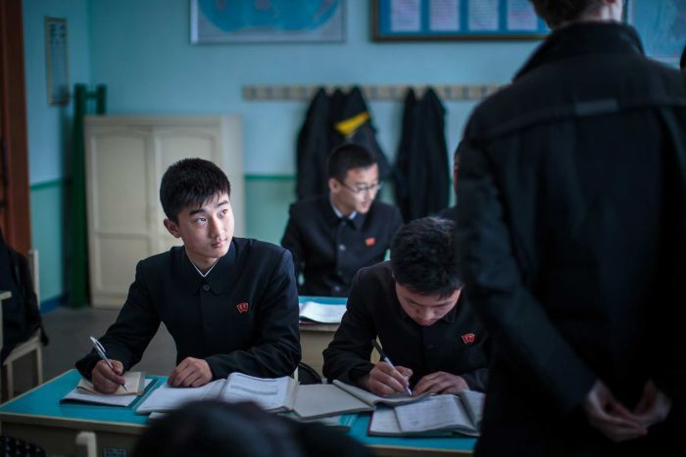
Population Control
Regimentation of everyday life
Propaganda forms
Social hierarchy
Caste system

Slide 6
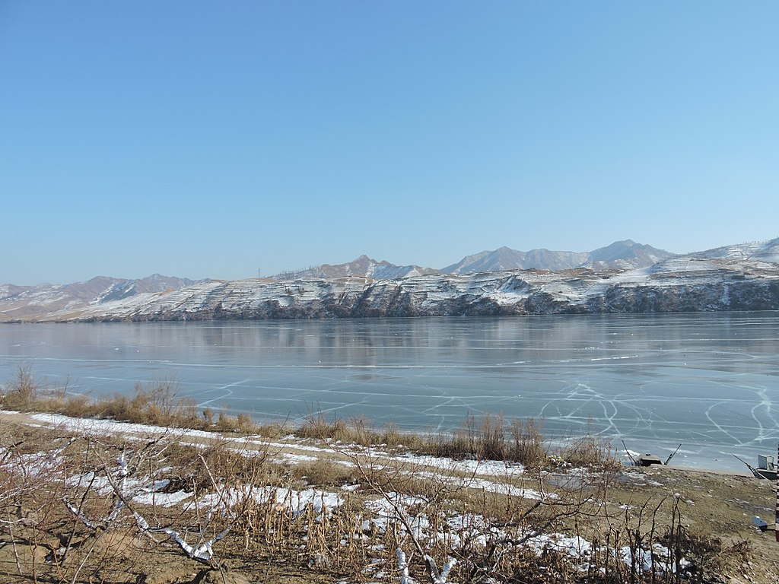
Escape and “Repatriation”
Border crossings
Abduction of foreigners
Malinvestment and famine
Death toll through mid-1990s

