Slide 1
China
Crimes of Communism

Slide 2
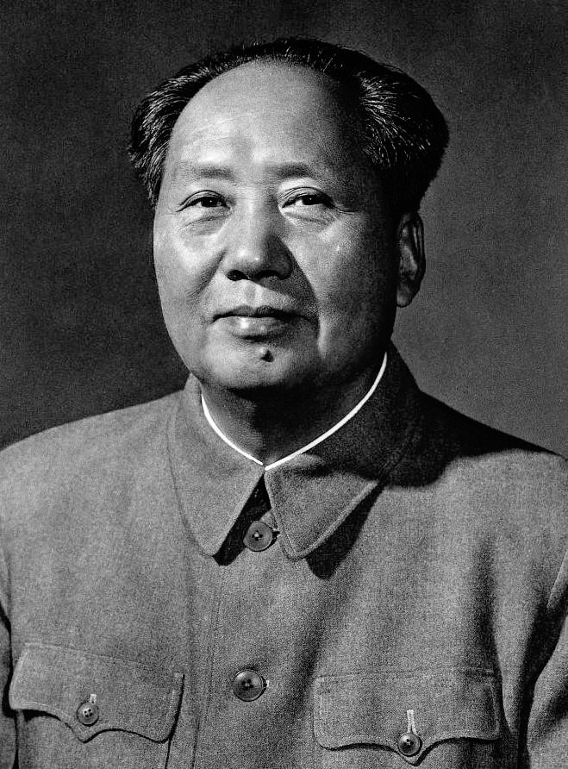
Overview
Deaths by execution and suppressions of Tibet
Long-term prisoners
Great Leap Forward
Influence throughout Asia

Slide 3
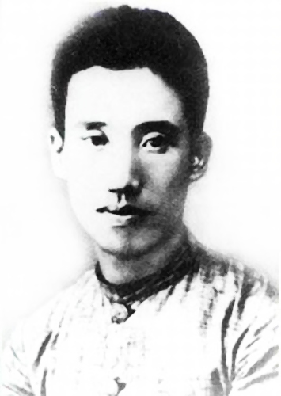
Unification through WWII
Tradition of violence
Peng Pai (1896-1929) and Chinese Communist strategy
Levies and purges

Slide 4
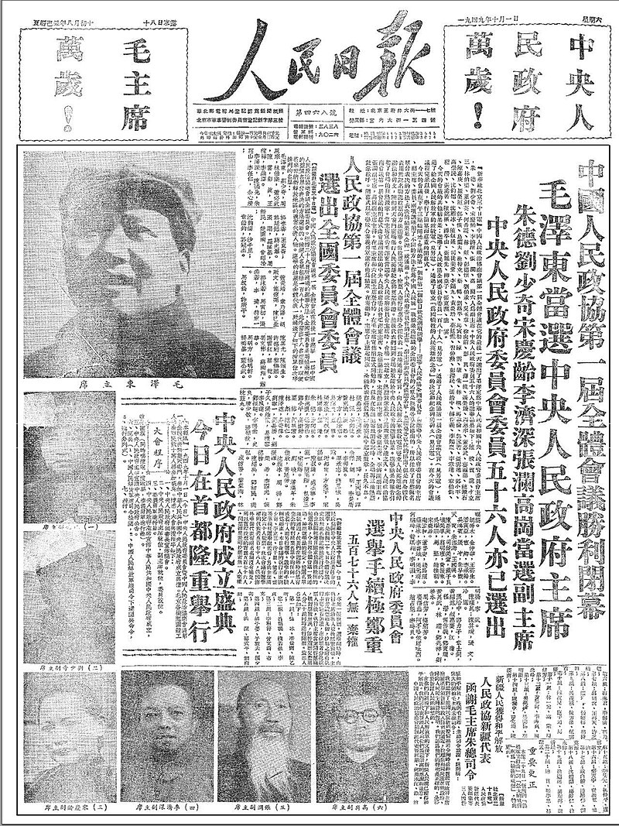
Class War in Country and City
“Good Mao/Bad Mao”
“Bitterness meetings”
Hundred Flowers campaign
Endless class enemies

Slide 5
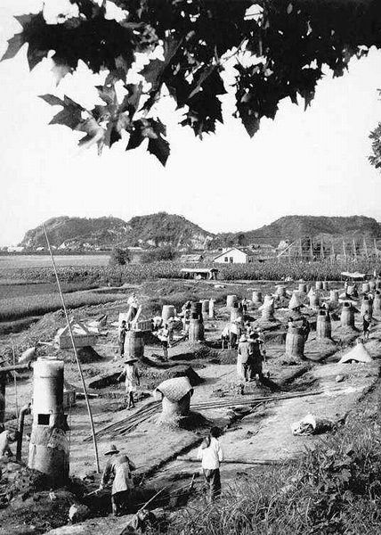
Great Leap Forward (1959-1961)
Collectivization of agriculture
Industry to the countryside
Lysenkoism
Campaign against peasants

Slide 6
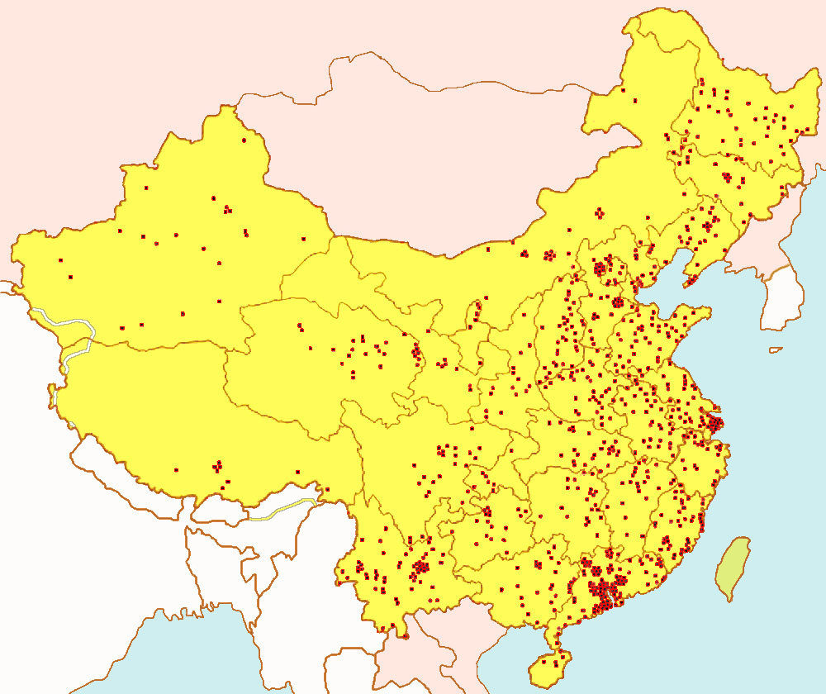
The Chinese Gulag
Laogai
Categories of prisoners
Brainwashing
Eternal guilt

Slide 7
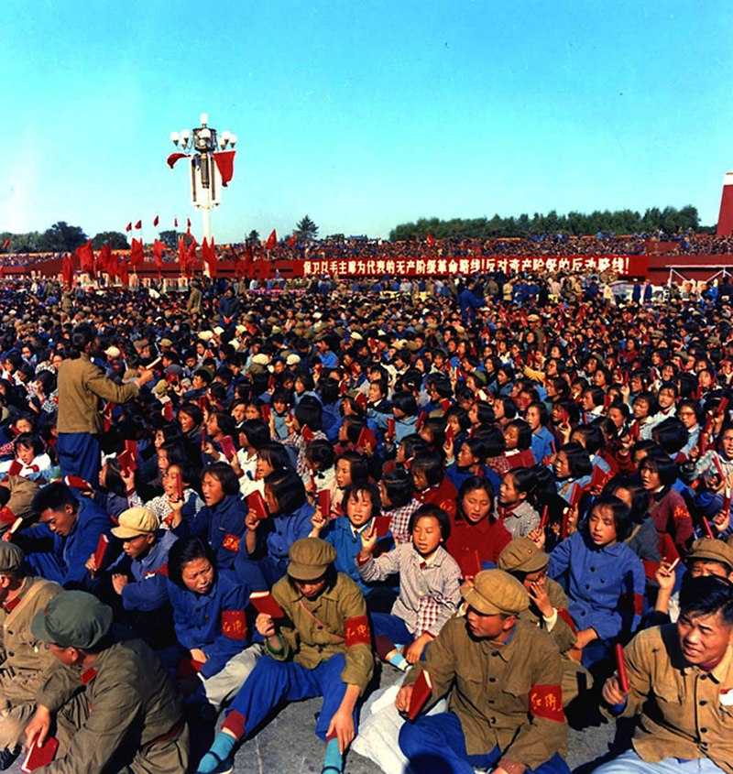
Cultural Revolution
Lin Biao and the Red Guard
Broken solidarity
School and college closures
Death toll
Deng era

Slide 8
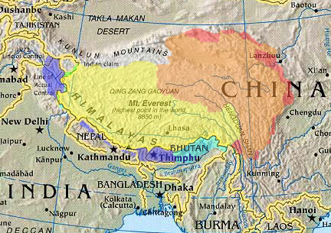
Tibet
Invasion in 1950
Collectivization
Cultural genocide
Death toll

