Slide 1
Comintern, Revolution,
& Civil War
Crimes of Communism

Slide 2
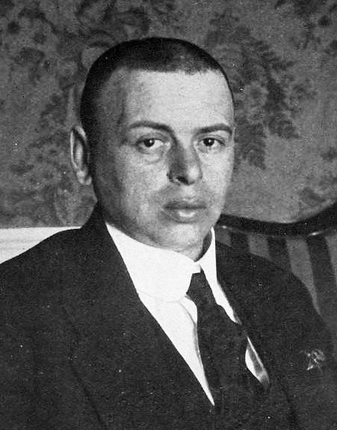
Revolutions in Europe
Germany
  Berlin
  Bavaria
Hungary
  Béla Kun
  “Lenin’s Boys”

Slide 3
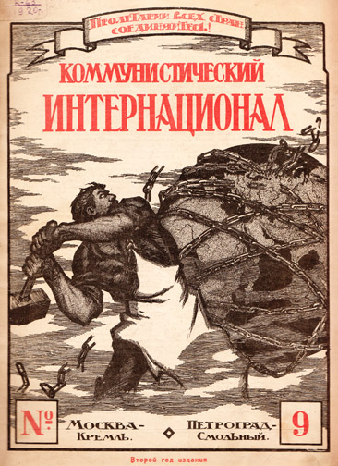
Comintern and Civil War (pre-WWII)
Formation of Comintern
Ruhr Occupation
Estonia
Bulgaria

Slide 4
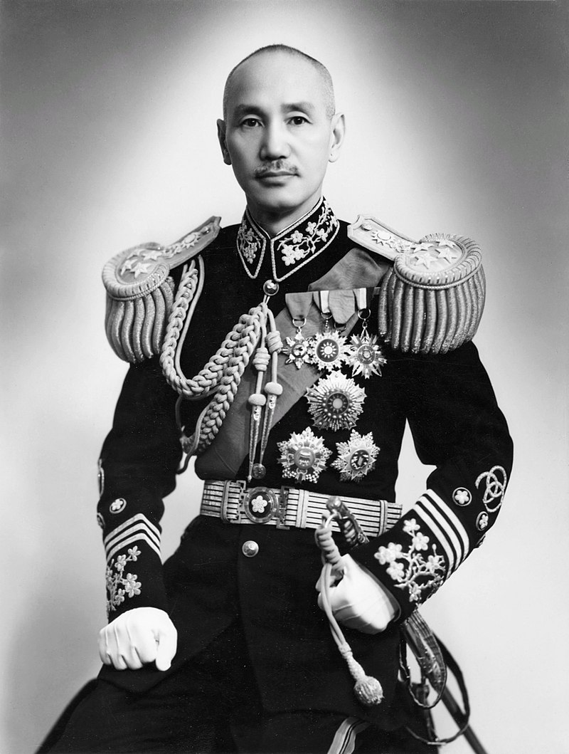
Comintern and Civil War (pre-WWII)
China
Germany
France

Slide 5
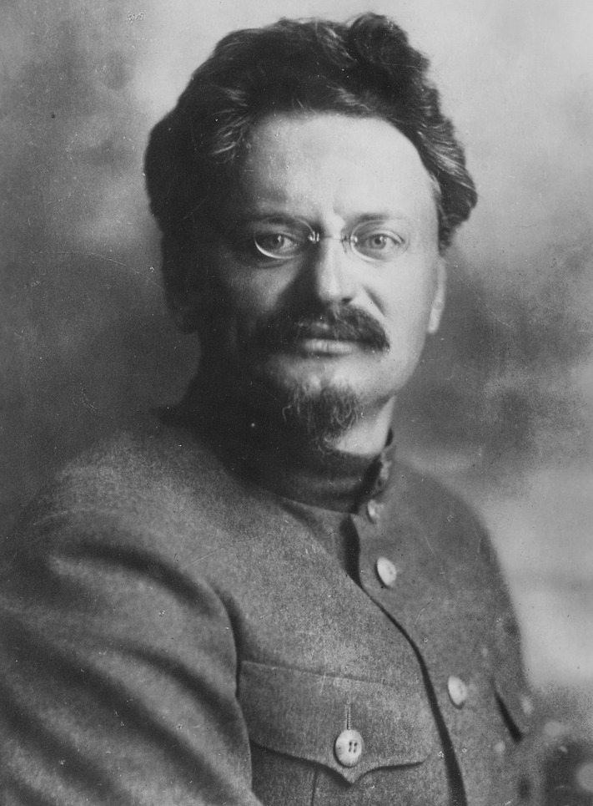
Comintern and Terror/Purges
“Political detention centers”
Comintern purge
Hunt for Trotsky(ites)
Foreign victims

Slide 6
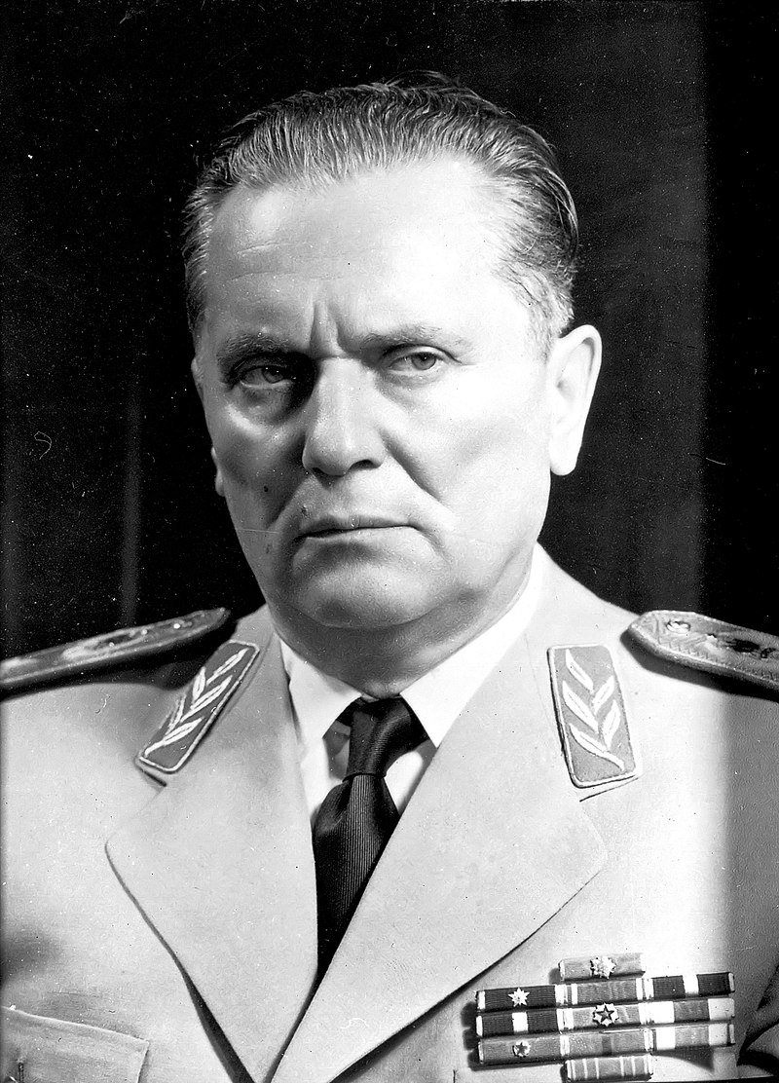
Comintern and National Liberation
Yugoslavia
  Marshal Tito (1892-1980)
  Support from Churchill
  Break with Stalin
Greece
  Civil war after Nazis
  Kidnapping of children

