Slide 1
USSR under Stalin
Crimes of Communism

Slide 2
Power Struggle
New Economic Policy
Cheka ➔ GPU
Deaths of Lenin and Dzerzhinsky
Rise of Stalin

Slide 3
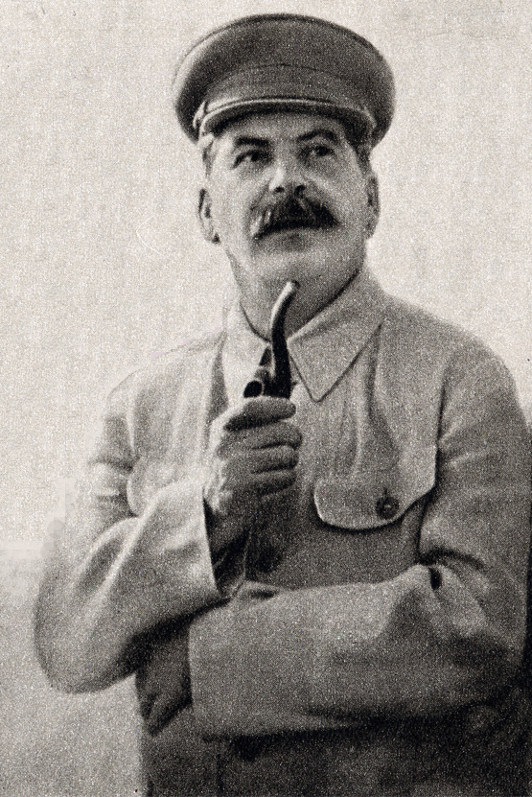
Collectivization & “dekulakization”
“Total collectivization”
Mass deportations
Engineered famine
Forced labor

Slide 4
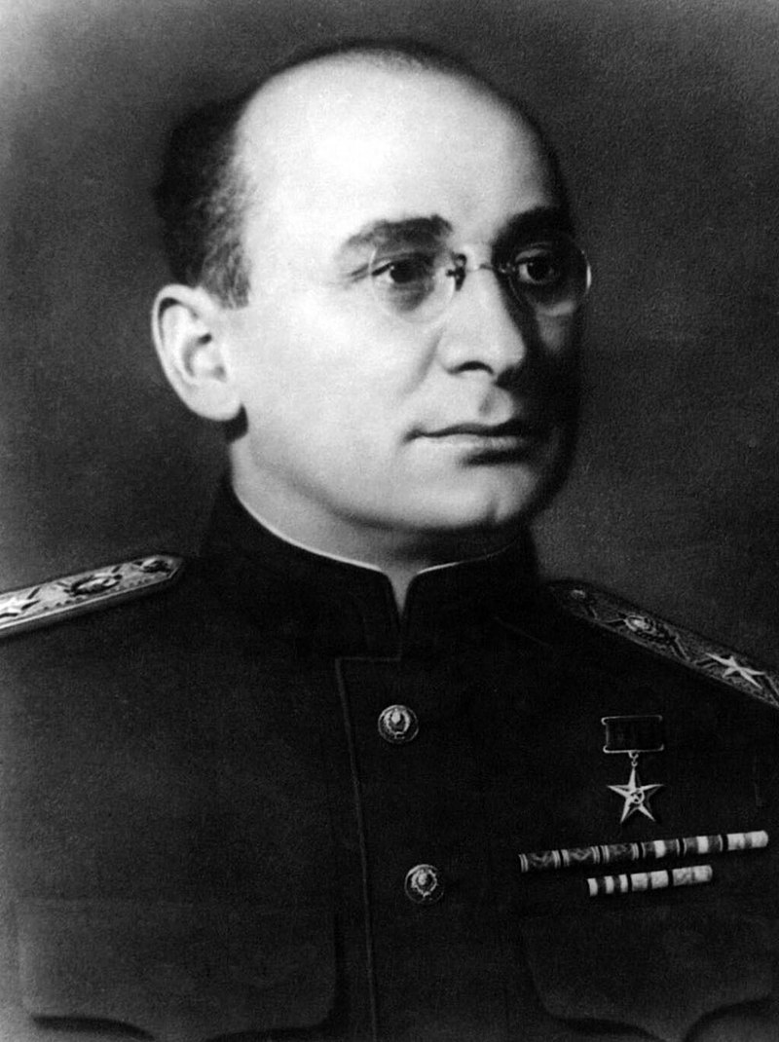
Great Terror
Robert Conquest
“Socially dangerous elements”
GPU ➔ NKVD
Operational Order 00447

Slide 5
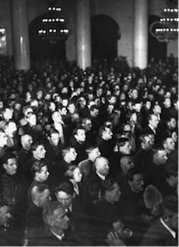
Great Terror
Intellectuals
Communist Party officials
Military
Russian Orthodox Church

Slide 6
Gulag Expansion
Number of prisoners
Food rations
Death toll

Slide 7
Gulag Expansion
Wartime conditions
  Deportations
  Executions
Postwar camp crisis

