Slide 1
Russian Revolution and Lenin
Crimes of Communism

Slide 2
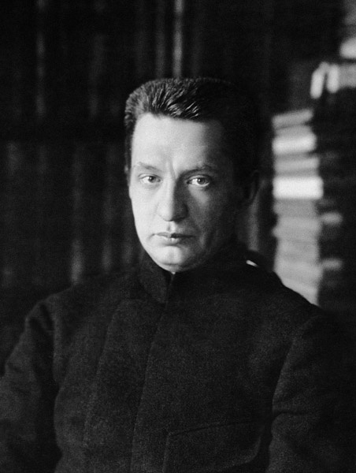
“February” Revolution & After
Provisional governments
Focus on “liberal” issues
War

Slide 3
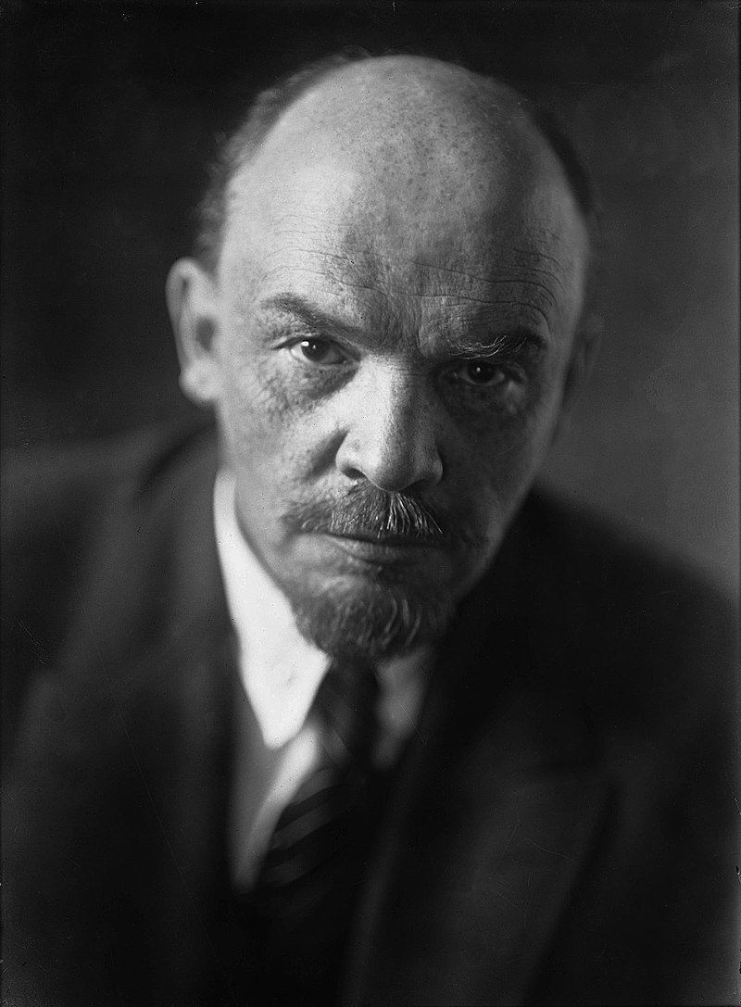
Lenin’s Opportunism
Social unrest spreads
State breakdown
Lenin’s Agitation
  From exile
  Urgency of revolution

Slide 4
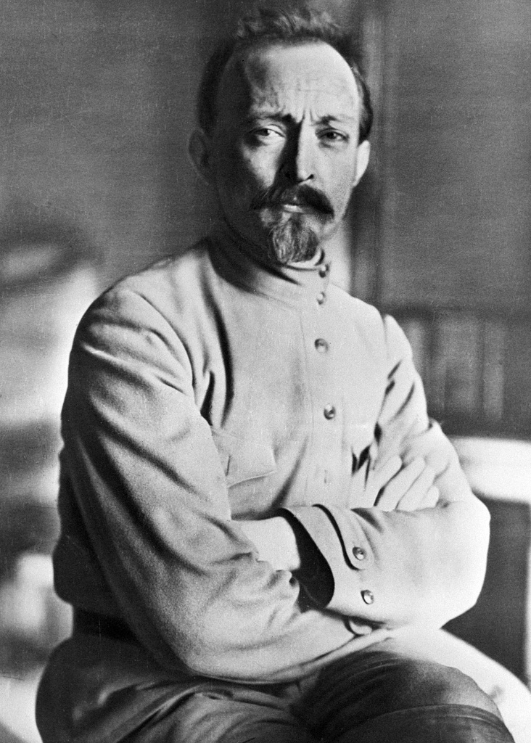
Dzerzhinsky and the Cheka
Felix Dzerzhinsky (1877-1926)
PRMC activity
Cheka and its activities

Slide 5
The Red Terror
Bolshevik insecurity
Policy of class extermination; “laws of civil war”
Setting up of camps

Slide 6
Civil War Repressions
Both Red & White atrocities
Mises on the socialist’s worst fate
Astrakhan massacre
War on the “Greens”; “de-Cossackization”

Slide 7
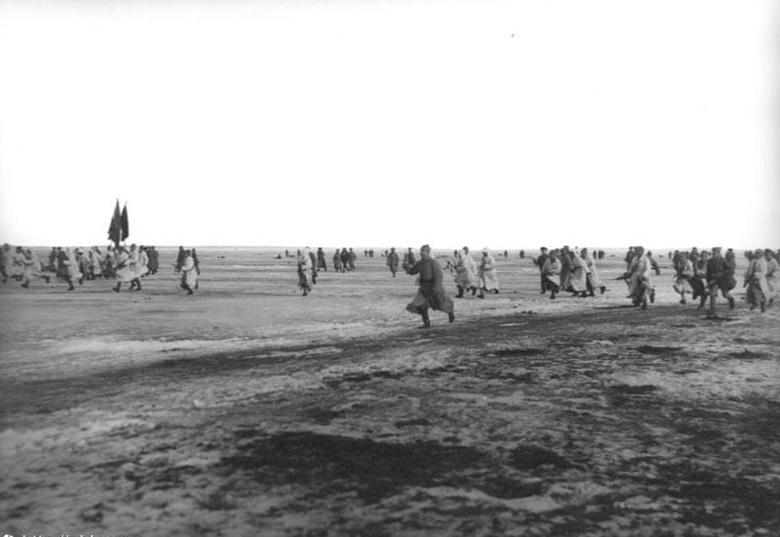
Lenin vs. Russia
Kronstadt Rebellion
Gassing the peasants
Attacking the Church

