Slide 1
Foundations
Crimes of Communism

Slide 2
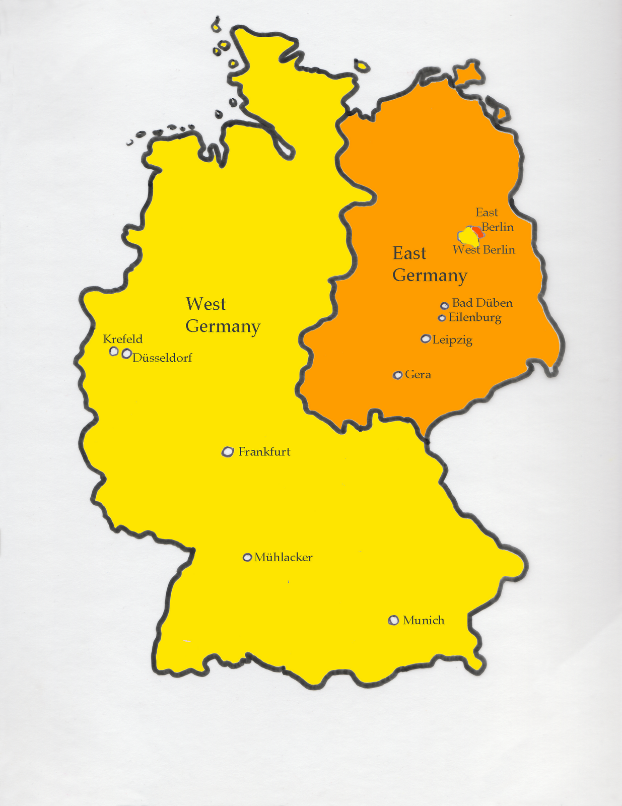
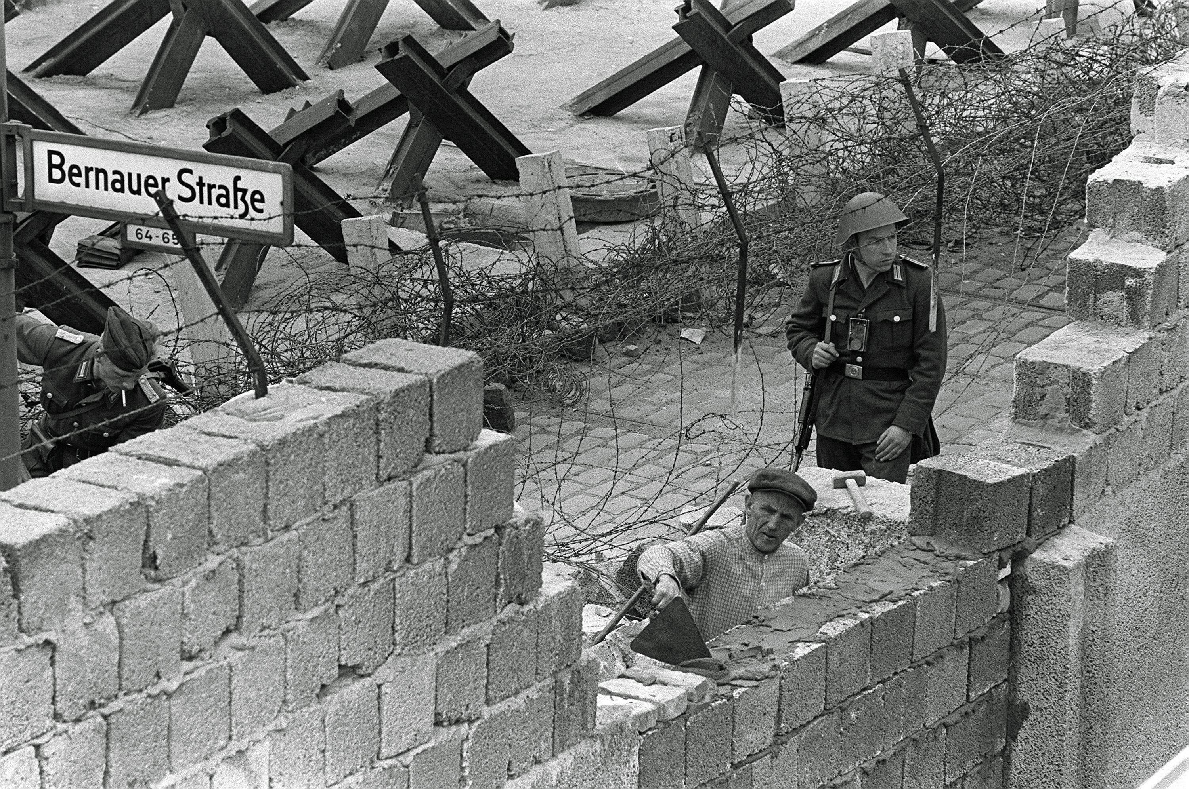
Growing up during the Cold War

Slide 3
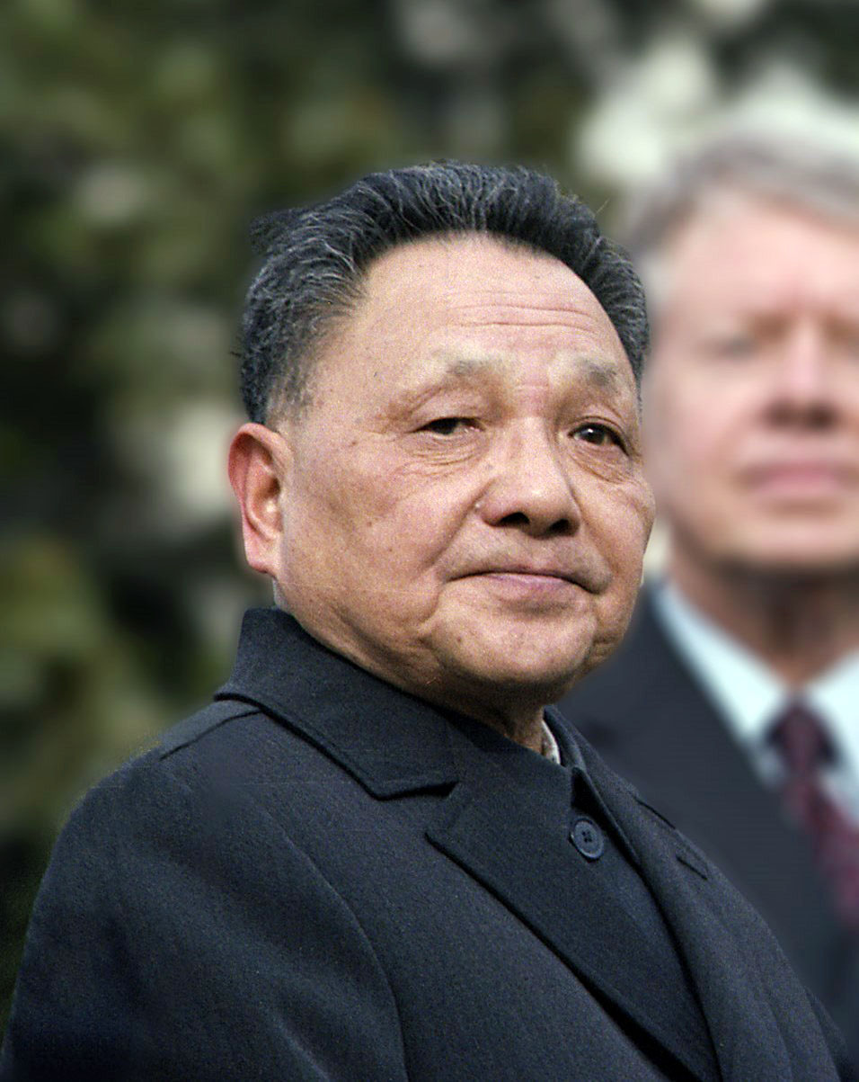
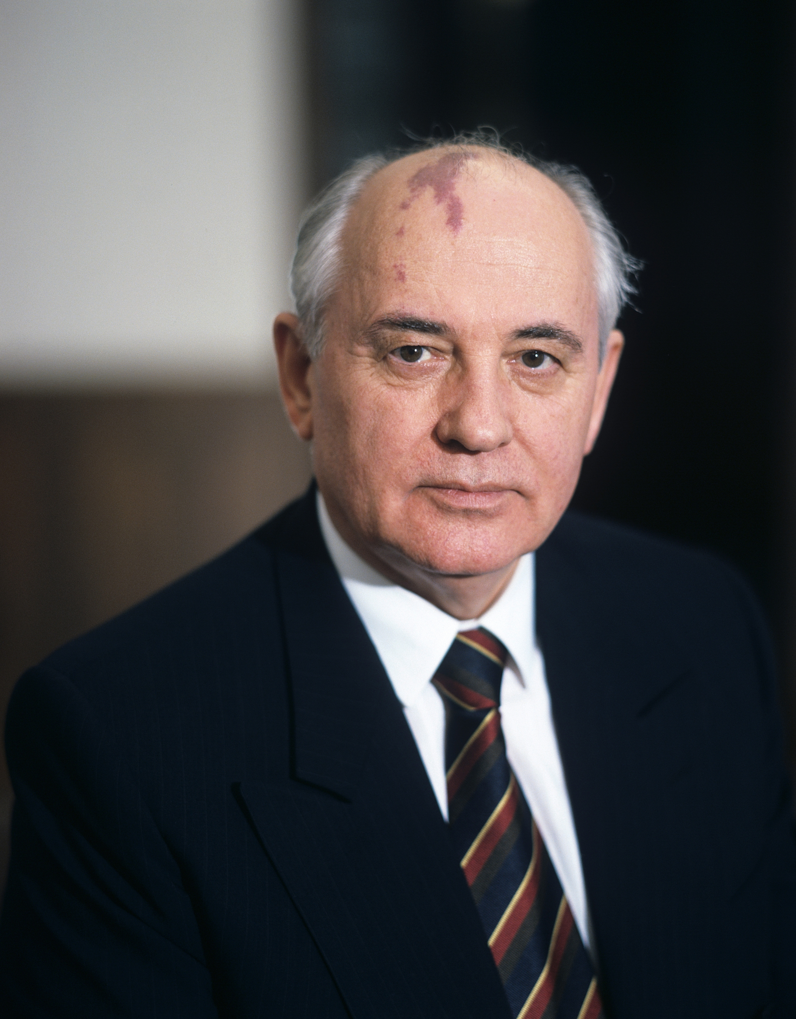
Communism Winds Down

Slide 4
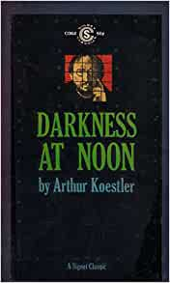

Truth Will Out

Slide 5
Why This Course?
Dangers of totalitarian ideology
Attempts to sweep communism’s crimes under the rug

Slide 6
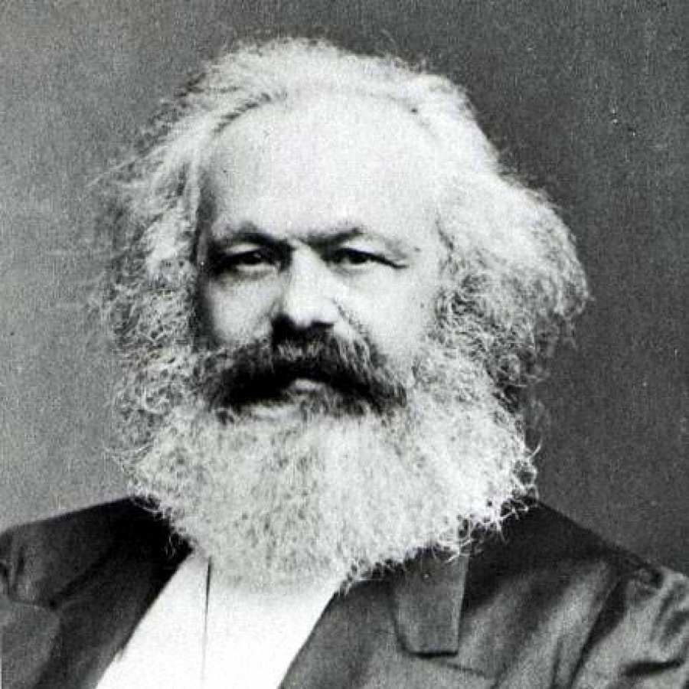
Definitions
Marxism
  Karl Marx (1818-1883)
  Class struggle
    Feudal nobility
    Bourgeoisie
    Proletariat

Slide 7
Definitions
Capitalism: private ownership of the means of production
Socialism: state ownership of the means of production
Communism: state withers away, communal ownership

Slide 8
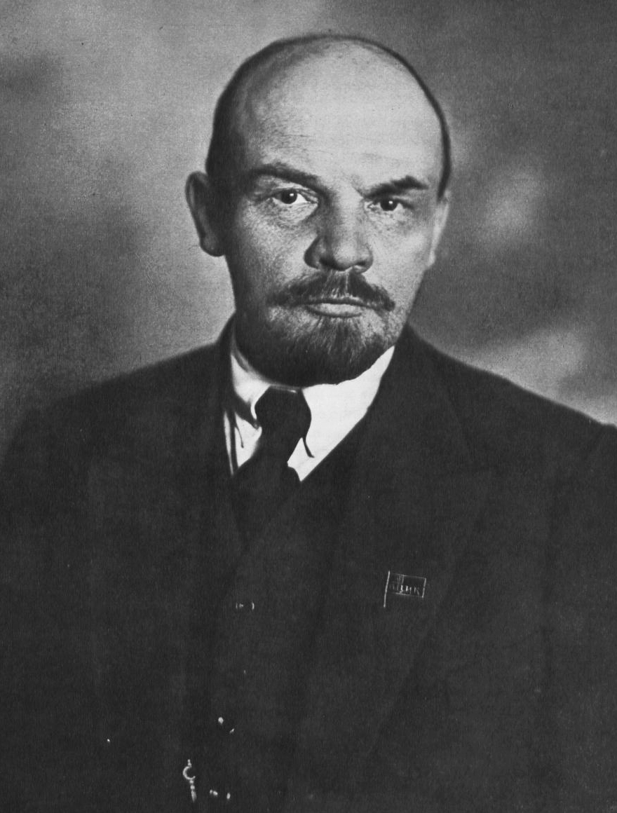
Definitions
Leninism
  V.I. Lenin (1870-1924)
  Focus on Communist Party
  “Proletarian dictatorship”
  “Marxism-Leninism”

Slide 9
The Rebranding of Socalism
“A theory or system of social organization based on state or collective ownership and regulation of the means of production, distribution, and exchange for the common benefit of all members of society; advocacy or practice of such a system, esp. as a political movement. Now also: any of various systems of liberal social democracy which retain a commitment to social justice and social reform, or feature some degree of state intervention in the running of the economy.”

Slide 10
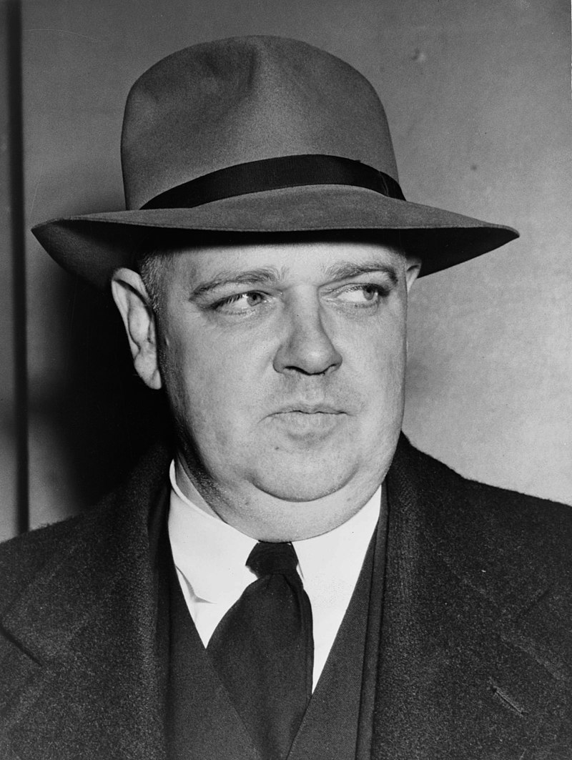
Crimes of Communism
“Have you the moral strength to take upon yourself the crimes of history?”
Crimes of communism: crimes committed by communists in order to realize the vision of communism

Slide 11
Course Overview
13 lectures
Lecture 1: definitions, foundations, background
Lectures 2-12: crimes of communism worldwide
  Soviet Union and Communist International
  Eastern Europe
  East Asia & SE Asia (China, North Korea, Vietnam, Cambodia, etc.)
  The “Third World” (Latin America, Africa, Afghanistan)
  Espionage and Terrorism
Lecture 13: communism since 1991

Slide 12
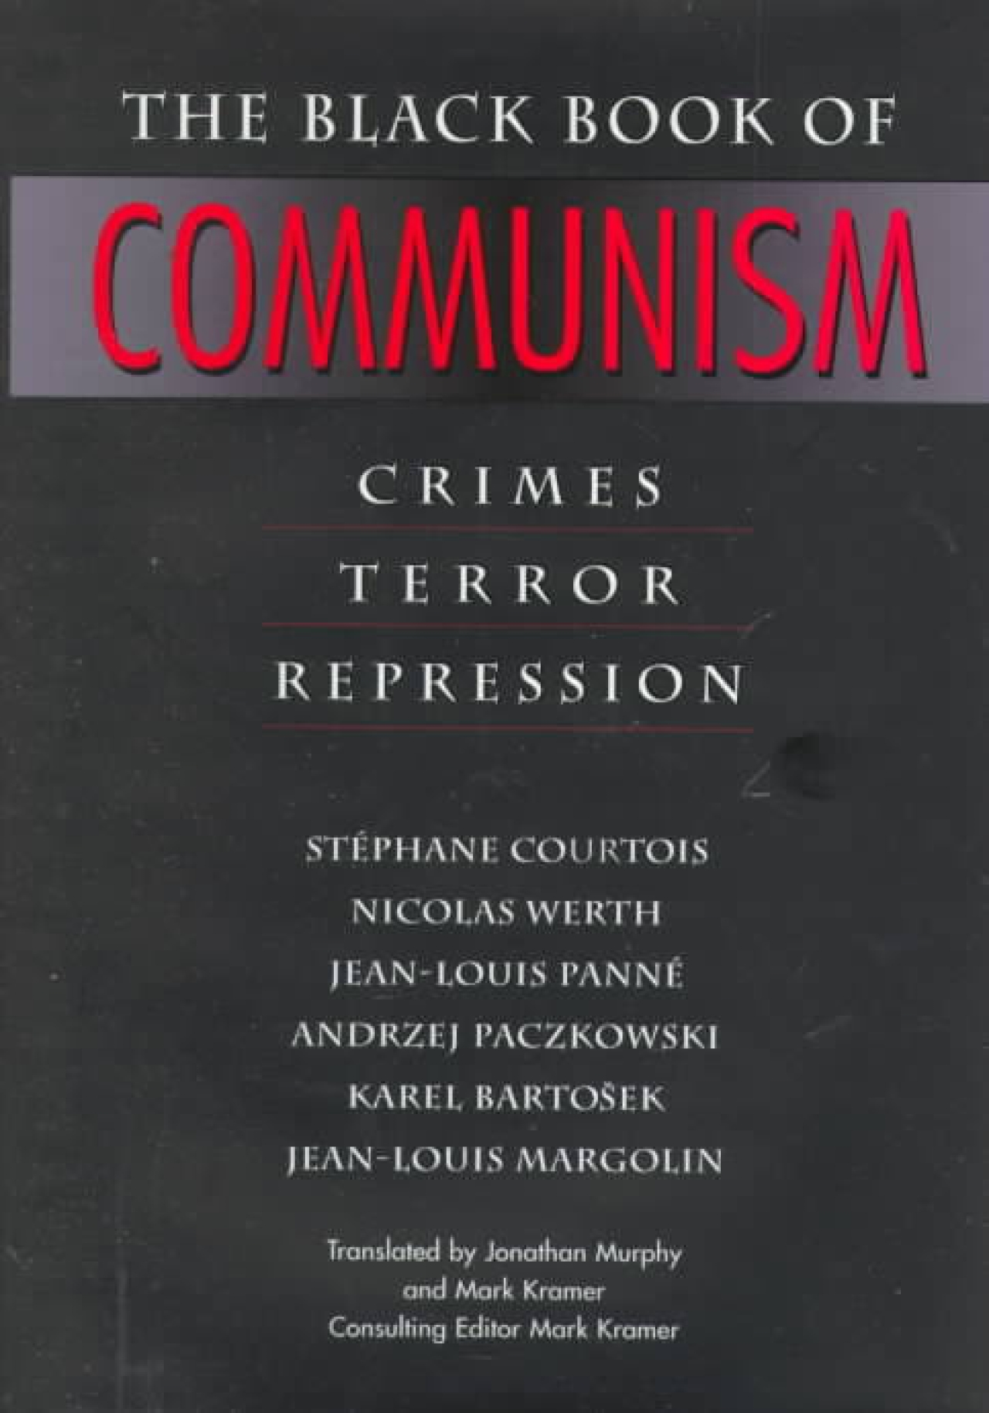
Black Book of Communism
Communism’s death toll
Categories of crimes
  Crimes against peace
  War crimes
  Crimes against humanity
Attacks on the Black Book

