Slide 1
Lecture 3: Roots of Libertarianism (18th-c. Britain/France)
Liberty Classroom: History of Conservatism and Libertariansim

Slide 2
Whiggism
“Good Old Cause” (Milton, etc.)
Popish Plot (1678) and Exclusion Controversy (1679-1681)
Key positions
  Opposition to Roman Catholic monarch
  Opposition to “popery” (standing army, arbitrary power)
  Toleration of Protestant dissenters
  Sovereignty of “the people” (Parliament)

Slide 3
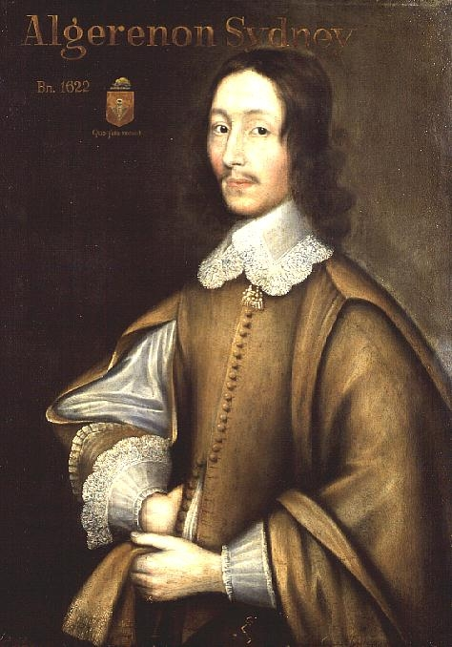
Algernon Sidney (1623-1683)
Civil Wars and Interregnum
Continental exile
Rye House Plot (1683)
Discourses Concerning Government (vs. Filmer)

Slide 4
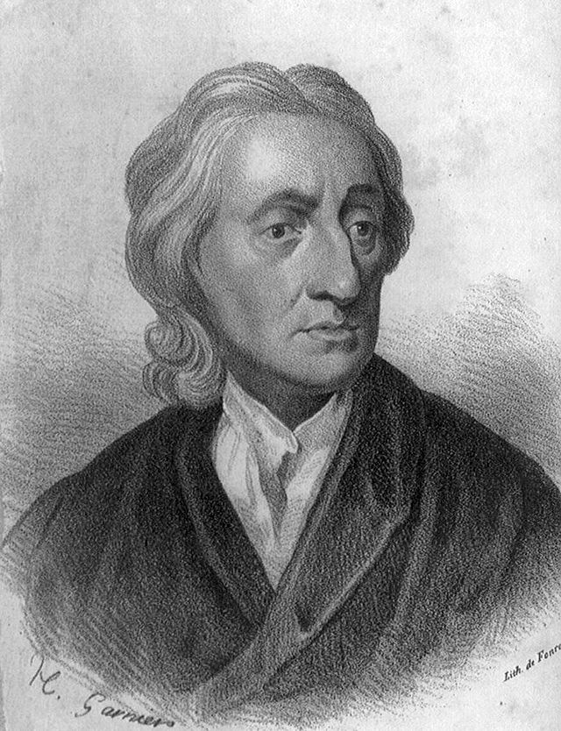
John Locke (1632-1704)
Empiricism
Connection to Earl of Shaftesbury
Two Treatises Concerning Civil Government
Letter Concerning Toleration
Casey: FP II 13-16

Slide 5
Cato’s Letters (1720-1723)
John Trenchard/Thomas Gordon
Cato the Younger (95-46 B.C.)
Topics
  South Sea Bubble
  Public corruption
  Natural law
  Freedom of speech
  Political resistance (“Defence of Brutus,” etc.)

Slide 6
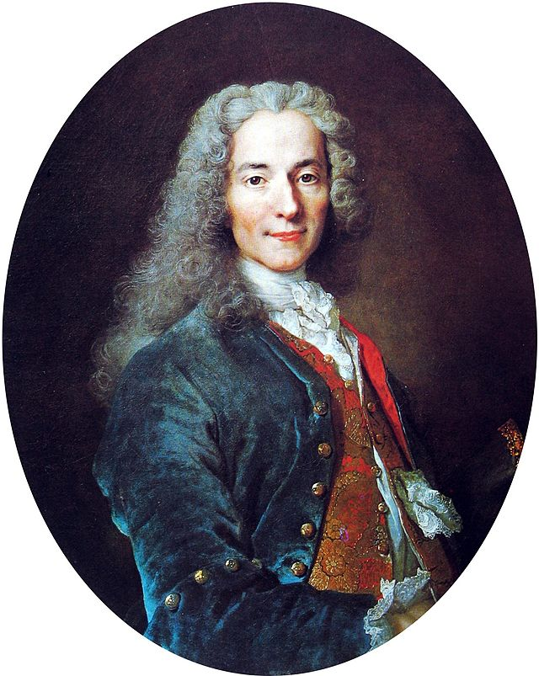
Voltaire (1694-1778)
Poet, playwright, humanist
Whiggish & Lockean concerns
Philosophical Letters
“Philosophical tales” (e.g., Candide)

Slide 7
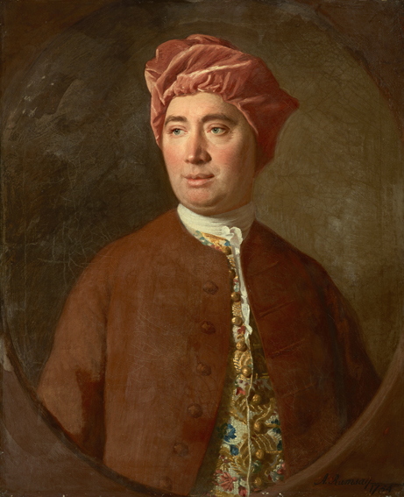
David Hume
Empiricism
Challenged contractarianism
Essays Moral, Political, and Literary (1741-42)
Casey: FP II, 19-21

Slide 8
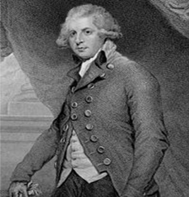
Cantillon & Physiocrats
Richard Cantillon (d. 1734) & Essay on the Nature of Trade in General
Physiocrats
  François Quesnay
  Challenged mercantilism

Slide 9
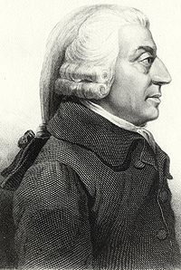
Adam Smith (1723-1790)
Professor of moral philosophy
Theory of Moral Sentiments (1759)
Wealth of Nations (1776)

Slide 10
Summary
Whigs & Allies
  Concern for religious toleration
  Suspicion of arbitrary power
  Affinity with Lockean empiricism
Political economists
  Recognition of benefits of trade
  Opposition to mercantilism

