Slide 1
John Locke
Part 1—Man, Nature, Freedom, Property

Slide 2
Locke is among all our political philosophers the philosopher most explicitly concerned with freedom, whether that freedom is religious (as in his A Letter Concerning Toleration—Catholics excepted of course), economic (in his Some Considerations on the Consequences of the Lowering of Interest and Raising the Value of Money) or political (as in his Two Treatises on Government).

Slide 3
Hobbes’s conception of man is that he is more or less that a wild beast in constant need of restraint so that society and state are required for the creation and maintenance of any order.
Locke’s conception of man is that he is naturally social and that only certain ‘inconveniences’ of his naturally social state move him to create and accept a political order.

Slide 4
In the state of nature, Locke believes that all men are free and equal.
This state of nature is not, however, without any law at all, as it is for Hobbes, for Locke believes that where there is no law, there can be no freedom.
Even in this state of nature there is a law of nature and that law is given to us by reason.

Slide 5
Reason teaches us that ‘no one ought to harm another in his life, health, liberty or possessions’ or, to put it in the language of rights, every man has the right not to be harmed by another in his life, health, liberty and possessions. [§6]
The purpose of the law of nature is to bring about ‘the peace and preservation of all mankind’. [§7] The justification for the law of nature is that we are all God’s creatures and his property and, as such, no man is innately superior or inferior to any other.

Slide 6
Since there are no spontaneously-operating law-enforcers in the state of nature, the execution of the law of nature is left to each and every man. This law permits the restraint of those who are prepared to invade another’s rights and, where they have done so, the exaction of reparation.
Locke is careful to state that the exaction of reparation must be proportionate to the transgression.

Slide 7
Mack on Locke’s 4 arguments for freedom:
1. The Perfect Freedom Argument –for Locke, the state of nature is one in which men are free ‘to order their actions and dispose of their possessions, and person, as they think fit, within the bounds of the law of nature…’ [Mack 2009, 25];
2. The Reciprocity Argument—‘the logical cost of affirming one’s own right not to be subject to force or deceit is one’s acknowledgement of other’s equal rights.’ [Mack 2009, 38];

Slide 8
3. The False Presumption Argument—the phenomenon of subordination falsely presumes that one individual exists to serve the purposes of another; and
4. The Like Reason Argument—as a man is bound to preserve himself, by like reason, he is bound, within reason, to preserve others. By the law of nature, every man is bound to preserve himself ‘and not quit his station willingly’ and, as far as possible, also to preserve all other men. [§6]

Slide 9
Does Locke deny the Hobbesian claim that men in a state of nature are at war with each other?
Yes, he does.
We have war when one man attempts to get another into his absolute power, to enslave the other. War is not a temporary or fleeting expression of hostility but ‘a sedate settled design upon another man’s life.’ [§16]

Slide 10
Despite their differences, Hobbes and Locke agree in some matters.
While they differ in their characterisations of the state of nature, both agree that it is something better departed from, either out of strict necessity—Hobbes—or for the remedying of inconveniences—Locke.

Slide 11
The state of nature is a state of war for Hobbes while for Locke it is the most likely condition in which war can occur. Both thinkers see our ineliminable desire for self-preservation as the impetus which takes us from the state of nature to another and better condition, that condition being either Leviathan or civil government, which can provide the only sure remedy for man’s wolfish nature or the inconveniencies of the state of nature.

Slide 12
Locke’s account of property and its relationship to government is one of of the most controversial aspects of his thought.
Property, which is not so much a thing but more a right to dispose of things without interference from others, is understood very widely by Locke to include not only the obvious material goods which man desires and needs but also the relatively intangible yet very real goods of life and liberty.

Slide 13
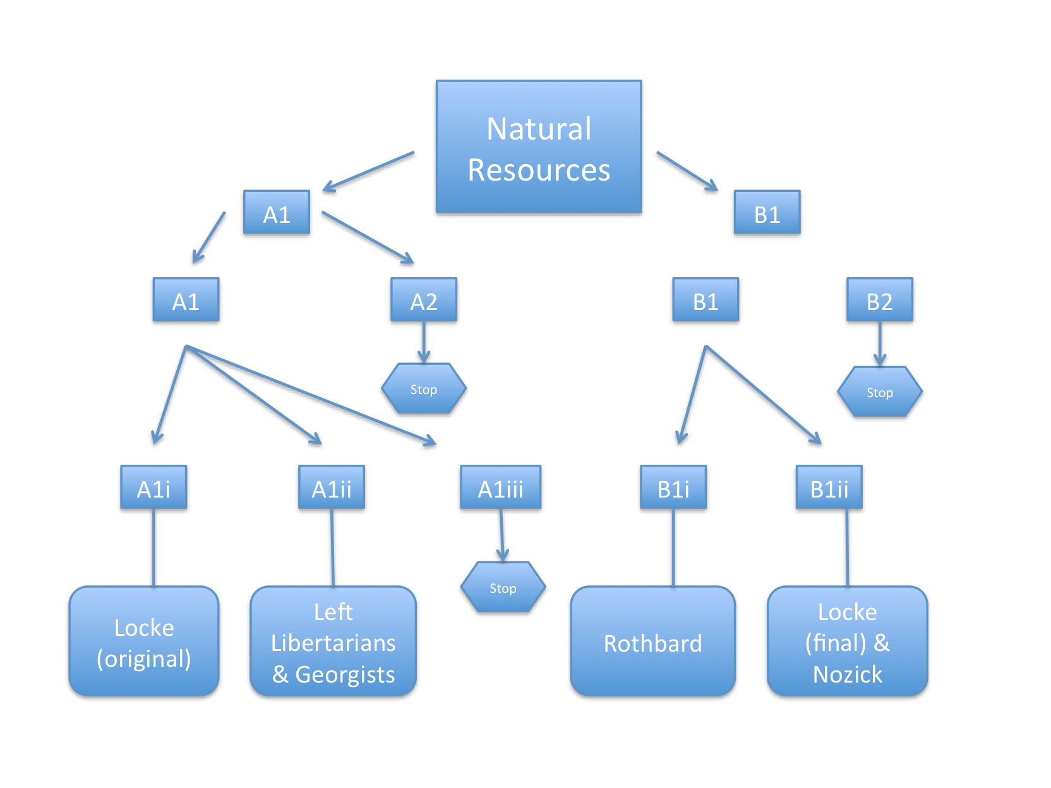

Slide 14
Is it possible to link any political theorists to any of these positions?
Original common ownership (A1i) appears to be Locke’s opening position though it may not be his final one. (see below)

Slide 15
Original several and equal ownership (A1ii) appears to be the position of the so-called left libertarians—Peter Vallentyne, Michael Otsuka and Hillel Steiner—and possibly the position of Henry George.
I cannot think of anyone who defends the position of original several and unequal ownership (A1iii) or any of the variations of A2, original ownership merely by some.

Slide 16
Position B1i appears to be the Rothbardian position. There is no original ownership; ownership is in principle available to all by employing the requisite procedure (in Rothbard’s case, what he calls homesteading, a variation on the Lockean labour-mixing criterion), and the intrinsic condition (which could, in principle, be null) is the deployment of a restriction in initial acquisition emanating from the homesteading procedure, hence, intrinsic.

Slide 17
Position B1ii appears to be Locke’s final position (and perhaps also that of Nozick). Nothing is actually owned by anyone originally. Natural resources are acquired by X using the requisite procedure, in this case, the mixing of labour or, understood more expansively, by improvement; and the extrinsic limiting condition is the proviso that enough and as good be left for others. The proviso is extrinsic because it is more than a simple implication from the acquisition procedure.

Slide 18
Positions B2—no original ownership, ownership available in principle only to some (plus various conditions)— do not appear to have any adherents.

Slide 19
‘Though the earth, and all inferior creatures, be common to all men, yet every man has a property in his own person: this no body has any right to but himself.’ [§27] Just as Locke believes that all men are God’s creatures and as such free and equal, so too he thinks that God has given the earth to all men in common. This appears to commit Locke to the position in my taxonomy that I have called A1i.

Slide 20
Locke’s thesis of God’s gift of the world to us all appears to reduce from the expansive claim that everybody owns everything to the more restricted claim that in the beginning no one in particular owns anything in particular. This is B1ii.

Slide 21
To remind you of what this says: If they come to be owned by all (B1), this comes about by all doing X (where X is some intentional action) + Δ2, where Δ2is some extrinsic limiting condition. (B1ii). Here, the X which is done is the ‘mixing of labour; and the Δ, the extrinsic limiting condition, is the infamous Lockean proviso.

