Slide 1
The Classical Anarchists
Part 1—Pierre-Joseph Proudhon

Slide 2
Proudhon’s background is that of the solidly provincial French peasant, although his father was an artisan rather than a farmer.
Proudhon had the common anarchist suspicion of industrial society. His rural and provincial upbringing infused him with a vision of the ideal society that was never to leave him, despite his long sojourn in Paris.
He had some formal education early in life but because of family circumstances he had to choose a practical trade. In his case, he chose printing.

Slide 3
What is Property? opens with the ringing and notorious claim that property is theft. Startling and unambiguous as this phrase may appear to be, it doesn’t actually mean what it is often taken to mean—it is not a universal condemnation of all and every form of property.
What it condemns is property inasmuch as it is employed by someone to exploit the labour of others without effort on the property owner’s part.

Slide 4
An objection somewhat along these lines is raised by those with communist inclinations. Why, they ask, should we arrogate the product to the producer? Why not have means and ends both be common?
This proposal Proudhon rejects. If the commonality of the means of production tends towards equality, the commonality of everything would, he thinks, be destructive of independence, and the importance of independence was a theme that runs throughout his work.

Slide 5
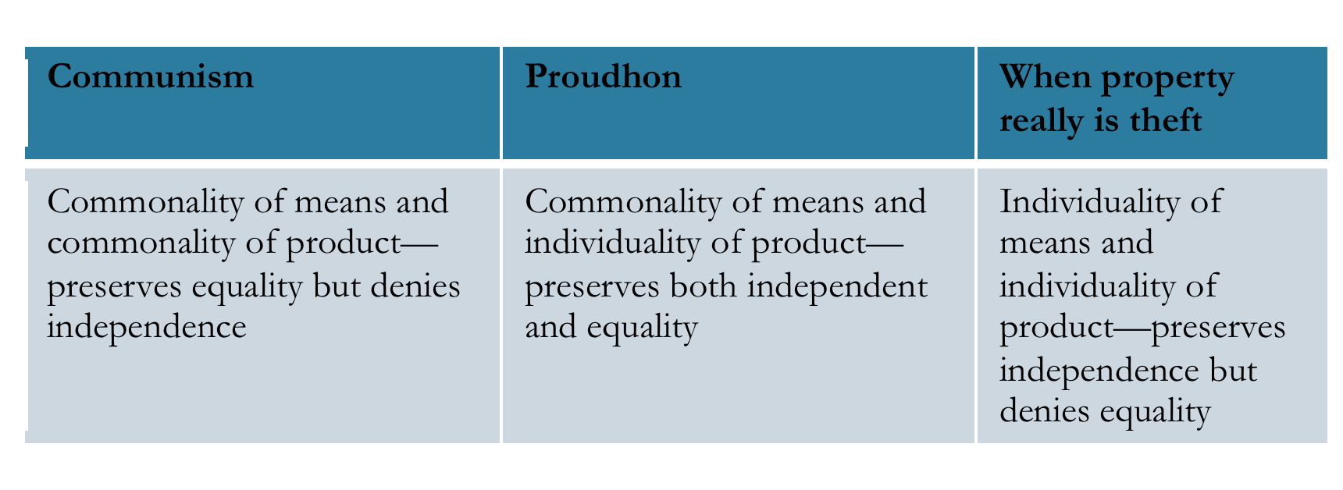

Slide 6
Like Stirner, Proudhon valued individual freedom and was chary of associations and movements.
Unlike Stirner, however, Proudhon was not opposed to society.
If Stirner is the egoistic individual, Proudhon could be said to be the social individualist.

Slide 7
Proudhon’s 1851 work, The General Idea of the Revolution, portrayed the revolution (presumably a revolution with ideas) as a kind of natural and irresistible force resembling the Nemesis of the ancients.
This idea of a fateful force as an agent of change was to become another standard element in anarchist thought, one echoed later by Kropotkin in a Darwinian mode.

Slide 8
‘What you call unity and centralization is nothing but perpetual chaos, serving as a basis for endless tyranny; it is the advancing of the chaotic condition of social forces as an argument for despotism — a despotism which is really the cause of the chaos. Well, in our turn, let us ask, what need have we of government when we have made an agreement?

Slide 9
Does not the National Bank, with its various branches, achieve centralization and unity? Does not the agreement among farm laborers for compensation, marketing, and reimbursement for farm properties create unity? From another point of view, do not the industrial associations for carrying on the large-scale industries bring about unity? And the constitution of value, that contract of contracts, as we have called it, is not that the most perfect and indissoluble unity?’ [Proudhon 1851, 245-246]

Slide 10
Although anarchy—society without government—has been the predominant mode of social organisation for most of human history, its very predominance meant that it was theoretically invisible so that it had rarely if ever been reflectively appropriated and rationally expressed.
Proudhon was the first person to coin the term and to describe himself as an anarchist.

Slide 11
As we have seen, Proudhon is notorious for his epigram that ‘property is theft’, which would seem to place him in the company of anarcho-communists.
However, Proudhon also said that ‘Property is liberty’
How may these statements be reconciled?

Slide 12
Proudhon used the term ‘property’ in one sense to denote (and to deprecate) the idea of ownership by those who had no continuing contact with what it was they allegedly owned, whereas he had no difficulty with the idea that land belonged to those who actually used or possessed it.

Slide 13
Proudhon distinguished sharply between one form of property (let’s call it Property-C) inasmuch as it was the outcome of conquest or exploitation and maintained only by the exercise of state power, and Property-L, inasmuch as it was the outcome of labour and intrinsically independent of state power for its maintenance.

Slide 14
The former kind of property is theft; the latter is freedom.
Proudhon’s Mutualism, unlike the communist and collectivist forms of anarchism, defends private property, property-L, provided that fundamental human equality is not thereby endangered.

Slide 15
Mutualism is opposed to what Proudhon regards as the theft of labour but by allowing currently unused land to be re-appropriated, it could be claimed that the labour invested in the land by the owner not currently in possession has been misappropriated.
Mutualists, in turn, find the libertarian anarchist theory of property acquisition or property justification to be less than convincing and, along with Georgists (ancient and modern) and latter-day left-libertarians, reject the idea that land can ever be property in a full-blooded sense since it is not the product of labour.

Slide 16
Pierre-Joseph Proudhon is one of the most important social and political thinkers of the nineteenth century. His ideas on anarchy, property, land and labour influenced almost all subsequent thinkers, whether they adopted them, adapted them, or rejected them.
What is Property? opens with the notorious claim that property is theft.

Slide 17
This claim is not a universal condemnation of all and every form of property. What it condemns is property inasmuch as it is employed by someone to exploit the labour of others without effort on the property owner’s part.
If Stirner is the egoistic individualist, Proudhon could be said to be the social individualist.

Slide 18
In the absence of a coercive government, law and order will be supplied by each citizen. In place of public force, collective force.
In place of standing armies, industrial associations.
In place of police, identity of interests.
In place of political centralization, economic centralization.

Slide 19
Proudhon’s anarchism wasn’t violent but tended towards the idea of a society’s organising itself on the basis of spontaneous self-governing producers. From here to the notion of federation was a short step.
In common with other forms of anarchism, Proudhon’s Mutualism rejects the state.

Slide 20
In place of the state, Mutualism allows, at best, a federation of free communes.
The economic system is to be based upon the free association of individual workers or, when the nature of their work required it, some kind of syndicalist arrangement.

