Slide 1
John Locke
Part 3—Cécile Fabre, Politics

Slide 2
Let’s leave Locke to one side for a moment and take a detour through the work of Cécile Fabre.
Fabre is the author of a paper with the innocuous title ‘Justice, Fairness and World Ownership’, and another paper ominously entitled ‘Justice and the Compulsory Taking of Live Body Parts’ and a book with the scarcely less chilling title, Whose Body is it Anyway? Justice and the Integrity of the Person.
This contemporary political philosopher denies that the claim of self-ownership is unproblematic. She argues that ‘if one thinks that the needy have a right to the material resources they need in order to lead decent lives, one must be committed…to conferring on the sick a right that the healthy give them some of the body parts they need to lead such a life.’ [Fabre 2003, 128]

Slide 3
Fabre believes the most contemporary theories of justice hold that those who are badly-off have a right to some of the resources of the well off in order to live a decent life
It is also held, she believes, that people should have a considerable degree of self-ownership or autonomy.
Fabre sees the right to a decent life and to right to autonomy as being in competition and the problem of political philosophy to reconcile them.

Slide 4
Principle of Sufficiency (PS)—this holds that people have a right to the resources they need in order to lead a decent life.
Principle of Autonomy (PA)—this holds that once PS is satisfied for everyone then everyone should be permitted to follow their ideas of the good and enjoy the fruits of their labour.
These principles are ordered. The Principle of Sufficiency must be satisfied before the Principle of Autonomy.

Slide 5
Fabre claims that neither collective ownership nor unrestricted private ownership can satisfy those principles.
Collective ownership violates the principle of autonomy; unrestricted private ownership violates the principle of sufficiency.
She is going to argue for a combination of both kinds of ownership rights as a way of satisfying her principles.

Slide 6
Suppose someone were to object that requiring the lucky to work for the unlucky is an infringement of their autonomy. ‘If the lucky have to work most, let alone all, of their time for the unlucky, my Dworkinian opponent would argue, they cannot implement those identity-conferring choices of theirs which do not revolve around work, and they thus do not have a decent life.’
This is a pretty potent objection, one would think!
Fabre denies that being forced to do work you do not want to do is a form of slavery, provided your life is still decent. She finally admits that even in such a case, her composite theory of property rights does, in fact, infringe on the autonomy of the lucky but not, she says, to an unacceptable degree.

Slide 7
The standard libertarian view (both left and right) is that our body is beyond the reach of legitimate demands from others whereas our personal possessions and our money are not.
On the liberal view, by contrast, we are not free to use our bodies in ways we ourselves desire even if in so doing we do not necessarily harm others and may in fact benefit them in some way, as in case of prostitution or the sale of organs.

Slide 8
The position that holds that people’s bodies must not be interfered with Fabre calls ‘body exceptionalism’.
She argues that if it is the case that we are susceptible to legitimate claims on our material resources from those who would appear to need them, we are also susceptible to legitimate claims on the use of our bodies and our body parts from those who need them. Our personal services may be demanded and our body parts confiscated.

Slide 9
I would run the Fabre’s argument precisely in the opposite direction: we do object to others interfering in our bodies without licence, the level of objection rising with the level of intrusion. Kidney extraction ranks pretty high.
That being so, by parity of argument, we object to others interfering with our rightfully acquired possessions also.

Slide 10
Her position, while consistent, is an reductio ad absurdum of the standard liberal position.
She is right to see a connection between the body and material resources and right to accuse the liberal position of inconsistency.
Libertarians would run the argument in the other direction—If conceding the legitimacy of taxation and suchlike leads to having to concede the right of others to use our bodies without our consent, this, turning the argument around, shows us that in protecting the autonomy of our bodies, we are also committed to a protection of our ownership of material resources.

Slide 11
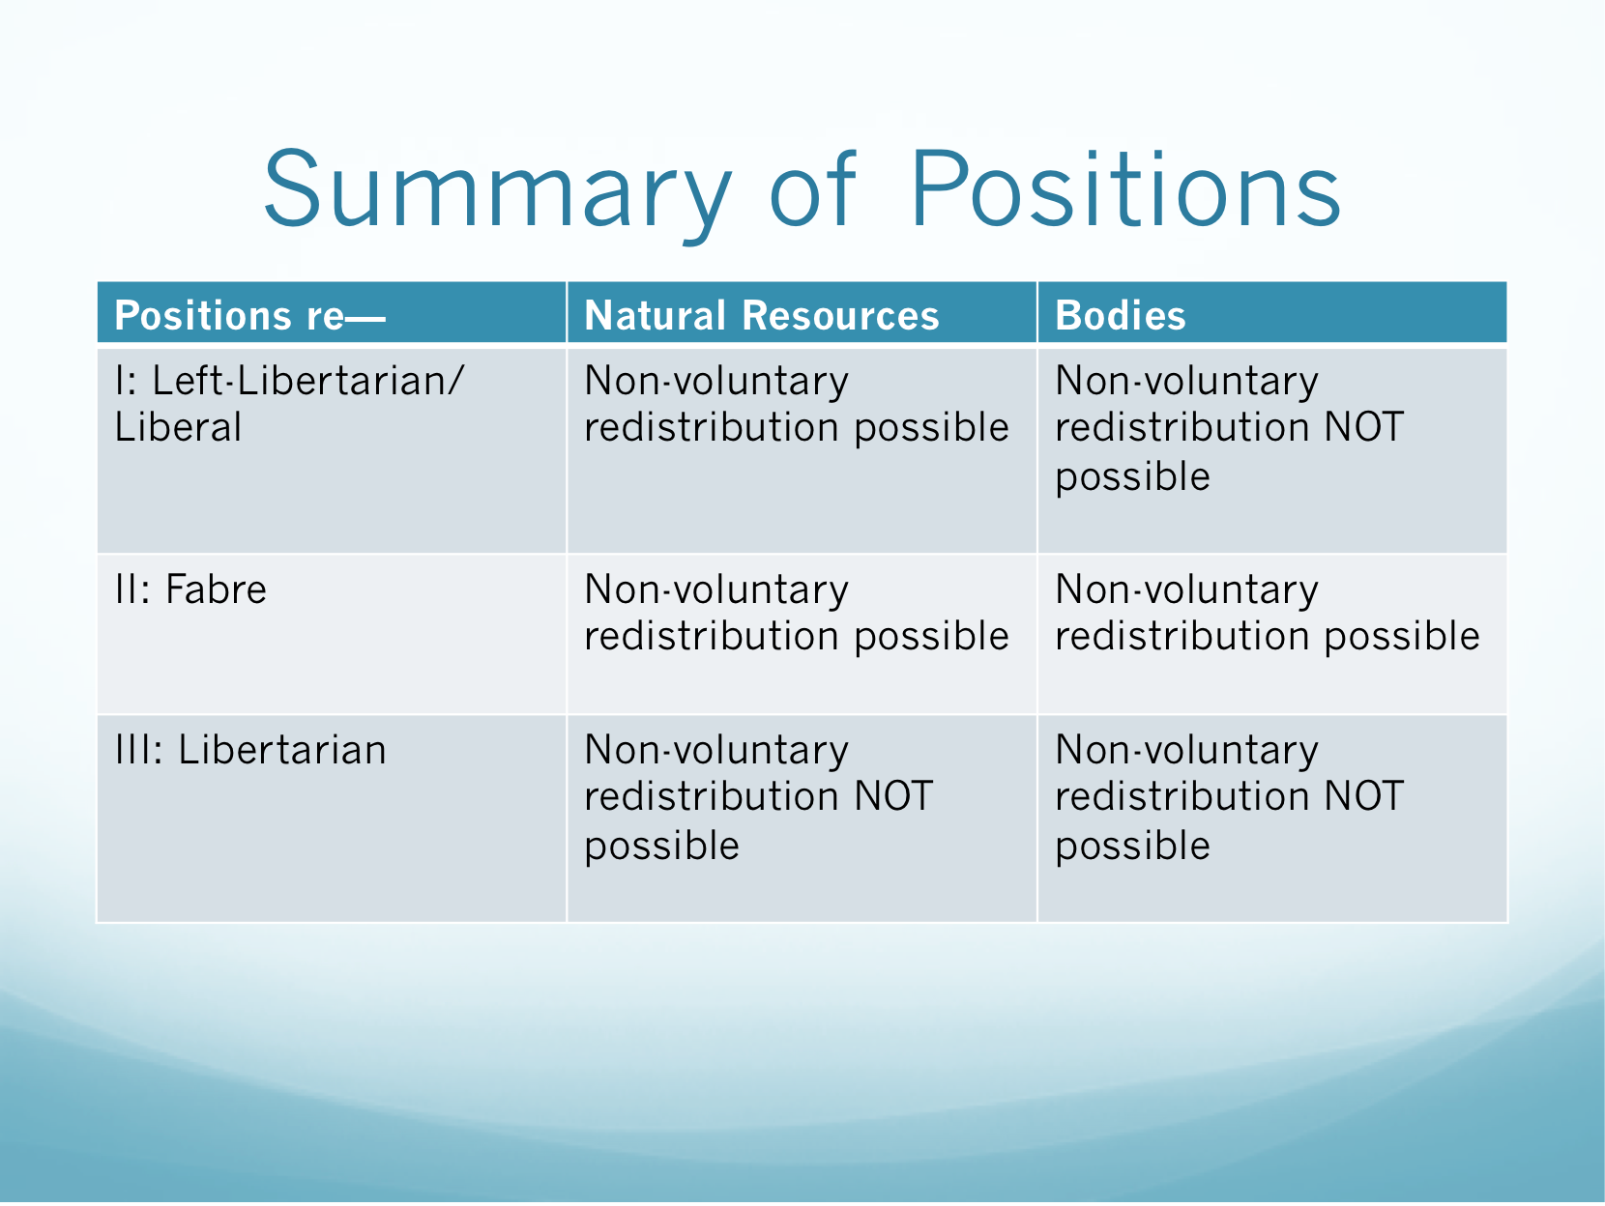

Slide 12
So far, Locke has established that every man possesses a natural right to life, liberty and estate and that each man’s property rights in external things derives ultimately from his property right in himself and his labour.
The invention of money and its effect on the distribution of property changes all this, disturbing the fragile social equilibrium and making it necessary to establish a means by which the rights of property, broadly construed, can be more effectively defended.

Slide 13
The state of nature, adequate as it might be at a certain stage of human development, suffers from certain obvious inconveniences (to use Locke’s own term). It lacks a known and settled law with which to resolve disputes; it lacks disinterested judges with the authority to determine the law in disputed cases; and it lacks a power to enforce and execute the sentences of our erstwhile judges. [§§124-26] These inconveniencies are what drive men to take refuge under the established laws of government.

Slide 14
If all men have this right to execute the law of nature, why should men ever make the move to civil society?
The answer, Locke thinks, is because the state of nature, even with men’s power to execute the law of nature, is, to use his term, ‘inconvenient’.
In that state, there is no known or settled law; there is no known indifferent judge to adjudicate between rival claimants and men being partial to their own causes, the lack of a neutral judge is likely to lead to escalating conflicts; and lastly, even though all men have the right to execute the law of nature, not all men have the requisite power to do so. [see §§124-126]

Slide 15
These drawbacks (‘inconveniencies’) of the state of nature are sufficient to push men to form a civil society in which they can be remedied. ‘And in this we have the original right and rise of both the legislative and executive power, as well as of the government and societies themselves.’ [§127; italics in original]

Slide 16
A government for Locke is simply an agency devised by those who desire to escape the inconveniences of nature, that agency being charged with securing everyone’s property ‘by providing against those three defects…that made the state of nature so unsafe and uneasy’ [§131]
But the power of government can never go further than is required to remedy those inconveniences.

Slide 17
In a compact with others, each man transfers his natural rights to look to his self-preservation and to punish offenders to the commonwealth. The right to attend to his self-preservation is not transferred completely or finally to the commonwealth but only to the extent that such a transfer is consistent with his self-preservation and the preservation of the rest of society. The right to punish offenders, however, is completely and wholly transferred. [§§129-130]

Slide 18
Here is one clear point where Hobbes and Locke disagree. Hobbes believes that the setting up of a single authority subject to no limitation and from which there can be no secession is the only way to establish peace. Locke, on the other hand, is unable to see how such an arbitrary power could resolve the problems emerging from the state of nature.

Slide 19
As Locke himself puts it, ‘as if when men quitting the state of nature entered into society, they agreed that all of them but one, should be under the restraint of laws but that he should still retain all the liberty of the state of nature, increased with power, and made licentious by impunity. This is to think, that men are so foolish, that they take care to avoid what mischiefs may be done them by pole-cats, or foxes; but are content, nay, think it safety, to be devoured by lions.’ [§93]

