Slide 1
Freedom’s Progress
8. Plato - Republic (1)

Slide 2
Plato
Beginning students in philosophy typically ‘do’ Plato’s most well-known work, the Republic, often in their first year of studies; whether they ever read it again is a moot point and that’s assuming that they’ve actually read it and not just a summary of it in the first place.
In contrast with the relative notoriety of the Republic, Plato’s other works on political philosophy, the Statesman and the Laws, are almost completely unread unless it be by Plato specialists or those with a keener than usual interest in ancient philosophy.
In this and the subsequent lecture, I’m going to give an account of all three of these works.

Slide 3
Plato was born in Athens in 427 BC into a wealthy and influential family and died in 347 BC at the ripe old age of 80. A career in public life was clearly open to him and, in normal circumstances, he probably would have taken the road well travelled by his family. A number of events, however, conspired to push him into a completely different career.

Slide 4
The first significant event that disturbed the even tenor of Plato’s life was the outcome of the war between Athens and Sparta. When the Peloponnesian war ended in defeat for Athens, Plato was 23 years old. The Athenian defeat was a shock for the young Plato who, along with many well-to-do citizens, was inclined to blame the democratic rulers of Athens for the defeat.

Slide 5
‘The Peloponnesian war was one of the two major formative influences on Plato in his youth and early manhood. He can hardly have failed to sense and share the bitterness and despair felt in Athens at the collapse and defeat of so many high ideals. Yet he was never an admirer of the Athenian democracy ……like many of the Athenians, he felt that Athens’ defeat was the defeat of laxity and incompetence by Spartan discipline and good order.’ [Saunders 1979, p. 19]

Slide 6
It is not unreasonable to conclude that this early bitter personal experience gave Plato distaste for involvement in the day-to-day world of practical politics and helped to turn his attention to more theoretical matters.

Slide 7
Without doubt, the single most important influence on Plato, however, was not the outcome of the Peloponnesian war and the humiliation of Athens, shocking though that was, but rather his encounter with Socrates. This encounter was to provide him with his basic philosophical outlook—that virtue is knowledge and no one knowingly does wrong and, above all, the conviction that what is really real is not anything changeable such as we encounter in our ordinary day-to-day experience but something stable and unchanging.

Slide 8
Plato, of course, went on to develop Socrates’s ideas in ways that Socrates himself perhaps never envisaged. We have no definite way to tell simply because our idea of what Socrates said and did is largely derived from Plato in the first place, the only other accounts we have of Socrates coming from Aristophanes’s comedy The Clouds (hardly reliable!) and Xenophon’s Memorabilia.
Whatever the ultimate truth of the matter in terms of particular details, no one denies that Plato was hugely influenced by Socrates and was himself, in turn, through the Academy that he founded, the teacher of Aristotle.

Slide 9
Plato left us a hugely significant body of philosophical work in his dialogues covering just about every area of philosophy—epistemology, metaphysics, ethics, philosophy of language, philosophy of science. The pre-eminence of Plato in philosophy is such that the 20th century philosopher, Alfred North Whitehead, once remarked that ‘The safest general characterization of the European philosophical tradition is that it consists of a series of footnotes to Plato’, which, if true, has not been an unmixed blessing. [Whitehead, 39]

Slide 10
The conventional division of the dialogues is into early, middle and late, though some commentators insert a transitional category between the early and middle. Whether or which, there is broad agreement on the chronology of the dialogues. The early dialogues would include the Crito, the Euthyphro and, perhaps most famously, the Apology, an account of Socrates’s last moments before he drinks the hemlock.

Slide 11
The middle dialogues include the Phaedo, the Theaetetus and, a dialogue that will be of major interest to us, the Republic.
Some see this dialogue as coming early in Plato’s middle period with some parts of it (Book I) belonging to the early Plato.
The late dialogues include the Timaeus, the Sophist and the Statesman, the Philebus and the Laws. Of these later dialogues, two—the Statesman and the Laws—will be of interest to us.

Slide 12
It is important to remember when reading Plato that his dialogues are works of art, not books or treatises or lectures. As it happens, we have Plato’s dialogues (all of them, it seems) but not the lectures he gave in the Academy.
In contrast, when it comes to Aristotle, Plato’s most famous student, we have his lectures or lecture notes but none of his other literary works. This accident of literary history tends to exaggerate the difference between the philosophies of the two men perhaps more than would be justified if we had access to their entire bodies of work.

Slide 13
Nonetheless, despite the close connection between them, there are real differences between the two men, so much so that it seems that we are all by nature either Platonists or Aristotelians, just as in Gilbert & Sullivan’s Iolanthe “…every boy and every girl that’s born into the world alive, is either a little Liberal, or else a little Conservative!’

Slide 14
In reading a literary work it is crucial to ask whose voice we are listening to. Just as in reading a novel, we would not assume that the author is expressing his own views through the mouth of a particular character, so too we must not assume that any particular character in the dialogues is speaking for Plato, not even Socrates.
Some commentators take an extreme view on this topic and appear to believe that the dialogues are a mask for Plato’s real views or, at best, a popular and perhaps superficial exposition of them.

Slide 15
I would certainly not want to go as far as this. Despite the literary form of Plato’s works they have a clear didactic intent, and I am going to take it, in agreement with most critics, that in them Plato is expressing his own views, primarily, though not necessarily exclusively, through the mouth of Socrates. The reason I say ‘not necessarily exclusively…through the mouth of Socrates’ is that, after the early dialogues, Socrates tends to recede somewhat as the principal interlocutor and indeed doesn’t appear at all in some of the dialogues of particular interest to us, such as the Laws.

Slide 16
Some readers are more impressed with the purely literary quality of Plato’s dialogues than I am or have ever been. I have never found them particularly dramatic or the dialogue within them really reflective of actual conversations. Moreover, whatever liveliness we may or may not find in the early dialogues, this seems to evaporate by the time we come to the later ones. As Saunders puts it, ‘In these late productions, philosophical analysis and exposition far outweigh dramatic interest’ [Saunders, 1970, pp. 22-3], which seems to me to be a polite British way of saying that the later dialogues are not particularly well written—a point even the most devoted Platonist would find hard to deny.

Slide 17
One more point and then we can get down to details. The Greek word polis is often translated as ‘state’. This is anachronistic since the state as we know it in the 21st century, or indeed as we have known it for the last 400 years, simply did not exist in Plato’s time. Ideally, we should keep the word polis untranslated and use it throughout our account. However, this is scarcely feasible, given the amount of commentary that has accumulated in the intervening 2,000+ years.

Slide 18
So, I’ll continue to use the word ‘state’ on occasion and hope that no irreparable damage will be done to our discussion provided the anachronism is borne in mind at all times. This is not just a mere matter of words but one of substance. For one thing, the polis about which Plato (and later Aristotle) writes is, by modern stands, a tiny political institution. Athens, gigantic by the standards of the time, had a mere 40,000 citizens or so which would hardly be the population of a moderate-sized town in the 21st century

Slide 19
Republic
Plato’s Republic is an anti-Sophist tract, through and through. Democracy, Plato thinks, is essentially mob rule and the Sophists are the facilitators of democracy. But Plato believes that only those who possess the requisite political expertise can and should rule, just as any other form of expertise is not a matter of popular opinion. ‘Fear of the people as a mob is at the back of Plato’s distaste for Sophism. He never doubts that mob oratory can be taught. It is a very inferior science, but it is based on a psychology of the common man that is in all respects essentially true….(cont’d)

Slide 20
The common man cannot think things out for himself and is therefore incapable of judging whether others have thought anything out properly; he does believe he can understand public affairs and will only listen to those who tell him that he can; he likes things put to him simply, and he likes simple answers to complex questions because he is really bewildered underneath his own self-confidence. En masse the common man is a great beast who needs to be stroked, fed, flattered and led by the nose.’ [McClelland, 15]

Slide 21
The Republic begins with Socrates and his friends walking from Athens to the seaport at Piraeus, all of them engaged, as usual, in intense conversation. The topic of the conversation emerges—justice—and Thrasymachus presents a version of the thesis that, whatever flattering unctions we may lay to our soul, in the end, justice turns out to be whatever is to the advantage of the strong in society. Socrates attempts to confute him using the elenchic technique which is Plato’s standard operating technique in the early dialogues.

Slide 22
The elenchus is basically a style of argument that works by getting one’s interlocutor to exhibit his ignorance of that which he claims to know by showing that he is unable to give a coherent abstract account of it. Thrasymachus retires from the dialogue at the end of the first book but his arguments are taken over and refined by Glaucon and Adeimantus (Plato’s brothers) and, for the first time in his dialogues, Plato’s Socrates moves beyond his elenchic technique to put forward a positive account of his own

Slide 23
Let me express what I take to be the central proposition in Plato’s thought about the state or polis.
The mass of people do not really know what is good for them, therefore, it is only right and proper that their lives be directed by those who do know what is really good for them. If this paternalistic idea sounds familiar and you haven’t read Plato, perhaps the familiarity is to be accounted for by your hearing something similar elsewhere—

Slide 24
How familiar does the following passage sound: ‘Above this race of men stands an immense and tutelary power, which takes upon itself alone to secure their gratifications and to watch over their fate. That power is absolute, minute, regular, provident, and mild. It would be like the authority of a parent if, like that authority, its object was to prepare men for manhood; but it seeks, on the contrary, to keep them in perpetual childhood; it is well content that the people should rejoice, provided they think of nothing but rejoicing…. (cont’d)

Slide 25
For their happiness such a government willingly labors, but it chooses to be the sole agent and the only arbiter of that happiness; it provides for their security, foresees and supplies their necessities, facilitates their pleasures, manages their principal concerns, directs their industry, regulates the descent of property, and subdivides their inheritances; what remains, but to spare them all the care of thinking and all the trouble of living?’ [de Tocqueville, 318]
This passage is, of course, from de Tocqueville.

Slide 26
The Platonic theme of ignorance, of false consciousness, of an agent’s not knowing what it is he really wants, is a commonplace of modern thought which can be found in Marxism and Freudianism. Here’s a contemporary example:

Slide 27
‘Brought up in a capitalist democracy, which arguably does not provide optimal conditions for developing one’s needs, wants, and interest,’ C. D. C. Reeve writes, ‘a person may desire profit above everything else. The more he deliberates under the aegis of that desire, the clearer it may become that his desire is perfectly rational. Yet it may not be in his real interest to make profit his goal. But to discover this he would have to begin deliberating already possessed of desires other than those he actually has.’ [Reeve, 78]

Slide 28
This, again, is a fairly blatant attempt to justify paternalism. What are a person’s real interests? Who is to determine what these real interests are? For Plato, the answer is clear—the ruler of the polis, the philosopher-king.
Why this combination of philosopher and king?

Slide 29
We can think of authority as occurring in two modes. The first is the authority of the expert. Let’s call this authority-E. You believe what your car mechanic tells you because he knows about cars and you don’t or, perhaps more accurately, you believe that he has this knowledge. So too with your doctor and your dentist. They have authority and you believe what they tell you because you believe they know more than you do about a particular subject matter. Others, however, have an authority that is not necessarily connected to any actual or perceived knowledge or expertise. It’s merely a matter of social or political organisation and the role a person plays in that organisation. Let’s call this authority-P.

Slide 30
A policeman has this kind of authority. He may be an idiot or a genius—it doesn’t really matter which—either way he has authority.
It’s possible to have neither kind of authority; or authority-E in some specific area; or authority-P in some respect; or, in rare cases, both authority-E and authority-P. What is unique about Plato’s account of political authority in the Republic is that he conflates both kinds of authority. One has, or should have, authority-P if and only if one has authority-E. Political authority is not, then, a matter of having the ability to use force (a la Thrasymachus) or a matter of cajoling the mob into giving it to you by means of flattery or promises; in the end, it is a matter of expertise.

Slide 31
What kind of knowledge or expertise is it that our would-be rulers must possess? They must know how things really are, as distinct from how they merely appear to be. Plato’s ideal of objective knowledge was mathematics which, in many of its branches, deals with ideal types that cannot necessarily be instantiated in the real world.

Slide 32
My high school mathematics teacher once drew what looked to us like a triangle on the blackboard and asked us what it was. Puzzled, we responded, ‘It’s a triangle!’ ‘Really?’ he said. ‘What’s the definition of a triangle?’ ‘A plane figure bounded by three straight lines,’ we answered. ‘Right’ he said, ‘and the definition of line is…?’ ‘Length without breadth.’ ‘So,’ he asked ‘don’t the ‘lines’ I have drawn on the board have breadth? How would you be able to see them if they didn’t? And if they have breadth, they’re can’t be lines. And if they’re not lines, what I’ve drawn on the board is not a triangle. You cannot see a triangle! Not because of some defect of vision; it’s just not the kind of thing you can see.’

Slide 33
’In the Republic Plato attempts to come up with an account of the state that is ideal in the same way that the triangle is ideal. He wants to know what a state has to be in order to be a state and what a good state has to be in order to be a good state, regardless of the messy details of contingent human experience.
Plato gives us two well-known images to illustrate this point: the allegory of the cave, and the image of the divided line. Look at the following picture:

Slide 34
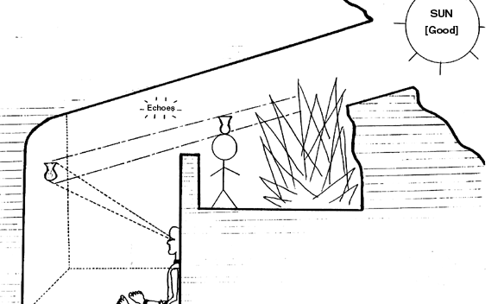

Slide 35
In the cave, the unenlightened prisoners are tied in position so that all that they can see are the shadows cast on the back wall of the cave by object placed behind them lit by the artificial light of a fire. If they were to free themselves and turn around, they would see the objects whose shadows had formerly been their only source of information. But if they were to leave the cave altogether, they would realise that everything that took place within the cave occurred in a world of shadow and darkness compared with the outside world illuminated by the sun.

Slide 36
Plato believes that we are all, as it were, cave-dwellers. In our world of everyday experience we see shadows, reflections and images of objects and the objects that are the source of those shadows images and reflections. But the everyday changeable objects of our experience are what they are only because they embody certain unchanging elements (Forms) which are themselves stable and abiding. These Forms are the proper object of real knowledge, as distinct from mere belief or imagination. But even these Forms are not the ultimate source of knowledge; that source is the Form of the Good which, in Plato’s image, is the sun shining outside the cave, the ultimate source of all the light that illuminates all that is real.

Slide 37
Plato gives us a somewhat less metaphorical account of the same issue in his image of the divided line.
Draw a horizontal line. Divide it into two parts, one left, one right. Divide each of these parts in turn into two, one left, one right.
This is what you get:

Slide 38
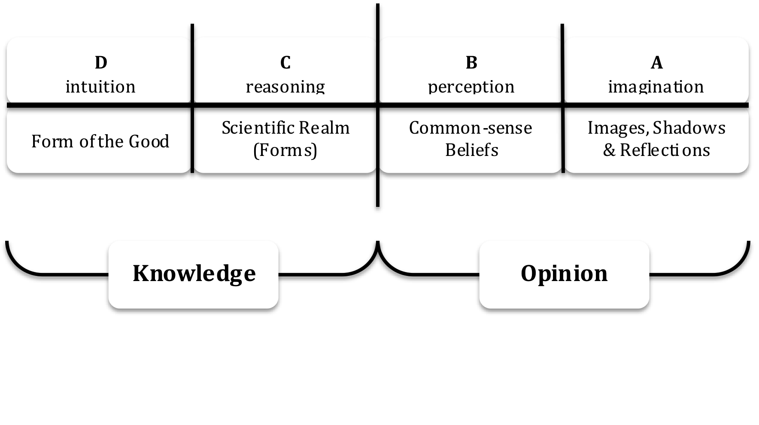

Slide 39
The original division separates knowledge (on the left) from opinion (on the right) and the other divisions are divisions within knowledge and opinion respectively. A is the realm of imagination and perception. Here, seeing is imagining both in respect of physical objects and matters of morality. (see Republic, 514ff) B is the realm of common-sense beliefs where seeing is believing without any reasoned grasp of the grounds we might have for those beliefs.

Slide 40
C is the scientific realm in which we come to grasp by means of our intellect the reasons for the beliefs and opinions we have in A and B (if they have any); and D is the highest realm of knowledge in which we grasp by rational intuition the ultimate reason for whatever is actually physically and morally real.
The rulers of Plato’s beautiful city (kallipolis) will be those who have left the cave, those who have access to the highest level of the divided line, those who know, really know, what is true and beautiful and good—good in itself and good for us.

