Slide 1
Introduction
In lecture 12 we extended the analysis of the circular flow of income and expenditure to include income earned and money expended in the production and utilization of durable capital goods.
In this lecture we will examine the market for loanable funds.
We will also analyze how inventories are treated in the context of the circular flow.
In the process the important (and confusing!) distinction between desired (realized) expenditure and “identical” (total incl. realized and unrealized) expenditure will be introduced.

Slide 2
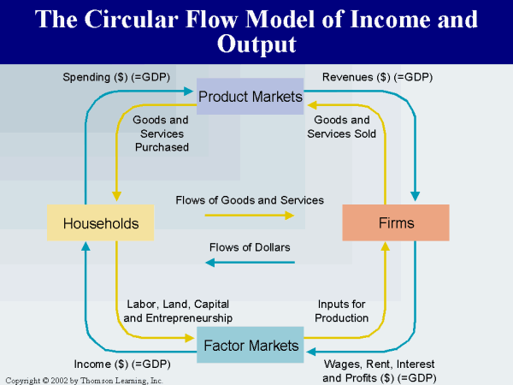
Lecture 13

Slide 3
Lecture 13
In the more extended circular flow, durable capital goods are produced alongside consumer and intermediate goods.
Income is generated in their production, just as in the case of the other two kinds of goods.
Expenditure incurred on them is categorized as investment expenditure and is financed out of savings – that part of total income earned by all individuals or households that is not spent on consumption.

Slide 4
Lecture 13
Investment
Firms
Financial
Market
Consumption
Income
Saving
Households

Slide 5
Lecture 13
Who saves? Who sacrifices consumption and instead frees up money to spend for the purposes of investment on durable capital goods?
There are two possibilities. Either the laborers save out of wages earned or the owners of the consolidated firm save out of the profits (and interest) that they have earned in the past.
If wage earners save, they lend this money to the single firm to finance the expenditure on the durable capital goods.
If the owners of the firm do the saving, they lend themselves the money.

Slide 6
Lecture 13
In either case, the act of saving introduces a new market in our circular flow analysis.
Over and above the factor market where labor (and land) are traded and the product market where final output is exchanged, we have a loanable funds market (“financial market” in the diagram).
In this market saved money is lent out at interest to the firm to invest. Even in the case of the owners saving and investing in their own firm, we can assume that this is done on this market, with imputed interest being earned.

Slide 7
Lecture 13
Investment
Firms
Financial
Market
Consumption
Income
Saving
Households

Slide 8
Lecture 13
So far we have analyzed the circular flow of income with the assumption that all goods produced in a given period (a year) are sold.
There were no unsold stocks in both scenarios we considered – with and without the production of durable capital goods.
Now we will drop this assumption and assume the possibility of inventories of goods being built up as well as drawn down.
What implications does this have for the flow of income and expenditure?

Slide 9
Lecture 13
The absence of inventories implies that there is always an equality between the income generated in production and the amount of realized and therefore desired expenditure out of that income.
Consider first our imaginary economy with no durable capital goods. The income generated in the production of bread and the two intermediate goods was $1000.
All of this $1000 was expended by consumers on the consumer good – bread. The desired expenditure was equal to the income generated.

Slide 10
Lecture 13
Table 1
Payments of wheat producers: $250 as wages (to labor), $25 as interest (to creditors/imputed). Revenue earned by selling wheat (to flour producers): $300. Total profits earned = $25.
Payments of flour producers: $300 to wheat producers, $225 as wages (to labor), $25 as interest (to creditors). Revenue earned by selling flour (to bread producers): $600. Total profits earned = $50.
Payments of bread producers: $600 to flour producers, $325 as wages (to labor), $25 as interest (to creditors). Revenue earned through sale of bread (to consumers): $1000. Total profits earned = $50.

Slide 11
Lecture 13
But what if all the income generated in current production was not spent on consumption?
Assume that only $800 out of the $1000 earned was spent on bread.
The result would be an unsold stock of goods in the “consumption goods sector” which would be held in inventory by the producers. The rate of sales of bread as well as wheat and flour would slow down.
These unsold goods would be carried over to the next year and the producers will hope that they will then be able to sell them.

Slide 12
Lecture 13
Thus, a mismatch between desired (and thus realized) expenditure and income earned is reflected in the emergence of inventories.
Remember that the money value of goods held in inventory amounts to unrealized expenditure and is counted as part of investment expenditure.
So total expenditure can still be defined to equal total income (given that we define investment exp. to maintain such an equality) and GDP is still $1000.
But desired expenditure is not equal to total income earned. All that is earned is not spent.

Slide 13
Lecture 13
What if the opposite were to happen? What if actual expenditure was to outstrip income earned in a given period of time?
How could this occur? By individuals running down unspent earnings from a previous period (or perhaps even through some form of monetary intervention).
Let’s assume $1200 was spent on bread in a year when only $1000 was generated in its production.
This would result in a drawing down of inventories brought forward from past years.

Slide 14
Lecture 13
If current expenditure exceeds current income, then previously unsold stock carried forward are now sold.
Sales of the bread producers and as a result wheat and flour producers proceed at a pace that is higher than the norm. Goods fly off the shelf at a much faster rate than normal.
In this case too total expenditure can be defined to equal total income. Investment expenditure counts the money value of inventories sold with a negative sign.
Thus, total expenditure = $1000 ($1200 - $200) and GDP = $1000. Nevertheless, actual expenditure was greater that earned income, resulting in a drawing down of inventories.

