Slide 1
Introduction
In this lecture we will study the circular flow of income and expenditure.
This concept will be analyzed in an economy producing only one consumer good (bread) and two intermediate goods (wheat and flour).
Throughout our analysis, we will assume no inventories or unsold stocks. The entire supply of goods produced is sold during the same year.
We will also extend the analysis to consider the important macroeconomic assumption of one vertically and horizontally integrated firm producing all goods.

Slide 2
Lecture 11
Consider first an economy where only consumer and intermediate goods are produced and no inventories are maintained.
The activities of production and consumption generates flows of income and expenditure – money earned and money spent.
The process of production generates a flow of income – net income to be precise. This flow consists of wages, interest and profits (also rent if land is included in the analysis).

Slide 3
Lecture 11
All income is earned by households or individuals, including profits and interest earned by firms. Owners of land earn the wages (of land, rent).
Firms or companies exist, nevertheless all incomes earned by such firms ultimately accrues to specific households – those of its owners.
This income earned is in turn spent – on the consumer goods that are produced. Given our assumptions, no investment expenditure.
This gives rise to a circular flow of income and expenditure – depicted on the following slide.

Slide 4
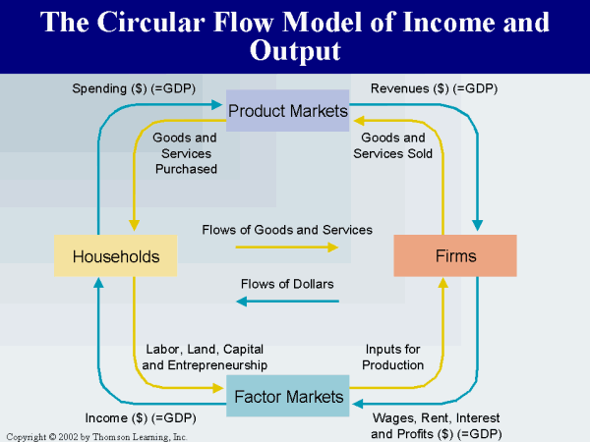
Lecture 11

Slide 5
Lecture 11
How do these flows of income and expenditure manifest themselves in our imaginary economy?
Flow of income amounts to $1000, earned in the production of bread, flour and wheat.
Flow of expenditure (out of this income earned) amounts to $1000, all of it expended on the only consumer good – bread.
In the factor markets labor is sold for wages, in the product market bread is exchanged for money, and interest and profits accrue to the owners of the firms.

Slide 6
Lecture 11
Table 1
Payments of wheat producers: $150 as wages (to labor), $50 as interest (to creditors/imputed). Revenue earned by selling wheat (to flour producers): $300. Total profits earned = $100.
Payments of flour producers: $300 to wheat producers, $100 as wages (to labor), $50 as interest (to creditors). Revenue earned by selling flour (to bread producers): $600. Total profits earned = $150.
Payments of bread producers: $600 to flour producers, $150 as wages (to labor), $50 as interest (to creditors). Revenue earned through sale of bread (to consumers): $1000. Total profits earned = $200.

Slide 7
Lecture 11
Note that in the diagram of the circular flow, just as in our analysis of GDP, there is no market for intermediate goods.
All expenditures on such goods used up in producing consumer goods are not explicitly considered.
In the product market in the circular flow diagram only bread is bought and sold ( bread is the only final good in this economy).
Intermediate goods are bought and sold by firms and thus find no place in this market. They constitute inter-firm transactions, not transactions between households and firms.

Slide 8
Lecture 11

Slide 9
Lecture 11
An important implication follows from this elimination of inter-firm transactions .
The entire income-expenditure analysis, i.e., the entire circular flow of income and expenditure can be carried out under a special assumption.
We can assume that all goods are produced by one, monolith firm. This firm produces all the intermediate goods (all produced inputs) – is vertically integrated.
It also produces all the consumer goods – is horizontally integrated.
This single firm hires workers and pays out wages and its owners earn interest and profits.

Slide 10
Lecture 11
Thus this one firm generates all the income flows in the economy.
Its ultimate goal of production is to produce consumer goods and sell them to the consumers (the various households or income earners).
The households expend money on these consumer goods out of the income earned via engaging in the production activities engaged in by the single firm.

Slide 11
Lecture 11

Slide 12
Lecture 11
In our imaginary economy, we can picture all three goods being produced by this single firm.
The firm hires workers, produces wheat and flour, uses them as inputs in its own production, ultimately churning out bread – the only consumer good.
The bread is then consumed by the various income earners who have earned their incomes by participating in the production of the three products.

Slide 13
Lecture 11
This assumption of all production being undertaken by one vertically and horizontally integrated firm is fundamental to the macroeconomic conception of the economy.
This way of viewing economic activity was one of the most important and perhaps the most lasting legacy of Keynes’ General Theory.
This assumption explains one of the distinguishing features of the macroeconomic perspective – its high level of aggregation, its attempt to find cause and effect relationships between various aggregates.

