Slide 1
Western Civilization since 1500
Lecture 38: World War II

Slide 2
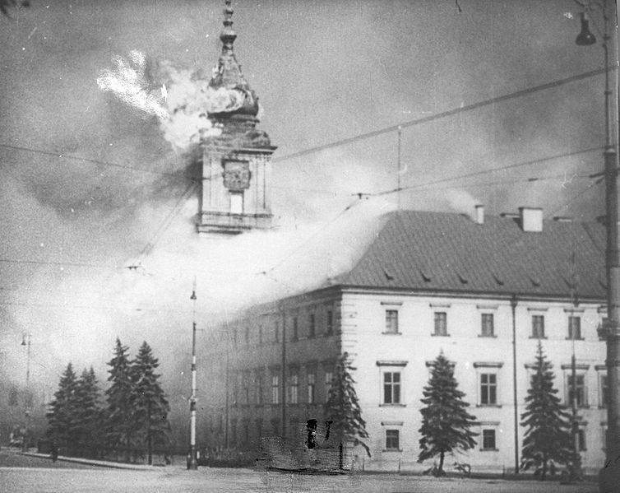
Conquest of Poland
9/1/1939—German invasion
Blitzkrieg
9/17/1939—Soviet invasion
Secret provisions of Molotov-Ribbentrop
10/6/1939—campaign ends

Slide 3
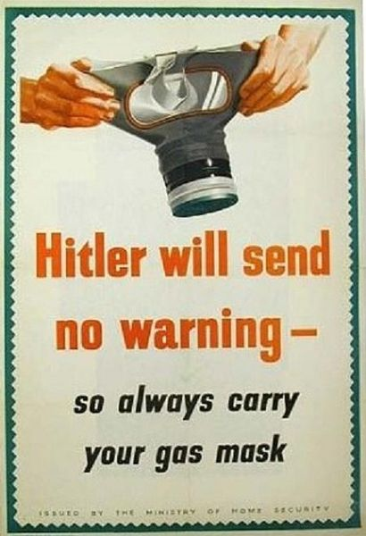
Winter, 1939-1940
“Winter War”
  Soviets occupy Baltic states
  Costly invasion of Finland
“Phony War”
  Britain and France idle
  Maginot Line
  “Sitzkrieg”

Slide 4
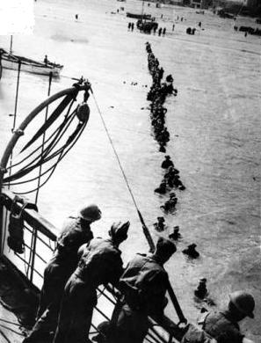
1940 Campaign
April—Germany invades Denmark, Norway
May—Germany invades Low Countries, France
  Fooled French
  Dunkirk evacuation
June—Italy enters

Slide 5
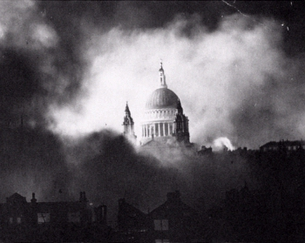
1940 Campaign
June—France surrenders
  Rump Vichy state
  “Free French” government in exile
Summer/Fall—Battle of Britain
  Operation Sealion
  “The Blitz”

Slide 6
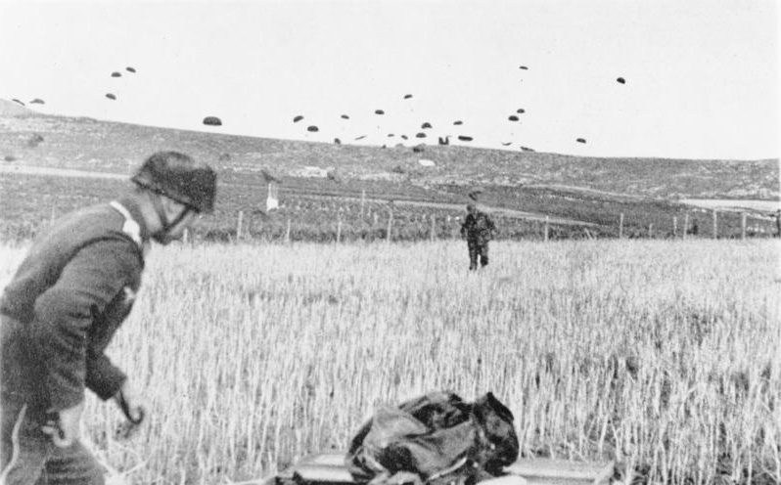
Spring 1941
Mussolini in Greece
April—Germany advances
  Yugoslavia
  Greece
  Crete
Oil fields, food supplies

Slide 7
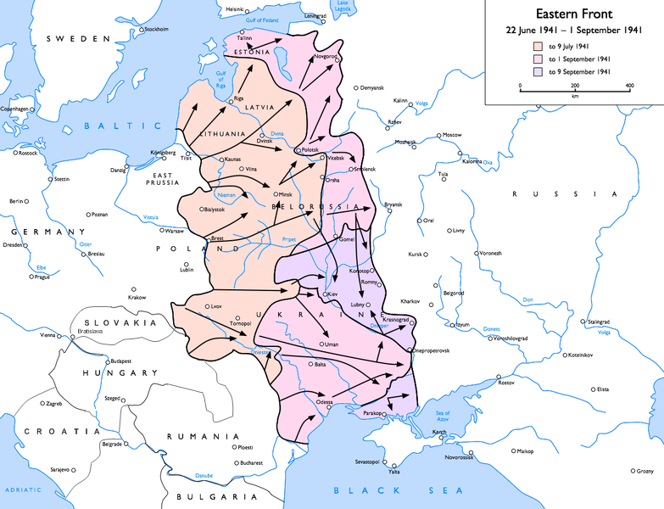
Operation Barbarossa
6/22/1941—Germany invades Russia
  Goal: Archangel-Astrakhan line
  Stalin surprised
Rapid advance
Lost six weeks for oil
Moscow in winter

Slide 8
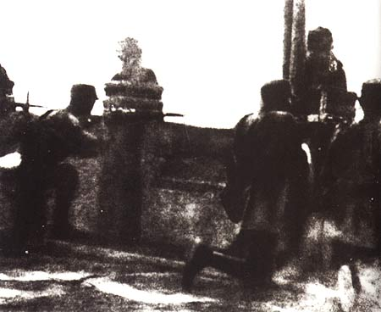
Asian Theater
Japanese occupation of Manchuria (1931)
1937—Marco Polo Bridge Incident
Occupation of major Chinese cities
U.S. sanctions
1940—Tripartite Pact
12/7/1941—Pearl Harbor

Slide 9
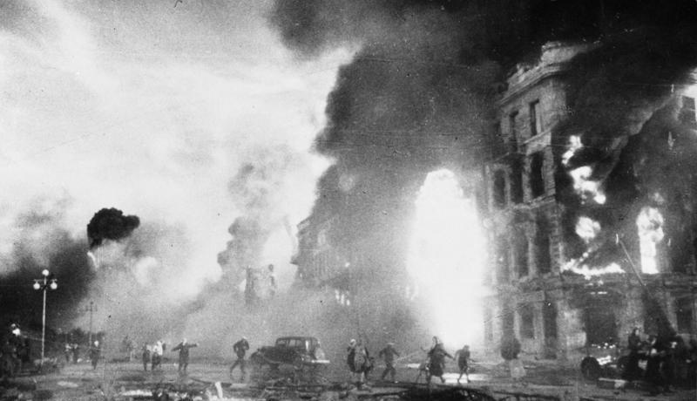
Eastern Front
Stalin and the West
  Kept afloat by aid
  Demanded 2nd front
  Demanded generous postwar settlement
1942—Siege of Stalingrad
1943—German retreat begins

Slide 10
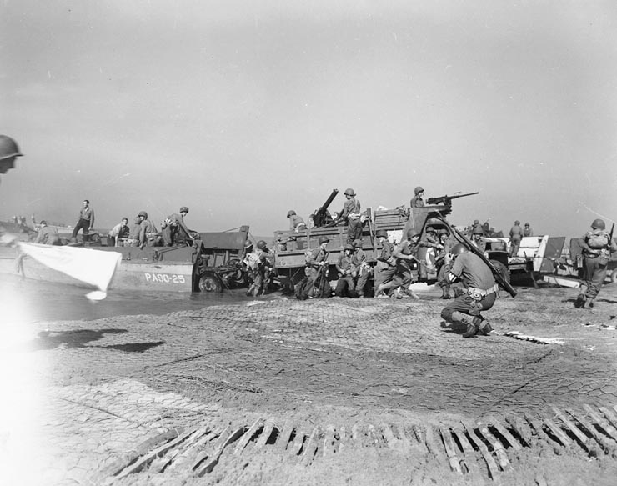
Mediterranean Theater
Africa
  Afrika Korps
  Battle of El Alamein
  U.S.➔Germans⬅UK
Italy
  “Soft underbelly”
  Sicily➔mainland
  Italian government switches sides

Slide 11
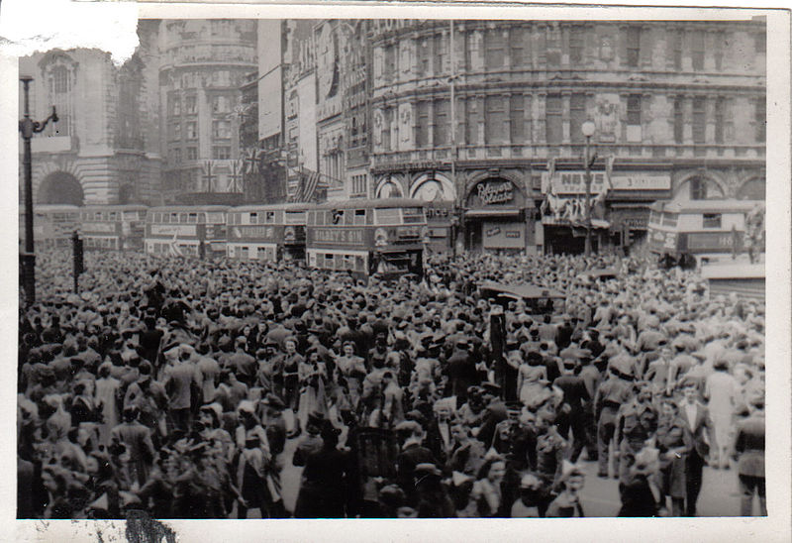
Endgame
6/6/1944—D-Day
  Operation Overlord
  Normandy invasion
Germans retreat on all fronts
Hitler refuses to negotiate
Race to Berlin
5/8/1945—V-E Day

Slide 12
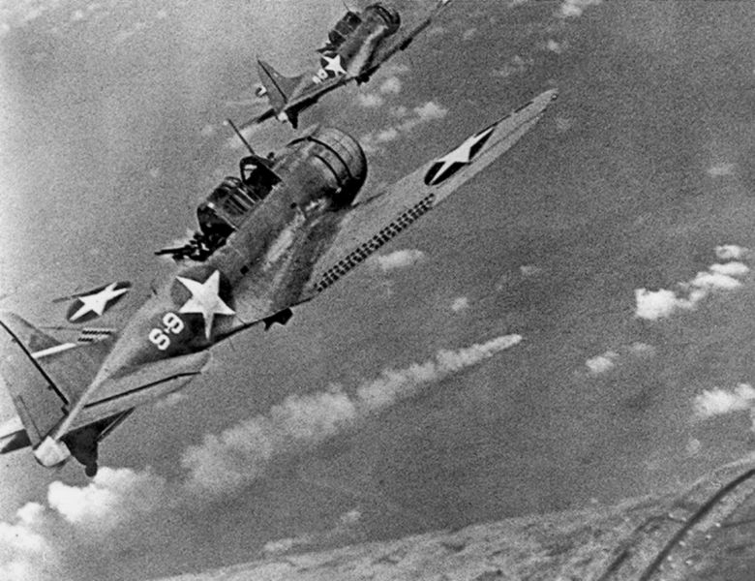
Asian Theater
Early Japanese gains
Coral Sea and Midway
Island hopping
1945—Philippines
Atomic bomb: Hiroshima, Nagasaki
8/14/1945—V-J Day

