Slide 1
Lecture 30: Current Issues in Conservatism and Libertarianism
Liberty Classroom: History of Conservatism and Libertarianism

Slide 2
Overview
Foreign Policy
Federalism & devolution
Immigration
IP
Cultural commitments

Slide 3
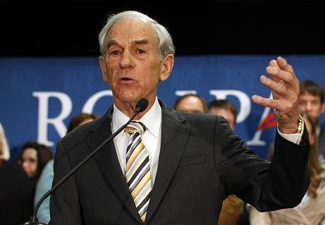
Foreign Policy
Significance of Ron Paul campaigns + consistent paleo voices
Arguments over Middle East, Ukraine

Slide 4
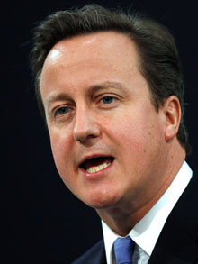
Federalism
Devolution in Britain
  New Labour
  SNP & referendum
  Aftermath & 2015 election
Nullification in USA
  Marijuana laws
  Gun rights
  NSA spying
  Tenth Amendment Center

Slide 5
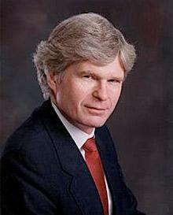
Immigration
Neocons: open borders
Paleos on restriction
  Chilton Williamson
  Brimelow: Alien Nation
  Buchanan: State of Emergency
Libertarian divisions

Slide 6

Intellectual Property
Most but not all libertarians pro-IP before 2000
Stephan Kinsella: Against Intellectual Property
  IP inconsistent with libertarian theory of rights

Slide 7
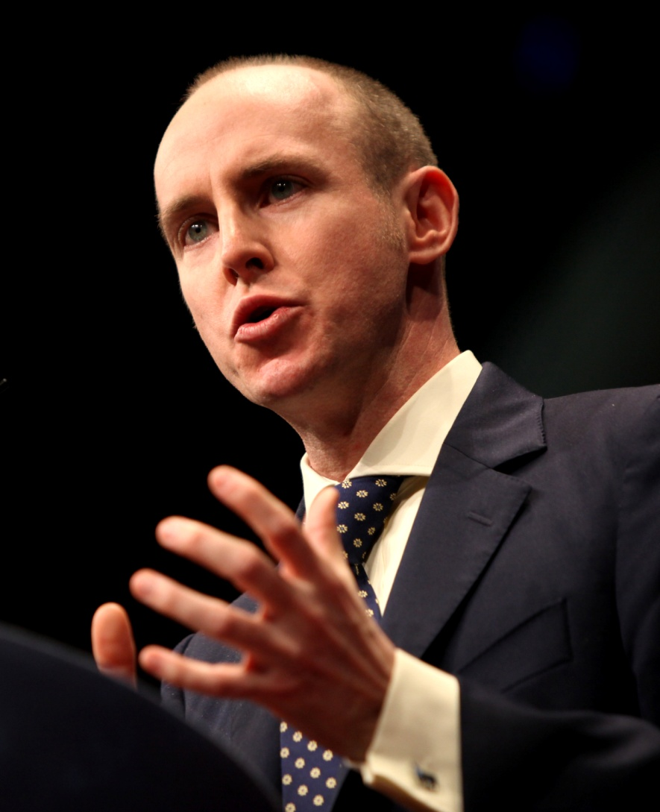
Cultural Commitments
Is religious faith necessary for conservatives?
Is the NAP enough for libertarians?
Are conservatism and libertarianism compatible? (Hannan on RP)

Slide 8
Summary
Conservatism has changed
  Reconciled to markets
  Reconciled to democracy
Classical liberalism survives in the conservative movement and in libertarianism
Plenty to argue about

