Slide 1
Lecture 29: The Ron Paul Presidential Campaigns
Liberty Classroom: History of Conservatism and Libertarianism

Slide 2
Overview
Early Career
LP Candidacy and “Wilderness” Years
2008 Presidential Campaign
2012 Presidential Campaign

Slide 3
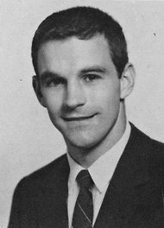
Ron Paul (b. 1935)
M.D. from Duke (1961)
Flight surgeon in USAF, 1963-1965
National Air Guard, 1965-1968
OB/GYN practice

Slide 4
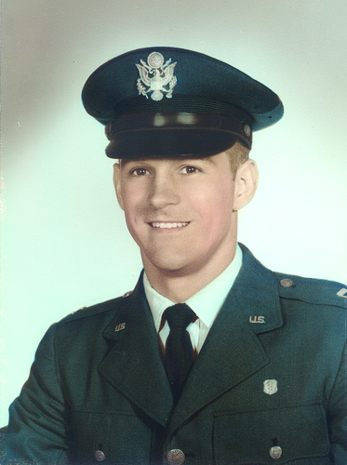
Entry into Politics
Read classical liberals & Austrians in the 1960s
Nixon’s “closing the gold window” motivated first congressional run
Lost in 1974, won and lost in 1976

Slide 5
Entry into Politics
In HoR 1979-1985
  Focus on banking
  Spoke against the draft
  Lost Senate primary run to Phil Gramm
Foundation for Rational Economics and Education
Citizens for a Sound Economy
Political and financial publishing, coin business

Slide 6
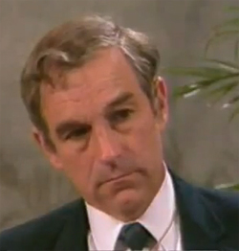
LP Candidacy
Left GOP in 1987
Beat Russell Means for LP presidential nomination in 1988
  Non-intervention
  Federalism on drugs
  Gold standard
  End the Fed
0.5% of popular vote (~430,000 votes)

Slide 7
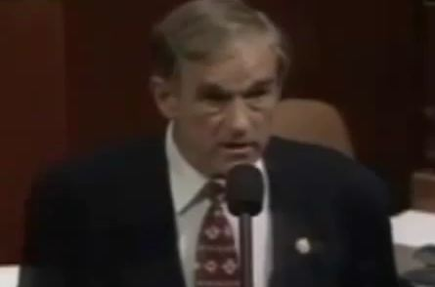
Predicting Crises
Returned to Congress in 1997
At odds with GOP leadership: “Dr. No”
Late 1990s warnings of blowback
2002 warning of housing bubble

Slide 8
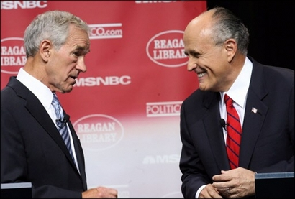
2008 Presidential Campaign
GOP suffered in 2006 because of Iraq
Crowded GOP field
May 15, 2007: exchange with Giuliani
Response: grassroots vs. establishment

Slide 9
2008 Presidential Campaign
“Moneybombs” on 11/5 and 12/16
“Meet the Press” interview, 12/23/07
Newsletter attacks
Rally for the Republic, 9/2008

Slide 10
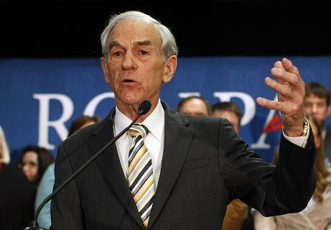
2012 Presidential Campaign
Financial crisis of 2008
Neoconservatism as culprit in foreign policy & financial problems
McConnell on Paul’s antiwar stance

Slide 11
2012 Presidential Campaign
Media response to early polling strength
GOP rule change to fix the national convention
Retirement from Congress in 2013, new launches

Slide 12
Impact
Changed GOP conversation on foreign policy
Made monetary policy a live issue
Launched “liberty movement”: activism, new candidates (e.g., Justin Amash)

