Slide 1
Lecture 28: The Paleos
Liberty Classroom: History of Conservatism and Libertarianism

Slide 2
Overview
Traditionalism ➔ paleoconservatism
Major paleo writers
John Randolph Club
Pat Buchanan presidential campaigns

Slide 3
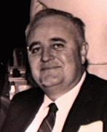
M.E. Bradford (1934-1993)
Literature professor at Univ. of Dallas
NEH nomination leads to fight
A Better Guide Than Reason
The Reactionary Imperative
“The Heresy of Equality”

Slide 4
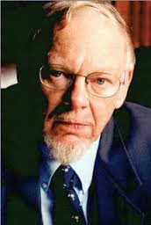
Southern Partisan (1979-2009)
Regional and Agrarian flavor
“Scalawag Award”
Thomas Fleming and Clyde Wilson (b. 1941)
Calhoun Papers

Slide 5

Chronicles (of Culture)
Rockford Institute
Thomas Fleming
  Politics of Human Nature
  The Morality of Everyday Life
Stresses cultural issues and Old Right themes

Slide 6
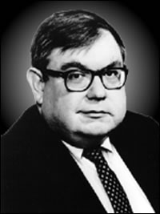
Samuel Francis (1947-2005)
Influence of Burnham; stressed machinery of power
“Anarcho-tyranny”
“Middle-American Radicals”
Beautiful Losers

Slide 7
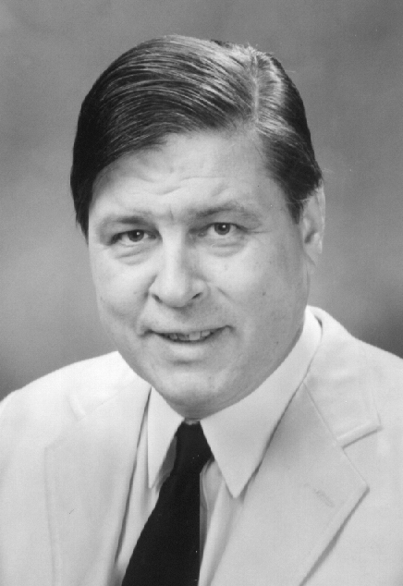
Joseph Sobran (1946-2010)
National Review, 1972-1993, fired at neocons’ behest
Anything Called a Program Is Unconstitutional
Alias Shakespeare
“Reluctant anarchist”

Slide 8
John Randolph Club
Paleocon-libertarian debating club from 1990
“Time to quarrel”
Mid-1990s rupture
  Deaths of Bradford and Rothbard
  Hans-Hermann Hoppe’s criticism of Francis

Slide 9
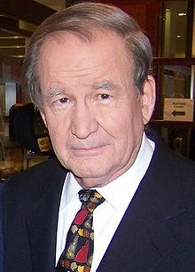
Pat Buchanan (b. 1938)
Journalist, adviser to Nixon and Reagan
Crossfire (1987-1999)
Presidential campaigns in 1992, 1996, 2000

Slide 10
Pat Buchanan (b. 1938)
Right from the Beginning (1988)
A Republic, Not an Empire (1999)
The Death of the West (2002)
Churchill, Hitler, and the Unnecessary War (2008)
The American Conservative (2002 - )

Slide 11
Summary
Paleoconservatives resisted the influence of neoconservatives from the Reagan administration onward
Stephen Tonsor on neoconservatives
Marginalized but still active

