Slide 1
Lecture 27: The Thatcher and Reagan Revolutions
Liberty Classroom: History of Conservatism and Libertarianism

Slide 2
Overview
Problems of the 1970s
Economists’ critiques
Margaret Thatcher
Ronald Reagan

Slide 3
Problems of the 1970s
Britain
Conservatives had not undone nationalizations
Powerful trade unions in state-owned industries
“The British Disease”—inflation, no growth
USA
“Guns and butter” of 1960s ➔ stagflation
Wage and price controls
Foreign policy trouble: Iran, USSR in Afghanistan

Slide 4
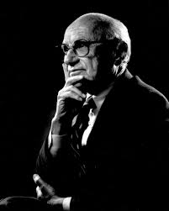
Milton Friedman (1912-2006)
Monetarism and “starve the beast”
Capitalism and Freedom (1962)
A Monetary History of the United States, 1867-1960 (1963)
Free to Choose (1979)

Slide 5
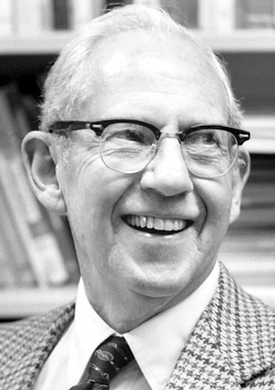
Public Choice
Key idea: Political actors are self-interested
George Stigler (1911-1991)
James Buchanan (1919-2013)
Gary Becker (1930-2014)

Slide 6
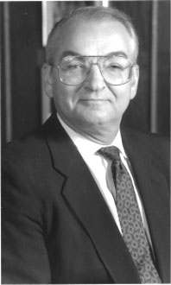
Supply-siders
Jude Wanniski (1936-2005)
“Two Santa Claus” Theory
The Way the World Works
Arthur Laffer (b. 1940) and the Laffer Curve

Slide 7
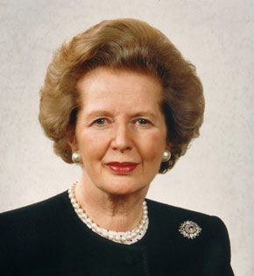
Margaret Thatcher (1925-2013)
Conservative MP from 1959, party leader from 1975, PM 1979-1990
1st term
Balanced budget
High interest rates
Unemployment
Falklands War

Slide 8
Margaret Thatcher (1925-2013)
2nd term
Miners’ strike
Denationalization emphasis
Council houses
Replaced by John Major in 1990
Reagan’s ally in Cold War

Slide 9
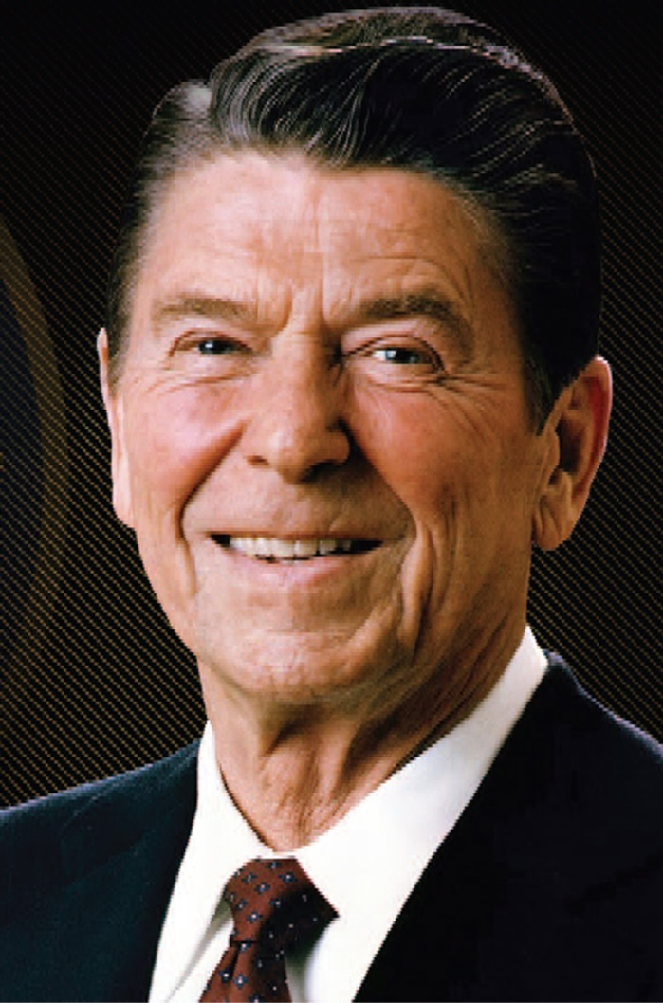
Ronald Reagan (1911-2004)
Actor ➔ politician
SAG president
TV host
Declared for Goldwater: “Time for Choosing”
CA governor, 1967-1975

Slide 10
Ronald Reagan (1911-2004)
President, 1981-1989
Foreign policy
End détente
Reagan Doctrine
SDI
Domestic policy
Tax reform
Deregulation of some industries
Air traffic controllers strike

Slide 11
Summary
Free-market economists formulated new policy ideas to counter economic problems of the 1970s
Thatcher and Reagan implemented some of those ideas and helped revive economic growth
Aggressive posture in the Cold War may have hastened the USSR’s collapse

