Slide 1
Lecture 26: The “Religious Right”
Liberty Classroom: History of Conservatism and Libertarianism

Slide 2
Overview
Evangelical cultural retreat
R.J. Rushdoony and Christian Reconstruction
Christian neoconservatives
Grassroots activism

Slide 3
Evangelical Cultural Retreat
Scopes Trial (1925)
1960s and Roe v. Wade cause stirrings
Dispensational premillennialism
  Hal Lindsey: Late Great Planet Earth
  “Don’t polish brass on a sinking ship”
Cultural engagement from Catholics and Calvinists

Slide 4
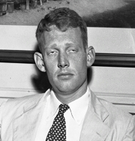
L. Brent Bozell, Jr. (1926-1997)
Catholic convert, WFB’s bro-in-law
Triumph (1966-1976)
Vietnam critic
Pro-life activism

Slide 5
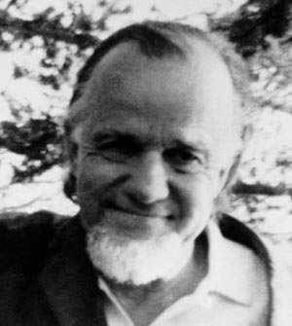
Francis Schaeffer (1912-1984)
Student of Cornelius Van Til (1895-1987) and J. Gresham Machen (1881-1937)
L’Abri (1955)
Traced Western decline across disciplines
How Should We Then Live? (1976)

Slide 6
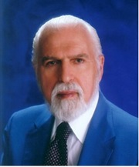
Christian Reconstruction
R.J. Rushdoony (1916-2001)
  Student of Van Til
  Messianic Character of American Education
  Institutes of Biblical Law
CR tenets
  Calvinism
  Postmillennialism
  Presuppositionalism
  Theonomy

Slide 7
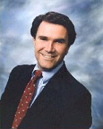
Christian Reconstruction
Greg Bahnsen (1948-1995)
  Reformed Theological Seminary
  Theonomy in Christian Ethics
  Apologetics
David Chilton (1951-1997)
  Productive Christians in an Age of Guilt-Manipulators
  Paradise Restored

Slide 8
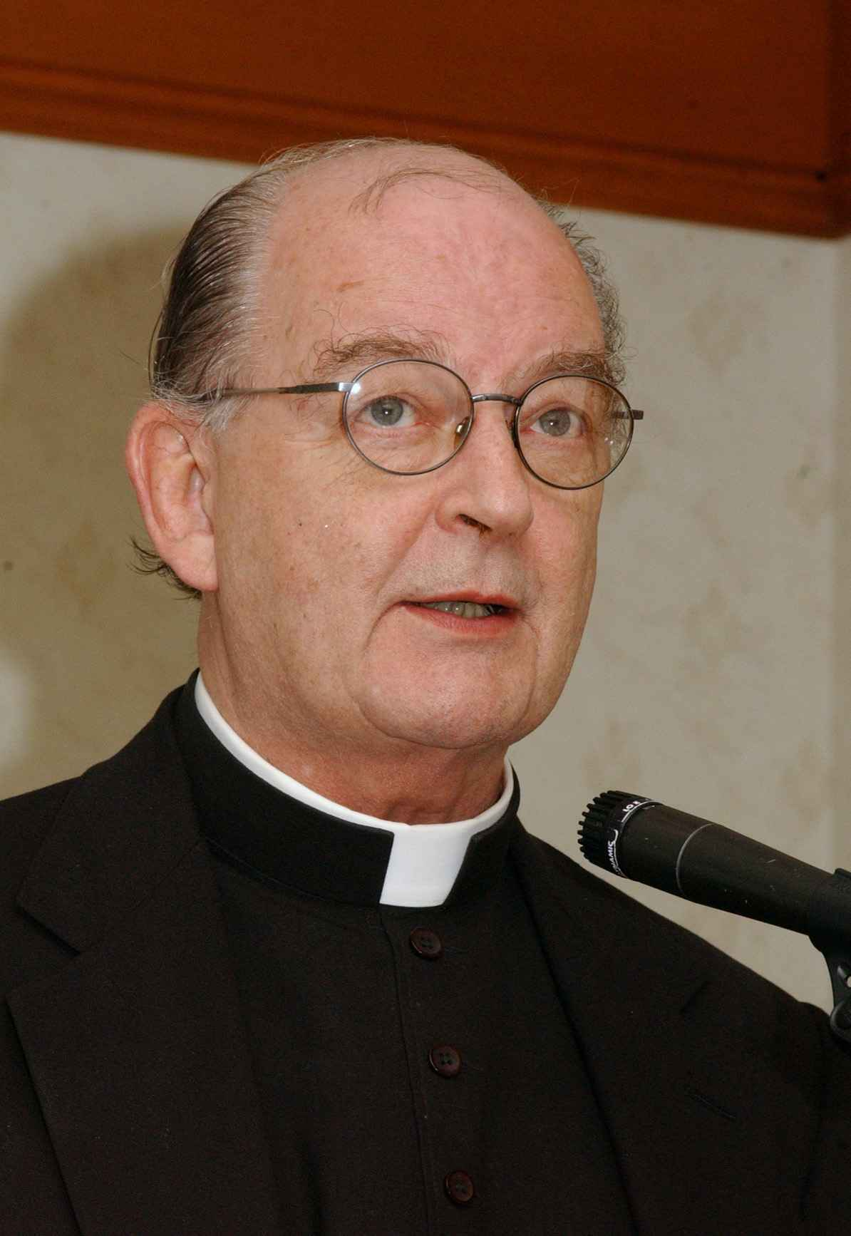
Richard John Neuhaus (1936-2009)
Lutheran ➔ Catholic
Rockford Institute ➔ Institute on Religion and Public Life
The Naked Public Square
Piety and Politics
First Things

Slide 9
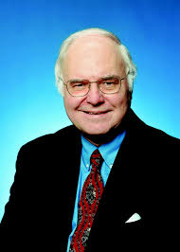
Neocon Christians
Michael Novak (b. 1933): Business as a Calling; The Universal Hunger for Liberty
George Weigel (b. 1951): Catholicism and the Renewal of American Democracy
George Gilder (b. 1939): Wealth and Poverty

Slide 10
Activists and Think Tanks
STOP ERA and Eagle Forum
Moral Majority
Christian Coalition
Operation Rescue
Chalcedon Foundation
American Vision
Acton Institute

Slide 11
Summary
Christians organized as a significant force on the Right from the 1970s
  Roman Catholic and Calvinist intellectuals
  Evangelical activists

