Slide 1
Lecture 25: Murray Rothbard and the Libertarian Party
Liberty Classroom: History of Conservatism and Libertarianism

Slide 2
Overview
Conservative & Libertarian publications and institutes
Career of Murray Rothbard
Libertarian Party

Slide 3
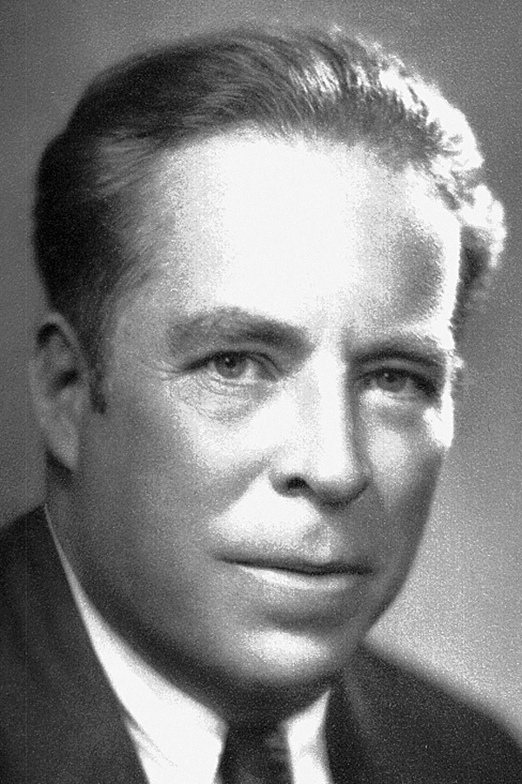
Human Events (1944-2013)
Felix Morley (1894-1982)
  Baltimore Sun, Washington Post
  Pulitzer in 1936
  Haverford College
  Power in the People
Henry Regnery
Influence on Reagan

Slide 4
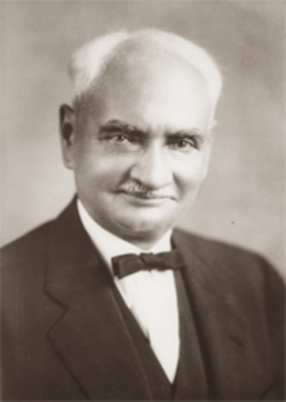
Volker Fund (1947-1964)
William Volker (1859-1947) & Harold Luhnow (1895-1978)
Funded classical liberals: Hayek, Mises
National Book Foundation
Old Right conferences
$$ ➔ Hoover Institution

Slide 5
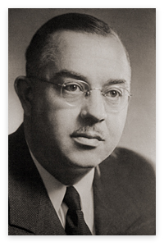
Institute for Humane Studies
F.A. “Baldy” Harper (1905-1973)
  FEE
  Mont Pelerin Society
  Volker Fund
IHS activities
  Conferences
  Campus events

Slide 6
Liberty Fund
Pierre Goodrich (1894-1973)
Activities
  Publishing
    Smith, Richardo, Tocqueville, Mill, Mises, etc.
    Natural law and Enlightenment
  Conferences

Slide 7
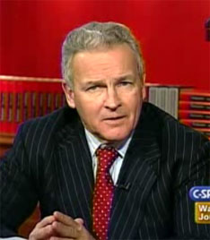
American Spectator (1967-2014)
R. Emmett Tyrrell (b. 1943)
Modeled on Mencken’s American Mercury
Generally libertarian
Peaked in Clinton years

Slide 8
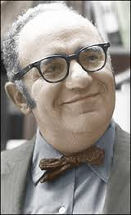
Murray Rothbard (1926-1995)
Brooklyn Polytechnic, UNLV
Student of Mises
Man, Economy, and State (1962)
America’s Great Depression(1963)

Slide 9
Murray Rothbard (1926-1995)
Break with Right: Left and Right w/Karl Hess & Leonard Liggio
For a New Liberty (1972): stressed NAP
Conceived in Liberty (1975-1979)
The Ethics of Liberty (1982)
Casey: FP II, 56

Slide 10
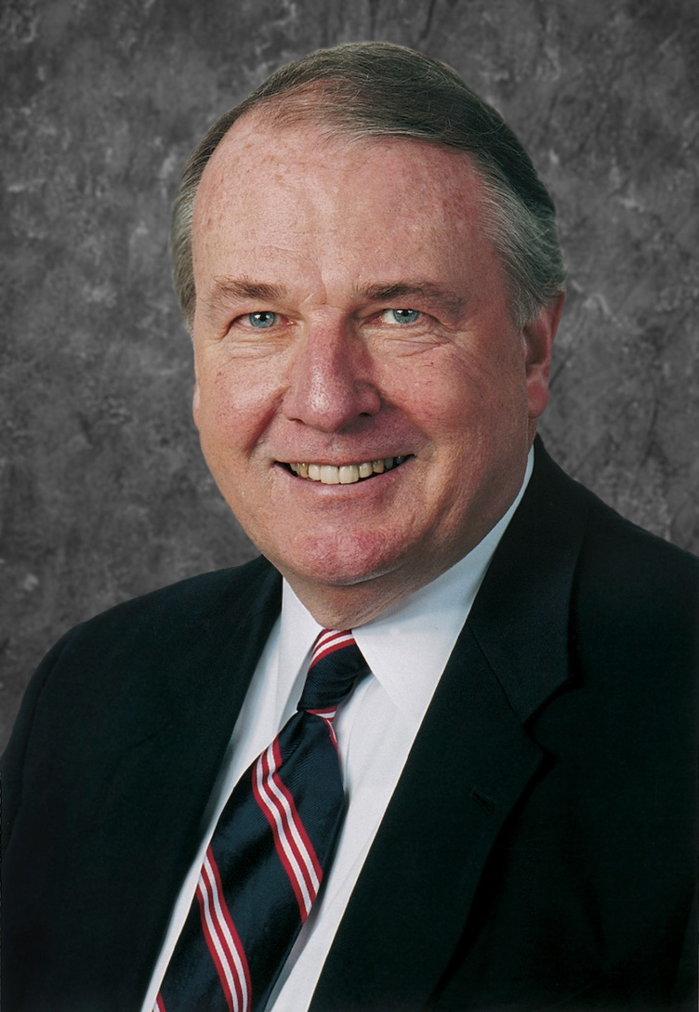
Cato Institute
Ed Crane (b. 1944)
Founded Cato with Rothbard and Kochs in 1977
“Moderate” libertarianism
Koch putsch, 2011-2012

Slide 11
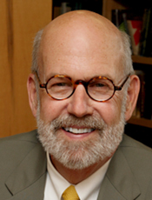
Ludwig von Mises Institute
Lew Rockwell (b. 1944)
LvMI founded as vehicle for Rothbard in 1982
Activities
  Conferences
  Research fellowships
  Publications

Slide 12
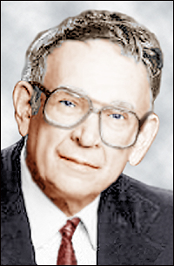
Libertarian Party
John Hospers (1918-2011)/Theodora Nathan (1923-2014) and Roger MacBride (1929-1995)
Ideas vs. electability
  Rothbard and the platform
  Clark/Koch candidacy and “low-tax liberalism”
Prominent candidates: Ron Paul, Bob Barr, Gary Johnson

Slide 13
Summary
Conservative and libertarian ideas could not spread without journals and institutions
“Mr. Libertarian” Murray Rothbard the central figure in the libertarian movement, 1960s-1980s
Libertarian Party’s difficulties in the two-party system

