Slide 1
Lecture 24: Straussians and Neoconservatives
Liberty Classroom: History of Conservatism and Libertarianism

Slide 2
Overview
Leo Strauss
Fallout of Great Society
Tenets of Neoconservatism
Leading Neoconservative Figures

Slide 3
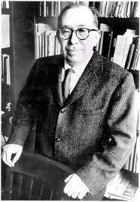
Leo Strauss (1899-1973)
University of Chicago
Emphasis on classical political philosophy and natural right
  Ancients: ideal system
  Moderns: self-interest
Hermeneutic of reading Great Books

Slide 4
Leo Strauss (1899-1973)
Complained of historicism
  Burke ➔ Hegel
  Invites Nietzsche
Athens vs. Jerusalem
Theory of esoteric writing

Slide 5
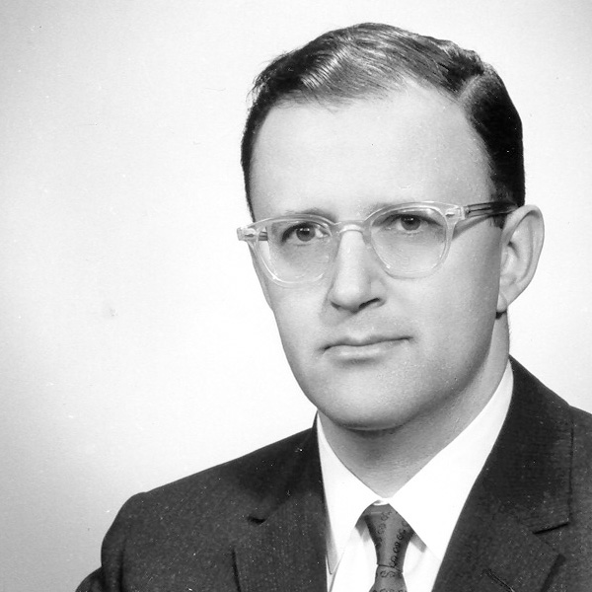
Straussians
East Coast
  Introspective; focus on philosophical life
  Allan Bloom (1930-1992)
West Coast
  More political; emphasize USA as a “proposition nation”
  Harry Jaffa (1918-2015): Lincoln refounded America

Slide 6
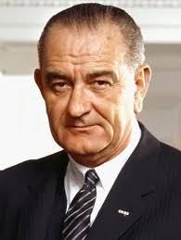
Failures of the 1960s
Conservatives on defensive
  Civil Rights
  Great Society programs
Opportunities for counterattack
  Black radicalism
  New Left & student protests

Slide 7
Neoconservatism
Second wave of leftists to defect
  Attacked “new conservatives” in the 1950s
  Disillusioned by domestic policy failures in 1960s and 1970s: “liberals mugged by reality”
Characteristics
  Social-science methodology
  Accepted social and economic inequality
  Supported welfare state
  Foreign-policy hawks

Slide 8
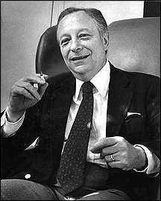
Irving Kristol (1920-2009)
Youthful Trotskyist
Anti-communist from late 1940s
Broke with left over Vietnam
Periodicals
  Commentary
  Encounter
  Public Interest
  Wall Street Journal

Slide 9
Irving Kristol (1920-2009)
Books
  On the Democratic Idea in America
  Two Cheers for Capitalism
  Reflections of a Neoconservative

Slide 10
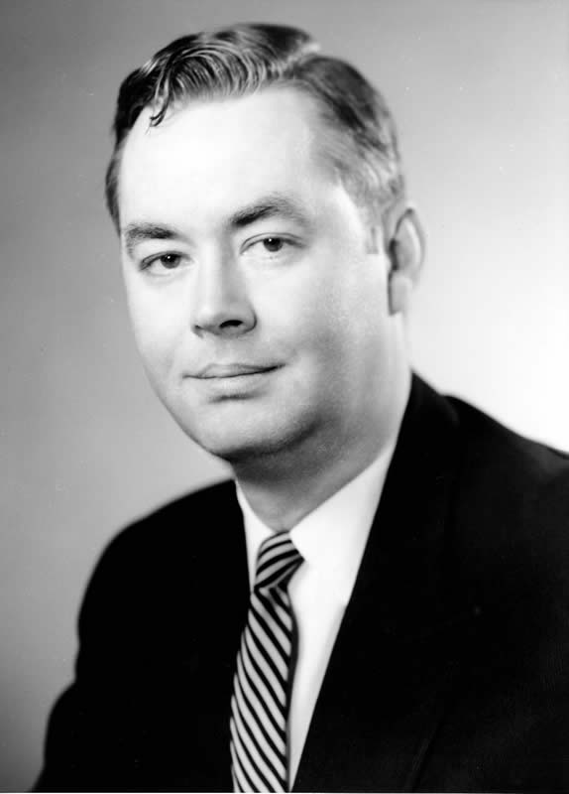
Daniel P. Moynihan (1927-2003)
Asst. Sec. of Labor in 1960s, ambassador to UN & India, then 4-term senator for NY
The Negro Family: The Case for National Action
Moderated on foreign policy in later career

Slide 11
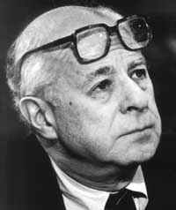
Norman Podhoretz (b. 1930)
Editor of Commentary,1960-1995
Moved Right in mid-1960s
Jabs at the Left
  Making It
  Breaking Ranks
  Ex-Friends
Debated anti-Semitism with Buckley in 1990s

Slide 12
Neocons and Foreign Policy
“Strong foreign policy”
USA must aid Israel
  Part of every issue of Commentary
  Iran and Iraq
Hawkish anti-communism
  Felt burned by events in SE Asia
  Disliked Carter’s focus on human rights
  Argued against SALT
  Jeane Kirkpatrick: “authoritarian” vs. “totalitarian” regimes

Slide 13
Summary
Straussians influence conservative movement with emphasis on centralized liberal democracy
Neoconservatives focused on social issues and foreign policy

