Slide 1
Lecture 23: William F. Buckley and National Review
Liberty Classroom: History of Conservatism and Libertarianism

Slide 2
Overview
Career of William F. Buckley
National Review and its influence
Goldwater candidacy

Slide 3
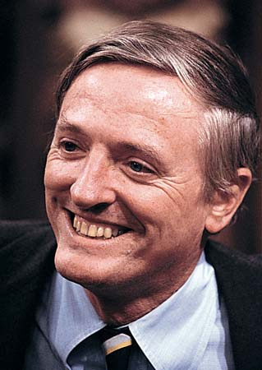
William F. Buckley, Jr. (1925-2008)
Oil family
God and Man at Yale (1951)
McCarthy and His Enemies (1954)
National Review (1955)

Slide 4
William F. Buckley, Jr. (1925-2008)
Up from Liberalism (1959)
Young Americans for Freedom (1960)
NYC mayoral campaign & The Unmaking of a Mayor (1966)
Firing Line (1966-2000)

Slide 5
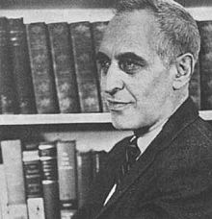
Frank Meyer (1909-1972)
CP member, 1931-1945
Influence of Hayek and Weaver
“Principles and Heresies” for NR
The Moulding of Communists (1961)
In Defense of Freedom (1962)

Slide 6
Frank Meyer (1909-1972)
Fusionism
  Libertarians wrong on skepticism
  Traditionalists wrong on authority
  Libertarians right on individuals’ value and minimalist State
  Traditionalists right on virtue

Slide 7
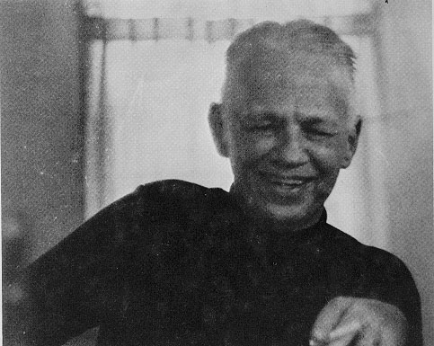
Willmoore Kendall (1909-1967)
Political science prof at Yale, University of Dallas
John Locke and the Doctrine of Majority Rule (1941)
  “Congressional”
  “Presidential”
Critic of the “open society”

Slide 8
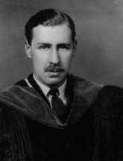
Erik von Kuehnelt-Leddihn (1909-1999)
Austria ➔ USA
Left = democracy; Right = conservatism, classical liberalism, anarchism
Portland Declaration
Liberty or Equality

Slide 9
NR’s Strategy
Hawks in the Cold War
  Burnham and the “Third World War”
  Sacrifice liberty at home if needed
  Pro-Vietnam War
Policing the conservative movement
  Ayn Rand
  John Birch Society
  Murray Rothbard

Slide 10
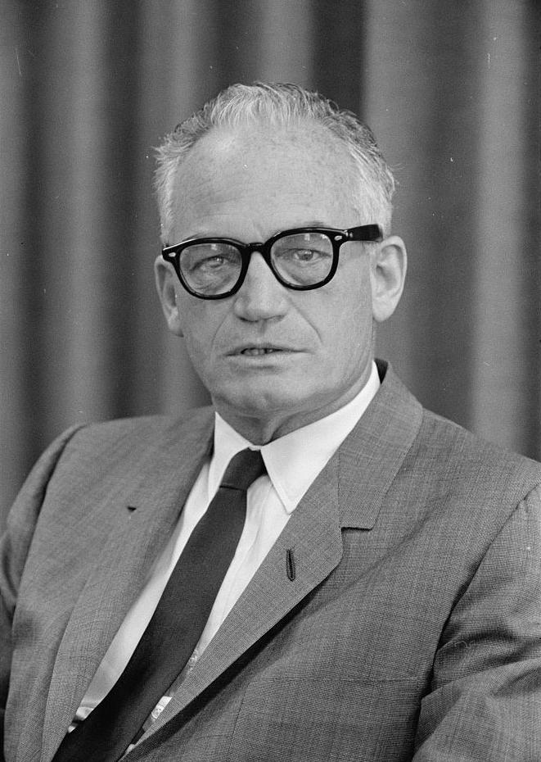
Barry Goldwater (1909-1998)
AZ senator
The Conscience of a Conservative (with Brent Bozell)
1964 candidacy
  Conservative rallying point
  Nomination speech
  Landslide defeat

Slide 11
Summary
National Review the most influential conservative publication from 1955
  Organ of “official” conservatism
  Attempts to maintain alliances between libertarians & traditionalists
  Periodically excommunicated the “fringe”
Goldwater candidacy helps make conservatives politically active

