Slide 1
Lecture 22: Anticommunism and McCarthy
Liberty Classroom: History of Conservatism and Libertarianism

Slide 2
Overview
“Red Decade” and the Cold War
James Burnham
Alger Hiss Case
Joseph McCarthy

Slide 3
Growth of Anti-Communism
“Red Scare” after WWI
Soviet sympathy in 1920s and 1930s
  Walter Duranty
  “Open Letter”
Eugene Lyons
  Radical in Moscow, 1927-1933
  The Red Decade (1941)
Responses to communist advances from 1945: Who lost China? Liberals!

Slide 4
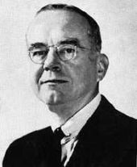
James Burnham (1905-1987)
NYU philosopher, editor of National Review
Trotskyist in the 1930s
The Managerial Revolution (1941)
The Machiavellians (1943)

Slide 5
James Burnham (1905-1987)
Urged rollback of Soviet communism
  The Struggle for the World
  The Coming Defeat of Communism
  Containment of Liberation?
  The Web of Subversion

Slide 6
James Burnham (1905-1987)
Congress and the American Tradition (1959): managers taking over in USA
Suicide of the West (1964): liberalism is psychology of Western decline

Slide 7
James Burnham (1905-1987)
Francis on Burnham’s influence on conservatism
  Conflict drives history
  Modernist vision
  Pro-Cold War without being globalist
  Managerial thesis

Slide 8
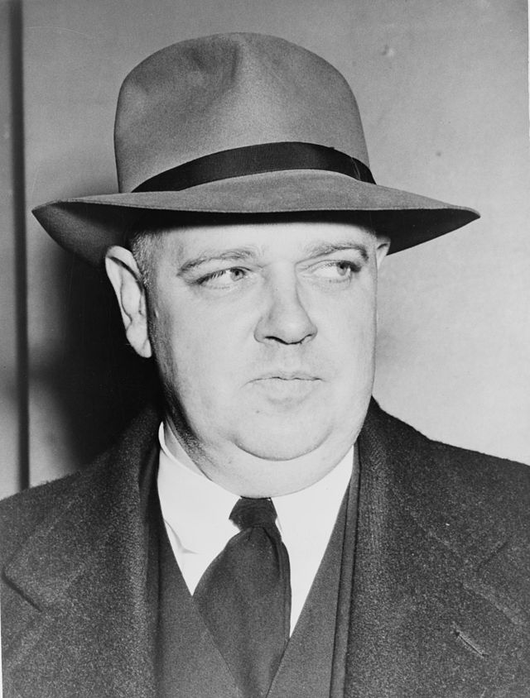
Alger Hiss Case
Whittaker Chambers (1901-1961)
  Editor of Time
  CP member in 1930s
Alger Hiss (1904-1996)
  State Dept. official
  Named by Chambers to HUAC in 1948

Slide 9
Alger Hiss Case
Chambers’s evidence of espionage; whisper campaign
Hiss’s perjury trials (1948, 1950)
Witness (1952)
Venona documents
Allen Weinstein: Perjury (1978, 1997)

Slide 10
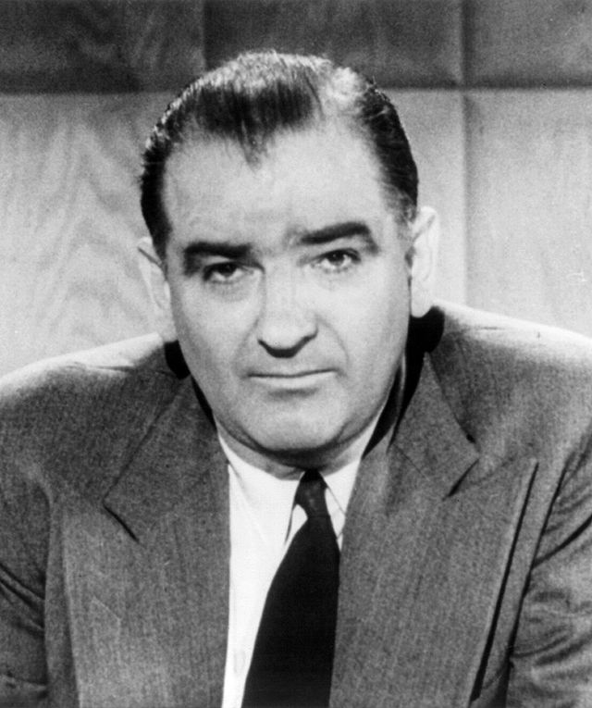
Joseph McCarthy (1908-1957)
Used anti-communist feeling as a vehicle for personal advancement
Alleged Red infiltration of State Dept., Truman administration, Army
Buckley & Bozell: McCarthy and His Enemies
1954 censure

Slide 11
Summary
Anti-communism a theme that unified the postwar Right (including libertarians)
Burnham and Soviet espionage persuade many conservatives of the need for activist foreign policy

