Slide 1
Lecture 21: American Postwar Traditionalists
Liberty Classroom: History of Conservatism and Libertarianism

Slide 2
Overview
Religious Revival of the 1950s
Richard Weaver
Russell Kirk
Robert Nisbet

Slide 3
Religious Revival of 1950s
Billy Graham
Eisenhower
Reinhold Niebuhr
Natural law revival (e.g., Leo Strauss)

Slide 4
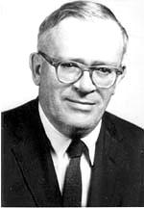
Richard Weaver (1910-1963)
Studied with Ransom & Davidson at Vandy; Brooks at LSU
University of Chicago
“Agrarianism in Exile”

Slide 5
Richard Weaver (1910-1963)
Ideas Have Consequences (1948)
The Ethics of Rhetoric (1953)
Defenses of the South
  Visions of Order
  The Southern Tradition at Bay
  Southern Essays

Slide 6
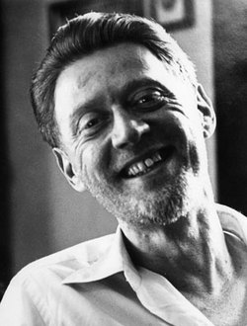
Peter Viereck (1916-2006)
Professor at Mt. Holyoke, Pulitzer for poetry in 1949
Metapolitics (1941)
Conservatism Revisited (1949)
Anti-McCarthy, anti-Goldwater

Slide 7
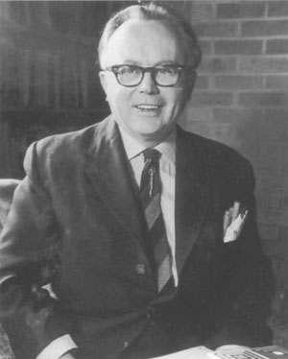
Russell Kirk (1918-1994)
Michigan State College ➔ independent writer
Fiction
  Old House of Fear
  Lord of the Hollow Dark
  Ancestral Shadows

Slide 8
Russell Kirk (1918-1994)
The Conservative Mind and six canons
  Providence
  Traditional life
  Hierarchy
  Property
  Prescription
  Change not reform
Four threats
  Perfectibility
  Contempt for tradition
  Political leveling
  Economic leveling

Slide 9
Russell Kirk (1918-1994)
Books on Burke, Eliot, Randolph
American tradition
  Roots of American Order
  Rights and Duties
  America’s British Culture
Critic of libertarians
Modern Age; University Bookman

Slide 10
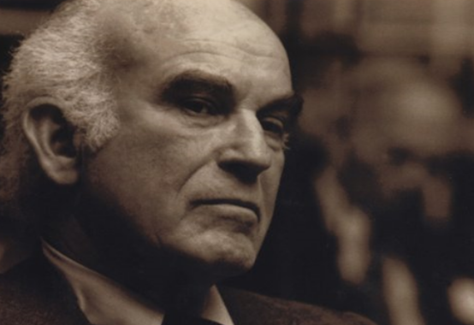
Robert Nisbet (1913-1996)
Sociology professor at UC-Riverside, Columbia
Conservative origins of sociology
The Quest for Community (1953)

Slide 11
Summary
“New Conservatives” articulated a traditionalist alternative to the mainstream liberal narrative of American history.
Stressed classical, Christian, and European antecedents for American social and political institutions

