Slide 1
Lecture 20: Libertarian Foundations II
Liberty Classroom: History of Conservatism and Libertarianism

Slide 2
Overview
Frank Chodorov
Isabel Paterson
Rose Wilder Lane
Ayn Rand

Slide 3
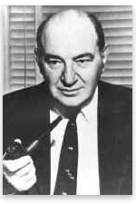
Frank Chodorov (1887-1966)
Analysis ➔ Human Events ➔ Freeman ➔ National Review
Georgist
The Income Tax: Root of All Evil (1954)
Intercollegiate Society of Individualists (1953)

Slide 4
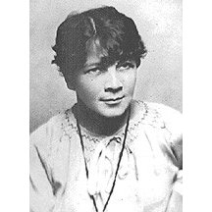
Isabel Paterson (1886-1961)
Journalist, novelist in Vancouver, New York
The God of the Machine (1943)
Society as a circuit
“The Humanitarian with the Guillotine”

Slide 5
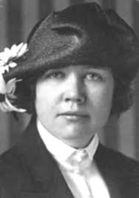
Rose Wilder Lane (1886-1968)
Daughter of Laura Ingalls Wilder
Journalist, activist
Convert from communism
Give Me Liberty (1936)
The Discovery of Freedom (1943)

Slide 6
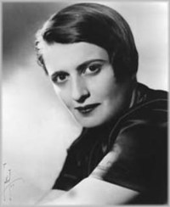
Ayn Rand (1905-1982)
Russian immigrant
Night of January 16th (1935)
We the Living (1936)
Anthem (1937)

Slide 7
Ayn Rand (1905-1982)
The Fountainhead (1943)
Atlas Shrugged (1957)
Nonfiction
The Virtue of Selfishness
Capitalism: The Unknown Ideal
For the New Intellectual
The Objectivist (newsletter)

Slide 8
Summary
Chodorov, Paterson, Lane, and Rand lay out individualist philosophy
Major influence on later libertarian and some conservative figures

