Slide 1
Lecture 19: Libertarian Foundations I
Liberty Classroom: History of Conservatism and Libertarianism

Slide 2
Overview
F.A. Hayek
Ludwig von Mises
Henry Hazlitt
Leonard Read

Slide 3
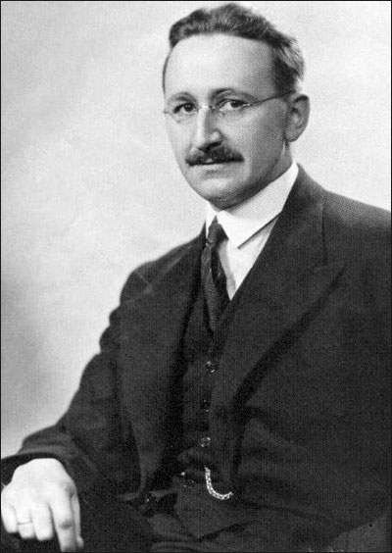
F.A. Hayek (1899-1992)
London School of Economics, University of Chicago
Rivalry with Keynes
Nobel Prize in 1974
“Spontaneous order”

Slide 4
F.A. Hayek (1899-1992)
“Knowledge problem” and the “fatal conceit”
The Road to Serfdom (1944)
The Constitution of Liberty (1960)
Law, Legislation, and Liberty (1973-1979)

Slide 5
F.A. Hayek (1899-1992)
“Why I am not a Conservative”
Mont Pelerin Society (1947) “Statement of Aims”

Slide 6
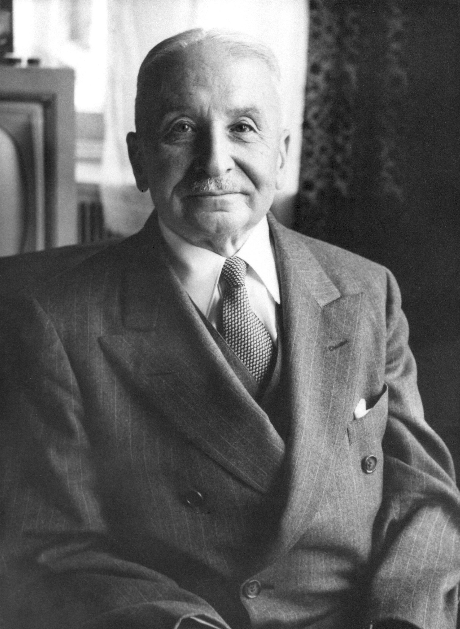
Ludwig von Mises (1881-1973)
Professional challenges
The Theory of Money and Credit (1912) and ABCT
Socialism (1922) and the “calculation problem”

Slide 7
Ludwig von Mises (1881-1973)
Liberalism (1927): Mises a fascist?
Human Action (1949)
Theory and History (1957)

Slide 8
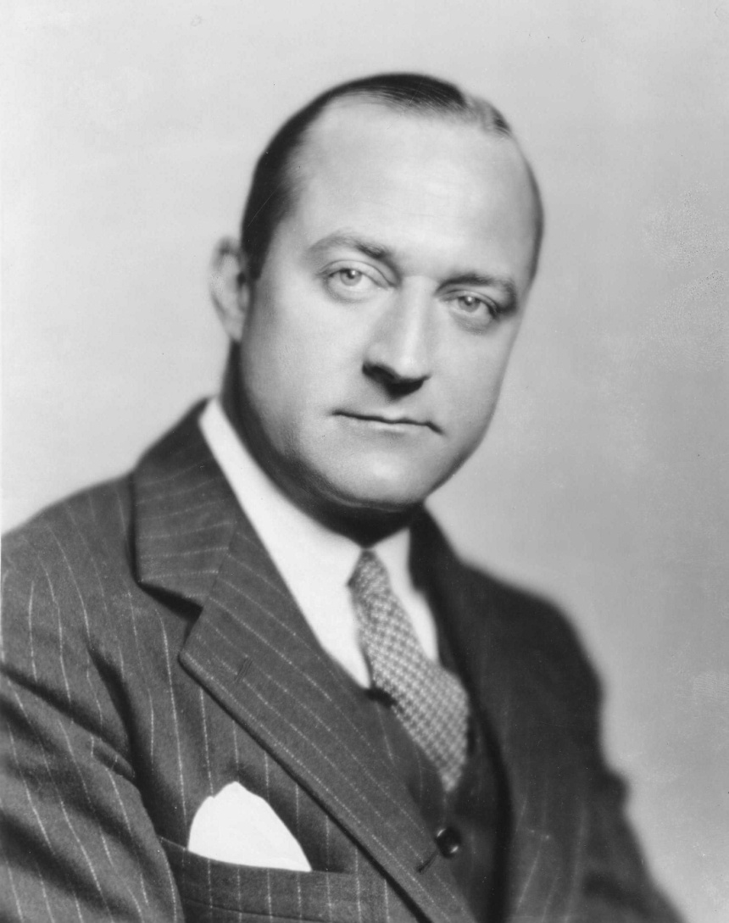
Henry Hazlitt (1894-1993)
Wall Street Journal, New York Times, Newsweek, the Nation
Organized support for Mises
Economics in One Lesson (1946) and the “broken window fallacy”
The Freeman (1950)

Slide 9
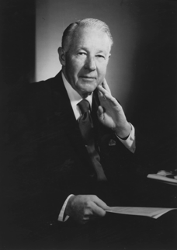
Leonard Read (1898-1983)
LA and national Chamber of Commerce
Foundation for Economic Education (1946)
“I, Pencil”

Slide 10
Summary
Classical liberal advocates of laissez-faire an essential foundation of modern libertarianism
Worked to build institutions and associations after WWII

