Slide 1
Lecture 18: Literary Conservatives
Liberty Classroom: History of Conservatism and Libertarianism

Slide 2
Overview
Christopher Dawson
T.S. Eliot
The Inklings

Slide 3
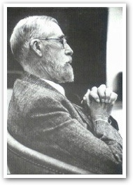
Christopher Dawson (1889-1970)
Cultural historian, faculty at Exeter, Edinburgh, Harvard
Age of the Gods
Progress and Religion
Religion and Culture
Dynamics of World History
Crisis of Western Education

Slide 4
Christopher Dawson (1889-1970)
Metahistory: big themes, especially religion’s impact on culture
Rehabilitates Middle Ages
Critique of classical liberalism

Slide 5
Christopher Dawson (1889-1970)
Influence
  Huge in mid-20th century
  T.S. Eliot
  C.S. Lewis
  Russell Kirk
Drops after Vatican II
Brad Birzer: Sanctifying the World

Slide 6
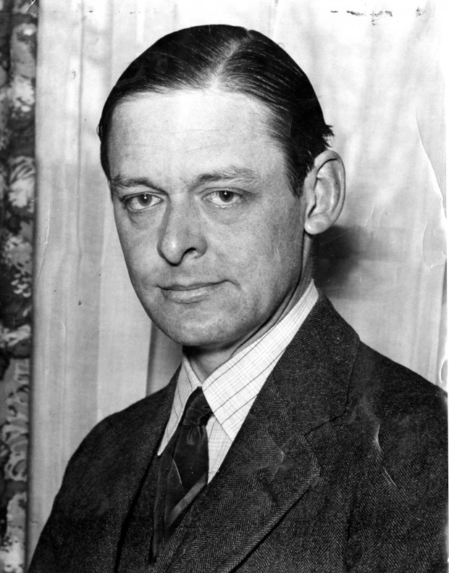
T.S. Eliot (1888-1965)
USA ➔ Britain
Modernist poet
  “Love Song of J. Alfred Prufrock”
  “The Waste Land”
  “The Hollow Men”
  “Ash Wednesday”
Plays: Murder in the Cathedral
Nobel Prize in 1948

Slide 7
T.S. Eliot (1888-1965)
Literary and cultural critic
  “Tradition and the Individual Talent”
  The Idea of a Christian Society
  Christianity and Culture
  Notes Towards the Definition of Culture

Slide 8
Inklings
Informal circle of Oxford writers, 1920-1950s
Met weekly at Magdalen College and the Eagle and Child pub
Focus on imaginative literature

Slide 9
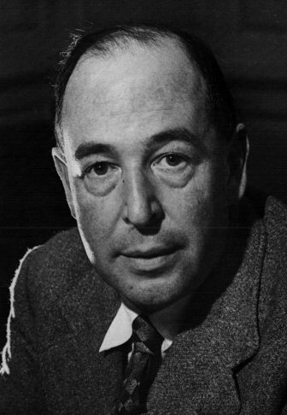
C.S. Lewis (1898-1963)
Oxford & Cambridge: Medieval & Renaissance literature
Christian apologist
  Pilgrim’s Regress
  Mere Christianity
  Abolition of Man

Slide 10
C.S. Lewis (1898-1963)
Imaginative Literature
  Screwtape Letters
  Space Trilogy
  Chronicles of Narnia
  Till We Have Faces
Advocated organic, traditionalist approach to politics

Slide 11
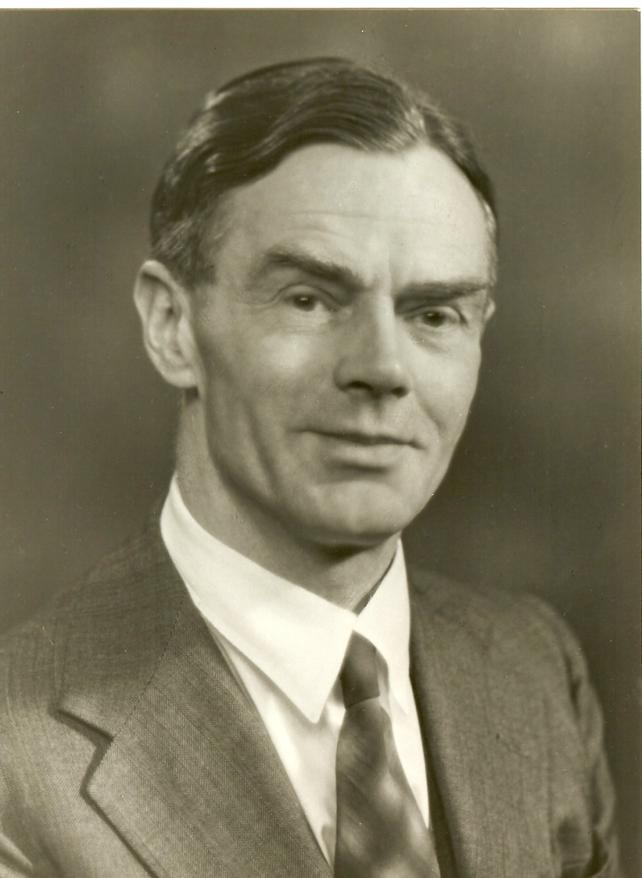
Owen Barfield (1898-1997)
Poet, author, solicitor
Rudolf Steiner and Anthroposophy
  Poetic Diction
  Worlds Apart
  Saving the Appearances

Slide 12
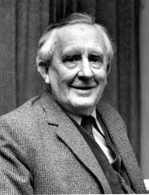
J.R.R. Tolkien (1892-1973)
Oxford Professor of Anglo-Saxon
  Beowulf
  Sir Gawain and the Green Knight
Middle-earth
  The Hobbit
  The Lord of the Rings
  The Silmarillion
Traditionalist anarchist

Slide 13
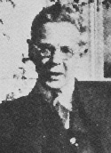
Charles Williams (1886-1945)
Editor at OUP
Philosophical-theological novels
  War in Heaven
  Descent into Hell
  All Hallows’ Eve
Theology of romantic love: Figure of Beatrice

Slide 14
Summary
Dawson, Eliot, and the Inklings articulated conservative visions of history and society
  Anti-modern
  Traditionalist
  Christian

