Slide 1
Lecture 17: Anglo-American Politics to Churchill
Liberty Classroom: History of Conservatism and Libertarianism

Slide 2
Overview
Impact of World War I
Collapse of classical liberalism
Fascism and the New Deal
Winston Churchill and World War II

Slide 3
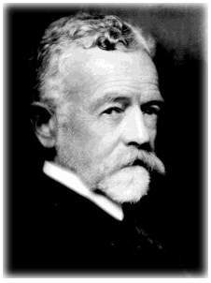
World War I and Ideology
Woodrow Wilson and David Lloyd George
Conservative postwar attitudes
  Henry Cabot Lodge and the League of Nations
  Doubts about British Empire

Slide 4
Fate of Classical Liberalism
Britain
  British public blamed Liberals for the war
  1922 election: Conservatives win, Labour gains, Liberals fade
  Labour replaces Liberals as major party
USA
  Progressive influence on both major parties
  Conservative and classical liberal convergence

Slide 5
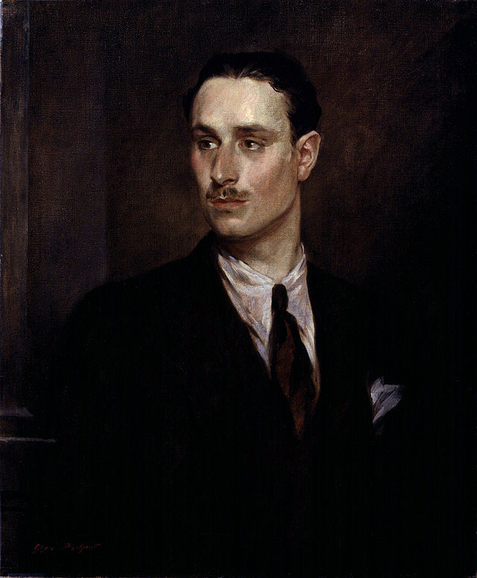
Fascism
Fascism: Left or Right?
Oswald Mosley (1896-1980) and the BUF
Fr. Charles Coughlin and Social Justice
Seward Collins and the American Review

Slide 6
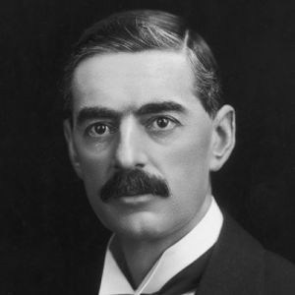
Anti-War Conservatives
British policy of appeasement
  Stanley Baldwin
  Neville Chamberlain
  Popular support
U.S. isolationism
  Smoot-Hawley tariff
  Charles Lindbergh and the America First Committee

Slide 7
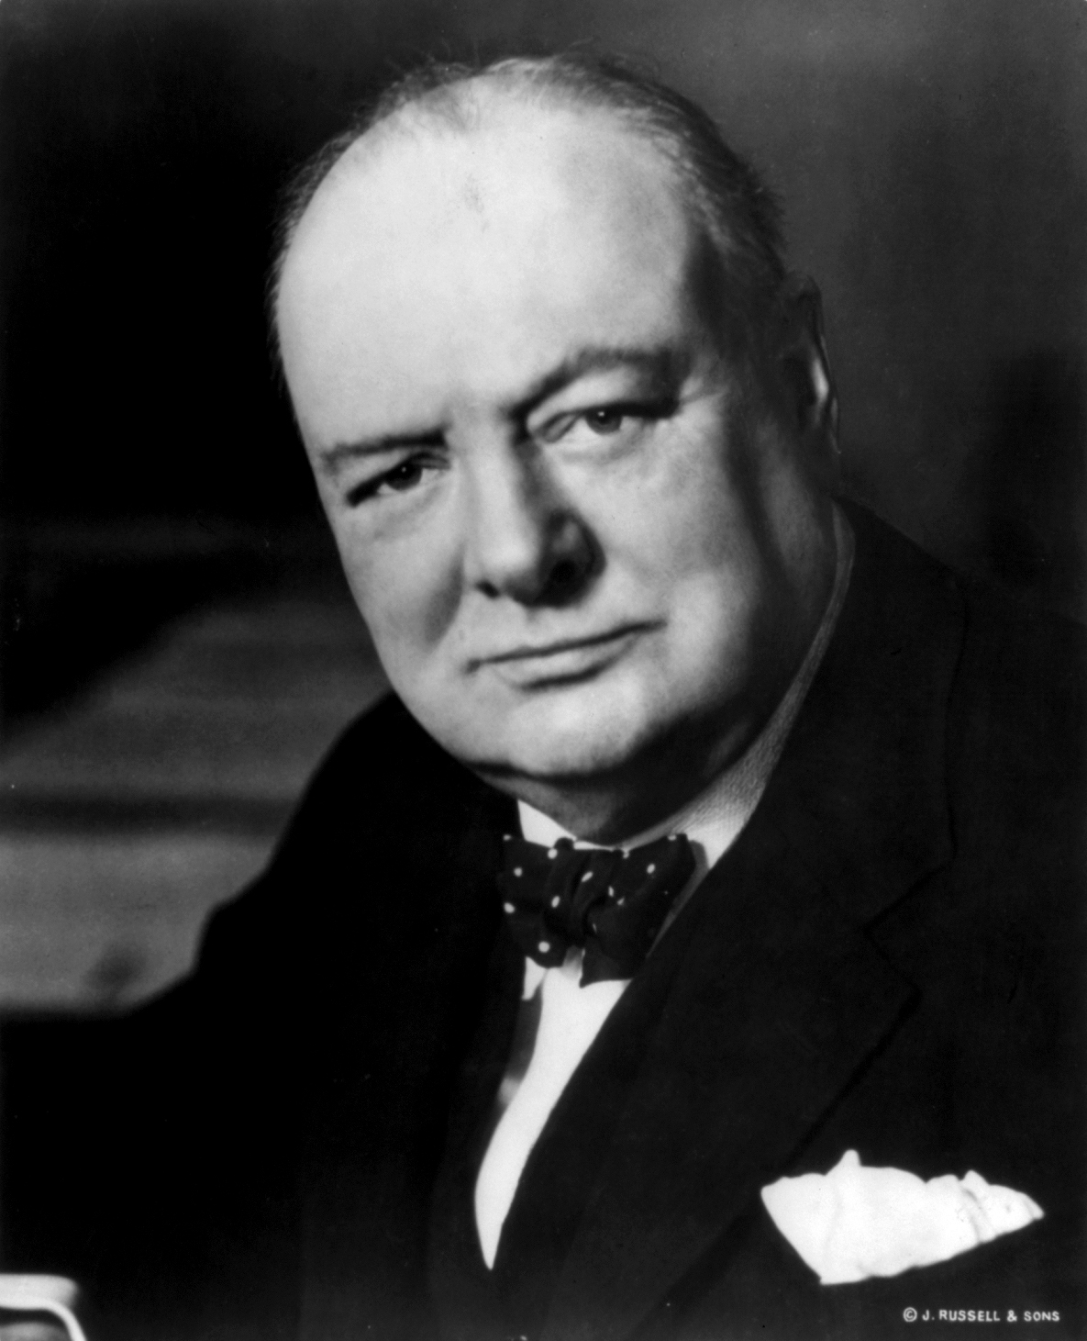
Winston Churchill (1874-1965)
Descendant of John Churchill, first Duke of Marlborough
Gained fame as a war correspondent in Cuba, Afghanistan, Sudan, and South Africa
MP from 1900

Slide 8
Winston Churchill (1874-1965)
1904: Conservatives ➔ Liberals
Protégé of Lloyd George
1st Lord of the Admiralty before WWI

Slide 9
Winston Churchill (1874-1965)
World War I
  Gallipoli campaign
  Western Front
  Munitions
Championed USSR intervention in 1919
1924: Liberals ➔ Conservatives

Slide 10
Winston Churchill (1874-1965)
Chancellor of Exchequer: gold standard
“Wilderness” years
Edward VIII
Argued against appeasement of Hitler, Indian independence

Slide 11
Winston Churchill (1874-1965)
1st Lord of Admiralty again
PM upon Chamberlain’s resignation (5/40)
Battle of Britain
Out as PM in 1945

Slide 12
Assessment of Churchill
“Man of the Century”?
  All comes down to 1940
Revisionist view (Raico, Buchanan)
  Poor judgment throughout career
  Urged Polish war guarantee
  Provoked Nazi invasion of Norway in 1940
  Refusal to negotiate led to tens of millions of deaths for questionable gains
  Complicit in war crimes, ethnic cleansing

Slide 13
Summary
Conservatism and classical liberalism converge in U.S., but classical liberalism fades in Britain
Conservatives mostly favor peace to 1939
Churchill the hawkish conservative archetype

