Slide 1
Lecture 16: Nock and Mencken
Liberty Classroom: History of Conservatism and Libertarianism

Slide 2
The Old Right
Eclectic group of anti-New Dealers
Garet Garrett
John T. Flynn

Slide 3
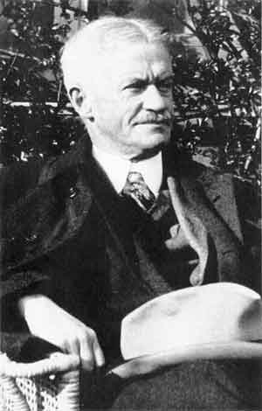
Albert Jay Nock (1870-1945)
Writer for the Nation, founded the Freeman (1920-1924)
Association with W.J. Bryan, Georgists
Liberal ➔ “radical”

Slide 4
Albert Jay Nock (1870-1945)
Jefferson (1926)
Essays
  On Doing the Right Thing (1928)
  Snoring as a Fine Art (1958)
Memoirs of a Superfluous Man (1943)

Slide 5
Albert Jay Nock (1870-1945)
The Theory of Education in the United States (1932)
Our Enemy, the State (1935)
  State vs. Society
  Impact of New Deal
  Economic means vs. political means
“Isaiah’s Job” (1936)

Slide 6
Nock’s Influence
Frank Chodorov
Leonard Read
Russell Kirk
William F. Buckley
Murray Rothbard

Slide 7
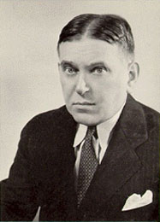
H.L. Mencken (1880-1956)
“American Voltaire”
Helped make Baltimore a literary center
The Philosophy of Friedrich Nietzsche (1908)
American Mercury (1924-1933)

Slide 8
H.L. Mencken (1880-1956)
Role in the Scopes Trial (1925)
Social criticism
  “Babbittry” and the “booboisie”
  Prohibition
  American myth: Lincoln, John Brown

Slide 9
H.L. Mencken (1880-1956)
“Tory anarchism”
Government as a conspiracy against superior men
“Sahara of the Bozart”

Slide 10
Mencken’s Influence
Lost influence during the Depression
Mainstream historians, e.g., Richard Hofstadter
R. Emmett Tyrell
Murray Rothbard

Slide 11
Summary
Nock and Mencken
  Consistent individualist philosophy
  Criticized the State
  Criticized the masses
  Nock favors high culture, Mencken an all-around skeptic

