Slide 1
Lecture 15: The New Humanists
Liberty Classroom: History of Conservatism and Libertarianism

Slide 2
Overview
Naturalism and progressivism
Irving Babbitt
Paul Elmore More
Other New Humanists and their influence

Slide 3
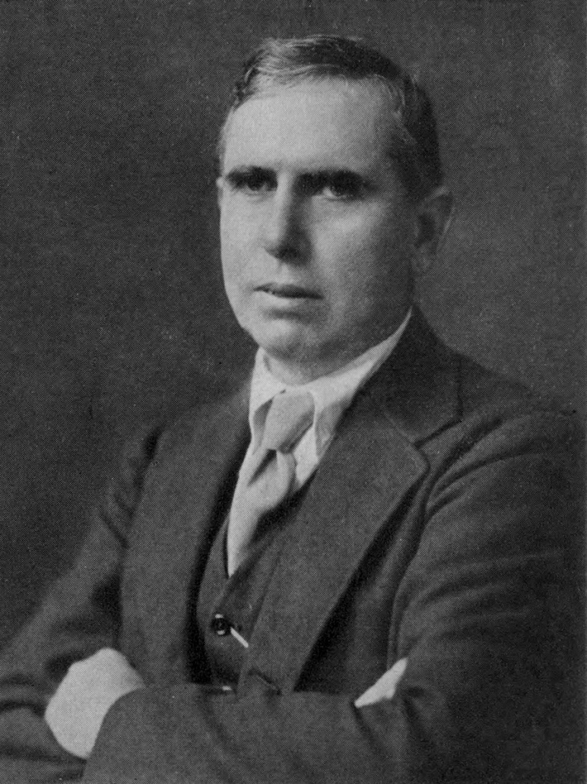
Naturalism
George Becker: “pessimistic materialistic determinism”
Scientific detachment
Environment shapes characters

Slide 4
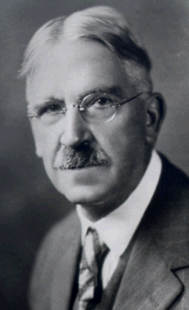
Progressivism
American pragmatism
John Dewey and utuilitarian educational theory

Slide 5
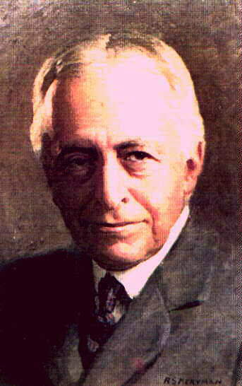
Irving Babbitt (1865-1933)
Harvard professor of literature
  Critic of elective system
  Literature and the American College (1908)
Humanism vs. Humanitarianism

Slide 6
Irving Babbitt (1865-1933)
Critiques of romanticism and naturalism: “emotional naturalism”
Rousseau and Romanticism (1919)

Slide 7
Irving Babbitt (1865-1933)
Follower of Burke and the moral imagination, critic of democracy
Democracy and Leadership (1924)

Slide 8
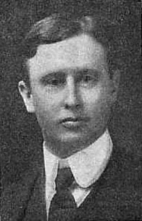
Paul Elmer More (1864-1937)
Editor of the Nation, Princeton professor
Scholar of Platonic and patristic philosophy
Shelburne Essays (1904-1921) and New Shelburne Essays (1928-1936)

Slide 9
Paul Elmer More (1864-1937)
Aristocracy and Justice
The Sceptical Approach to Religion
Themes
  Natural aristocracy
  “New Morality”
  Philosophical & religious dualism

Slide 10
More New Humanists
Stuart Pratt Sherman (1881-1926)
  Essayist: The Genius of America (1923)
  Feud with H.L. Mencken
Norman Foerster (1887-1972)
  The American State University (1937)
  Edited Humanism and America (1930)

Slide 11
Influence
T.S. Eliot
Russell Kirk
Peter Viereck
George Will

Slide 12
Summary
New Humanists preserve conservative focus on high culture
Champions of tradition and the Western heritage in the Progressive era
Significant influence on many later conservative thinkers

