Slide 1
Lecture 14: Distributism and Agrarianism
Liberty Classroom: History of Conservatism and Libertarianism

Slide 2
Overview
Tenets of distributism
Major distributists
Tenets of agrarianism
I’ll Take My Stand

Slide 3
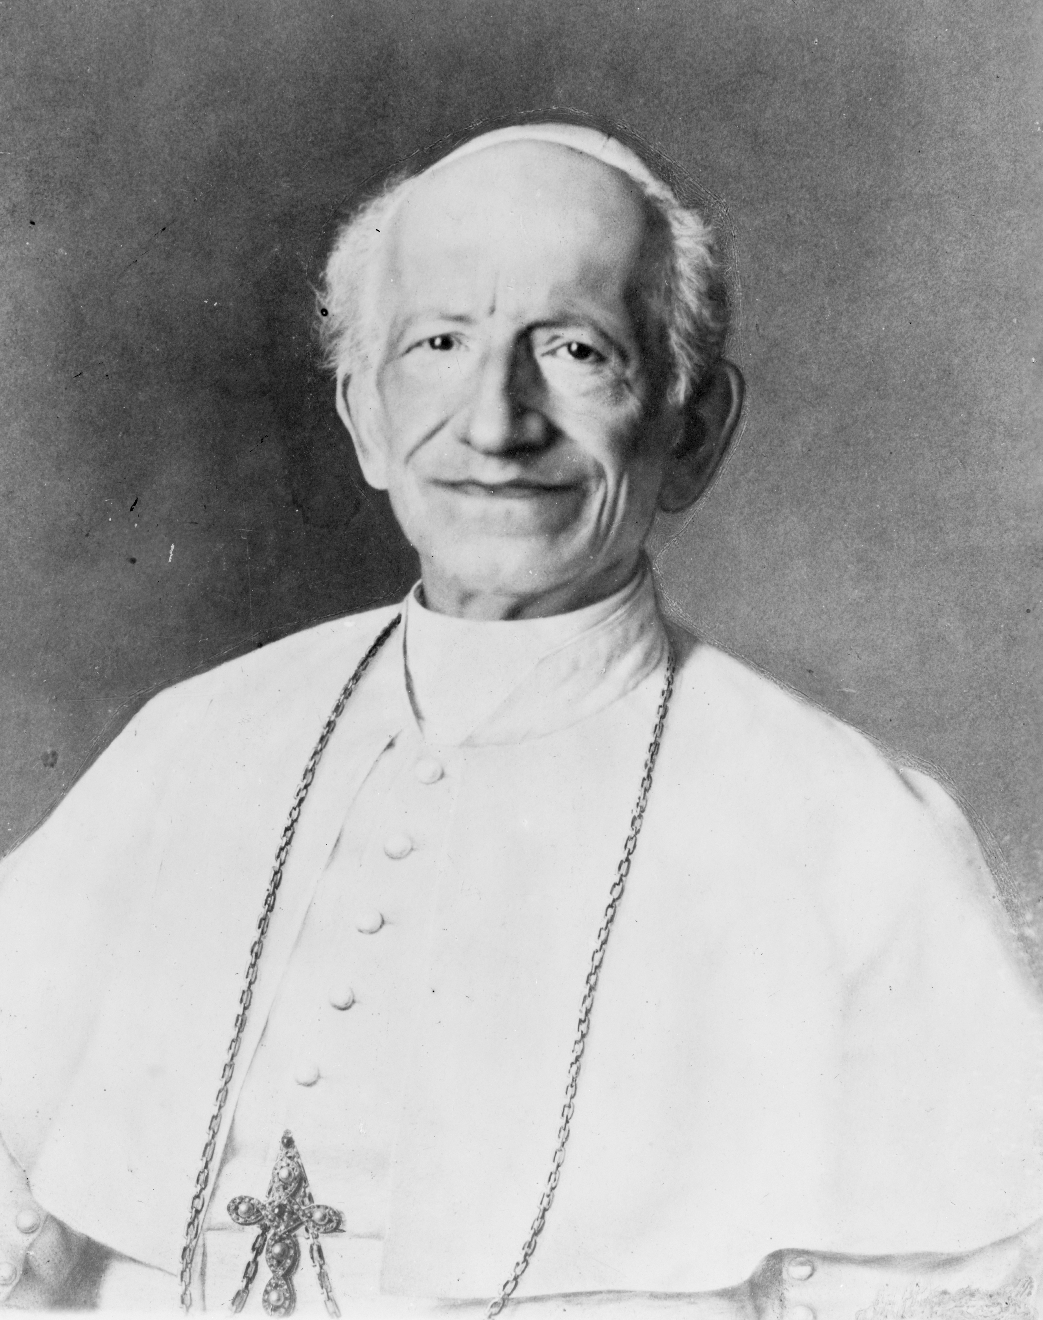
Catholic Social Teaching
Rerum novarum (1891)
Quadragesimo anno (1931)
Stress on virtue, mutual obligations of social groups
Acknowledges role of the State

Slide 4
What Is Distributism?
Economic system compatible with CST
Rejects political and economic centralization
Widest possible distribution of property ownership
Subsidiarity

Slide 5
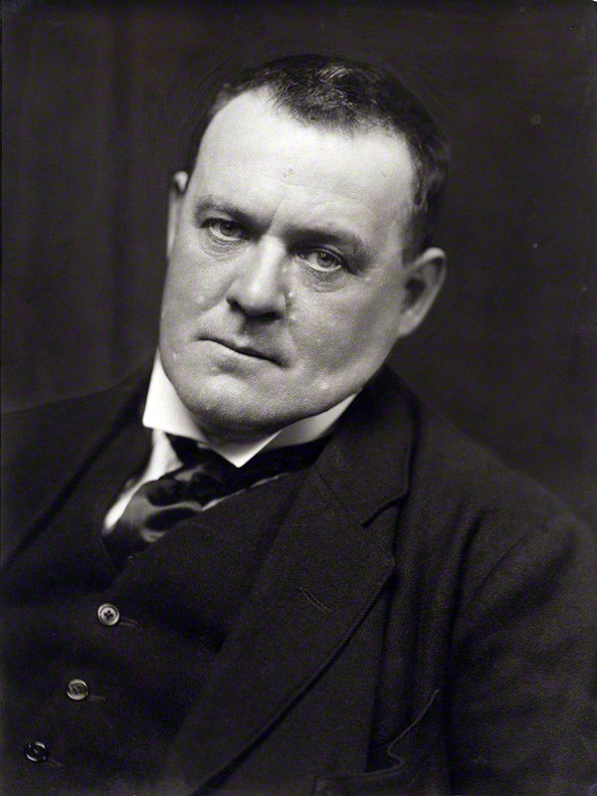
Hilaire Belloc (1870-1953)
Oxford Union, MP
Historical works
  Bios of Charles II, James II
  The Servile State
  Europe and the Faith
Attacked Whig history

Slide 6
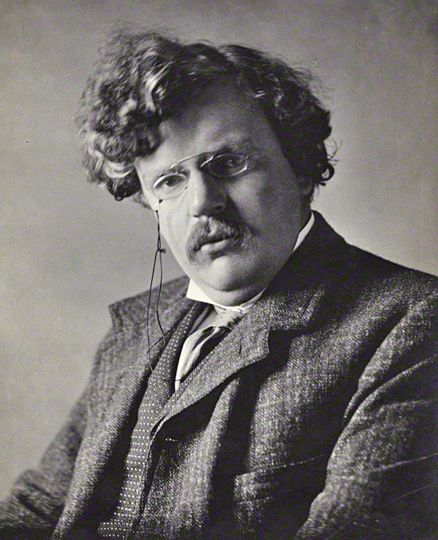
G.K. Chesterton (1874-1936)
Celebrated fiction and poetry
  Father Brown stories
  The Man Who Was Thursday
  Lepanto
  The Napoleon of Notting Hill

Slide 7
G.K. Chesterton (1874-1936)
Nonfiction works
  Bio of Thomas Aquinas
  The Everlasting Man
  Heretics
  Orthodoxy
  The Outline of Sanity
“Democracy of the dead”

Slide 8
More Distributists
Fr. Vincent McNabb: The Church and the Land
Arthur Penty: Guilds, Trade and Agriculture
Herbert Agar: Land of the Free
E.F. Schumacher: Small is Beautiful

Slide 9
What Is Southern Agrarianism?
Attempt to preserve and nurture positive aspects of Southern life
  Social stability
  Rural character
  Culture prizing the “higher things”
Resisted industrialism, preoccupation with material well-being

Slide 10
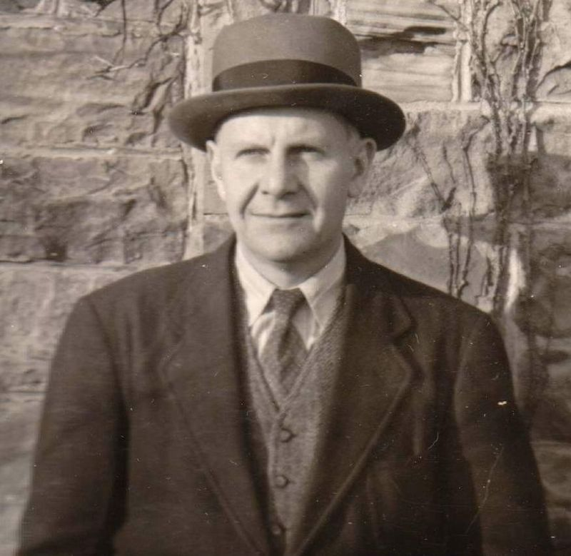
Southern Agrarians
John Crowe Ransom (1888-1974)
  Vanderbilt
  The Fugitive
  God without Thunder
  “New Criticism”

Slide 11
I’ll Take My Stand
Twelve Southerners
  Ransom: “Reconstructed but Unregenerate”
  Donald Davidson: “A Mirror for Artists”
  Andrew Lytle: “The Hind Tit”
  Frank Owsley: “The Irrepressible Conflict”
  Robert Penn Warren: “The Briar Patch”

Slide 12
Joining Forces
Who Owns America? (1936)
  Edited by Herbert Agar (distributist) and Allen Tate (agrarian)
  Distributist contributors: Belloc, Agar et al
  Agrarian contributors: Ransom, Davidson, Owsley, Tate, Lytle, etc.
American Review (1933-1937)

Slide 13
Summary
Distributism an adaptation of Catholic Social Teaching
Southern Agrarianism an attempt to preserve distinctiveness of the South

