Slide 1
Lecture 13: American Conservatives and Liberals, 1860-1914
Liberty Classroom: History of Conservatism and Libertarianism

Slide 2
Overview
Conservatism and the War
“Southern Tradition at Bay”
“Conservatism Frustrated”

Slide 3
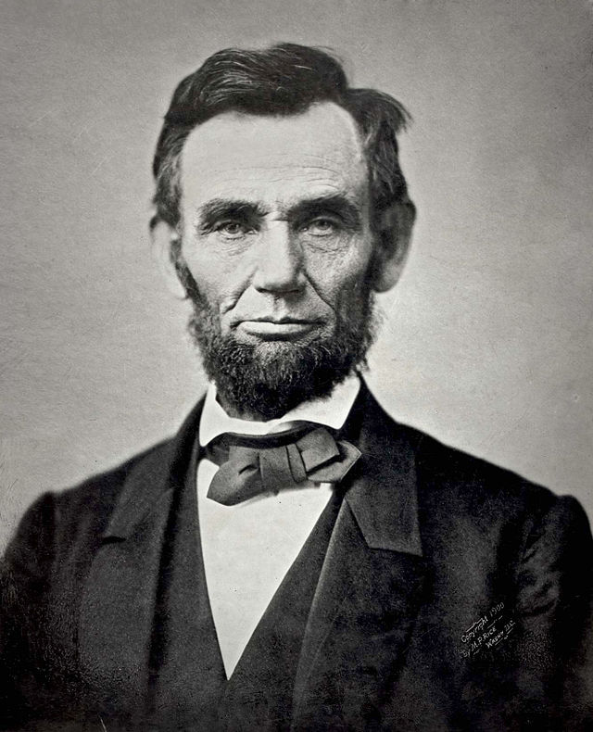
Conservatism and the War
War between two kinds of conservatism?
Was Lincoln conservative?
Kirk on Lincoln

Slide 4
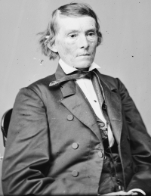
Postwar South
Devastation of the war
Ku Klux Klan
Apologia in treatise and fiction
  Legal arguments
  Attacks on secularism
  Soldiers’ testimony
  Race theory

Slide 5
Postwar South: “Lost Cause”
Thesis: North wasn’t the virtuous victor
Albert Taylor Bledsoe: Is Davis a Traitor?
Edward Albert Pollard: The Lost Cause

Slide 6
Postwar South: “Lost Cause”
Alexander Stephens: A Constitutional View of the Late War Between the States
Jefferson Davis: Rise and Fall of the Confederate Government

Slide 7
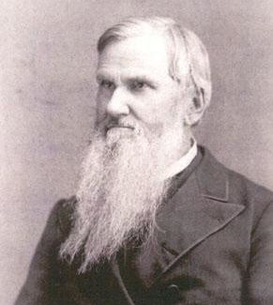
Postwar South: Anti-Secularism
Thesis: North an outgrowth of French Revolution
R.L. Dabney
  Stonewall Jackson bio
  Defence of Virginia

Slide 8
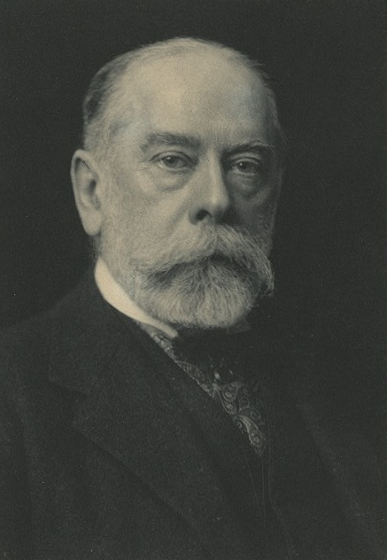
Mugwumps
Kirk on Northern conservatives after 1865
Edwin L. Godkin (1831-1902) and the Nation
William Graham Sumner (1840-1910)
  Herbert Spencer (1820-1903)
  “The Forgotten Man”
  What Social Classes Owe to Each Other

Slide 9
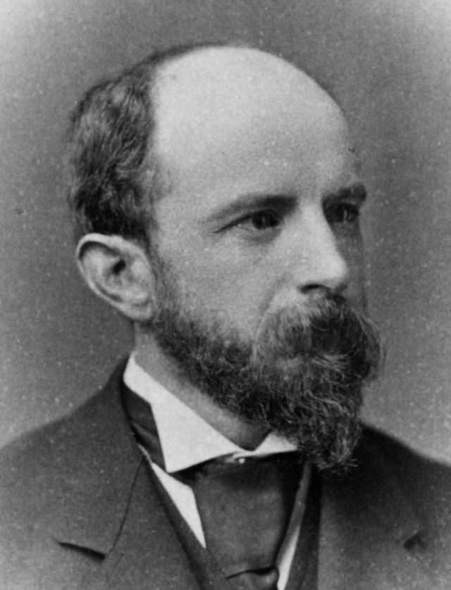
Mugwumps
Brooks Adams (1848-1927): The Law of Civilization and Decay
Henry Adams (1838-1918)
  Works on U.S. history
  Education of Henry Adams
  Mont St. Michel & Chartres

Slide 10
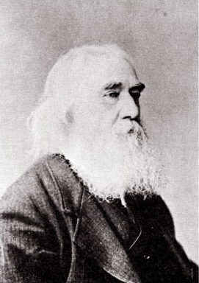
Anarchists
Josiah Warren (1798-1874)
Lysander Spooner (1808-1887)
Benjamin Tucker (1854-1939)
Casey: FP II, 41-43

Slide 11
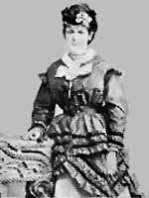
Women’s Suffrage
Terms of debate
  Men and women are fundamentally different
Would suffrage improve political tone or degrade women?
Helen Kendrick Johnson (1844-1917): Woman and the Republic

Slide 12
Summary
Role of conservatism in 1861-1865
Southern postwar intellectual energy went into defenses of its antebellum society
Northern convergence of conservatism and classical liberalism

