Slide 1
Lecture 12: British Liberalism, 1848-1914
Liberty Classroom: History of Conservatism and Libertarianism

Slide 2
Overview
Turn from laissez-faire
William E. Gladstone
Irish Home Rule
Parliamentary Reform

Slide 3
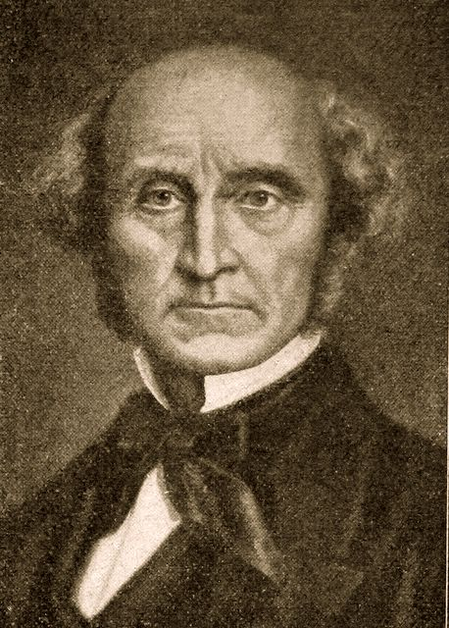
Turn from Laissez-Faire
J.S. Mill’s deviations
  Production vs. distribution
  Trade not liberty
  Foreign intervention
  No harmony of interests
Raico and Raeder on Mill

Slide 4
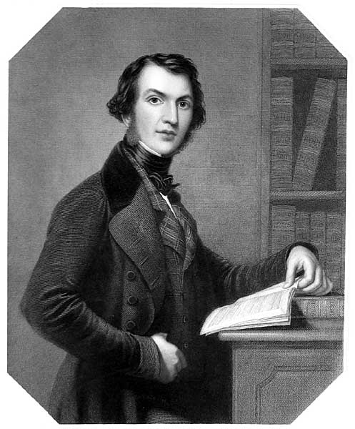
William E. Gladstone (1809-1898)
Classical scholar, devout Protestant
Early career
  High Tory MP (from 1832)
  Opposed abolition
The State in Its Relations with the Church (1838)

Slide 5
William E. Gladstone (1809-1898)
Peel Ministry (1841-1846)
  Coal Vendors Act
  Maynooth Grant
Led Peelites after Peel’s death

Slide 6
William E. Gladstone (1809-1898)
Chancellor of Exchequer in coalition (1852-1855)
  Lowered tariffs
  Extended income tax & lowered threshold
  Doubled income tax to pay for Crimean War

Slide 7
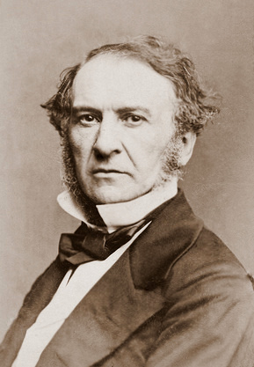
William E. Gladstone (1809-1898)
Joined new Liberal Party in 1859
Chancellor of Exchequer (1859-1866)
  Raised income tax again, then lowered it
  More tariff reduction
  Publicly supported Confederate independence

Slide 8
William E. Gladstone (1809-1898)
Leader of Liberals from 1867
Great Ministry (1868-1874)
  Reduced national debt
  Lowered income tax
  Poor Law reform
  Disestablished Church of Ireland
  Pro-peace foreign policy
  Military reforms
  Education Act

Slide 9
William E. Gladstone (1809-1898)
Second Ministry (1880-1885)
  Reform Bill of 1884
  Employers’ Liability Act
  Repression in Ireland
Home Rule (1886, 1893)
  Liberal split
  Defeat in Lords
Fought rearmament

Slide 10
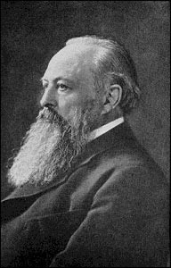
Lord Acton (1834-1902)
Catholic historian, Liberal MP, ally of Gladstone
Edited The Rambler after Newman; issues with R.C. hierarchy
Cambridge professor from 1895

Slide 11
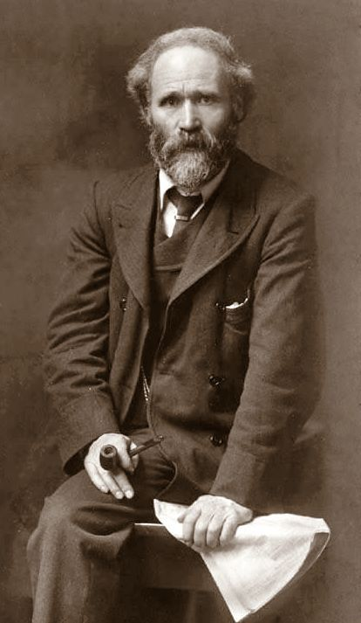
Response to Labour
Labour Party threatened Liberal working-class support
Stable class system increased class consciousness
Keir Hardie (1856-1915)

Slide 12
Response to Labour
Liberal/Labour alliance in 1906; welfare payoff
“People’s Budget” of 1909; Lords reject
Parliament Act of 1911
Home Rule stalls when WWI begins

Slide 13
Summary
Liberals gradually turn from laissez-faire
Gladstone a pivotal figure
  Pro-peace, reduced taxes
  Gradually increased intervention elsewhere
Liberals try to co-opt Labour by offering welfare legislation

