Slide 1
Lecture 11: British Conservatism, 1848-1914
Liberty Classroom: History of Conservatism and Libertariansim

Slide 2
Overview
Benjamin Disraeli
Imperialism
Salisbury and Balfour

Slide 3
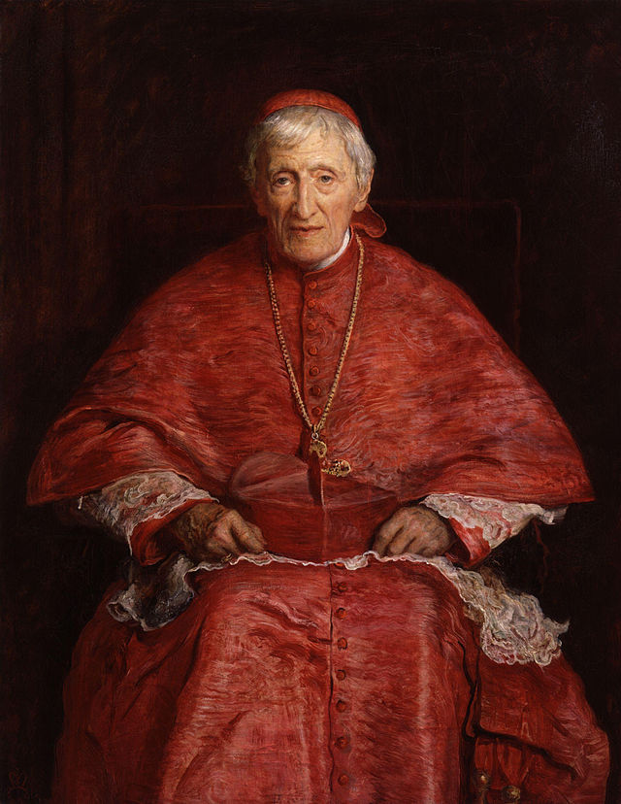
Romantic Conservatives
Vision of traditional society
  Semi-feudal order
  Strong monarchy
  Established Church
  Noblesse oblige
Oxford Movement (Tractarianism)
Young England

Slide 4
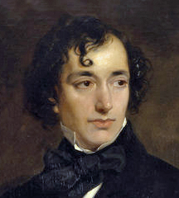
Benjamin Disraeli (1804-1881)
Judaism ➔ Anglican
Radical ➔ Tory
Vindication of the English Constitution (1835)
Novels: Coningsby, Sybil, Tancred

Slide 5
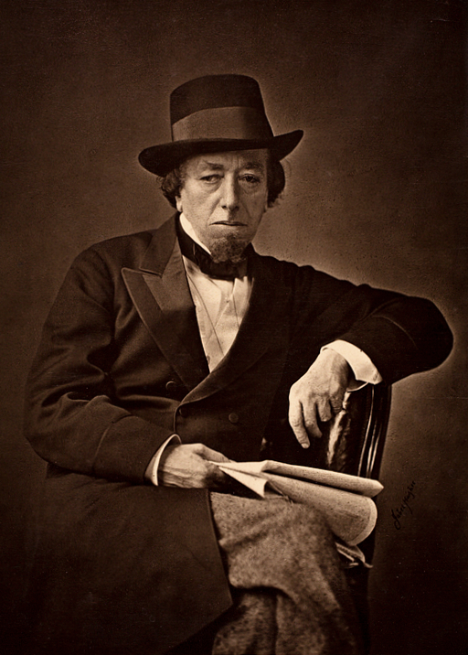
Benjamin Disraeli (1804-1881)
Tory MP from 1837
Broke with Peel in 1846
Helped fill “New” Tories’ leadership vacuum

Slide 6
Benjamin Disraeli (1804-1881)
Earl of Derby’s lieutenant
Reform Act of 1867
First premiership (1868)
  Public executions
  Nationalization
  Church of Ireland

Slide 7
Benjamin Disraeli (1804-1881)
Opposition leader, 1868-1874
  Lothair (1870)
  Wife’s death
Second premiership (1874-1880)
  Earl of Beaconsfield (1876)

Slide 8
Disraeli and Empire
Jingoism
Suez interest (1875)
Royal Titles Act
Congress of Berlin (1878)
Afghan Intervention
Zulu War (1879)

Slide 9
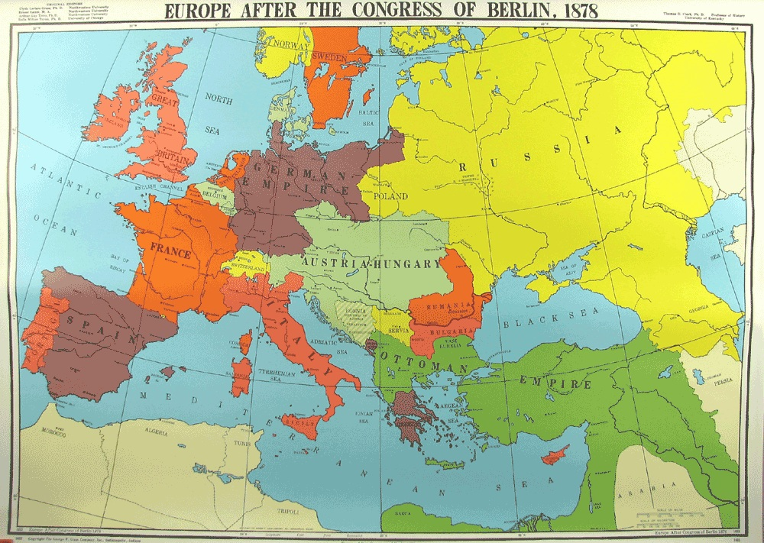
Congress of Berlin (1878)

Slide 10
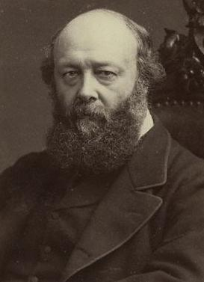
Post-Disraeli Conservatism
Robert Cecil, Marquess of Salisbury (1830-1903): PM 1885-1886, 1886-1892, 1895-1902
Arthur Balfour (1848-1930): PM 1902-1905

Slide 11
Post-Disraeli Conservatism
Empire
  “Splendid Isolation”
  Scramble for Africa
  Boer War
  Conservatives => Unionists
Joseph Chamberlain and “tariff reform”

Slide 12
Summary
Disraeli a pivotal figure
  Appeal to working class
  Stress on empire
Social and foreign policy questions over economic theory

