Slide 1
Lecture 10: Continental Conservatives and Liberals, 1848-1914
Liberty Classroom: History of Conservatism and Libertariansim

Slide 2
Overview
Liberalism and Religion
Marx’s Challenge
Conservative nationalism
Anarchism

Slide 3
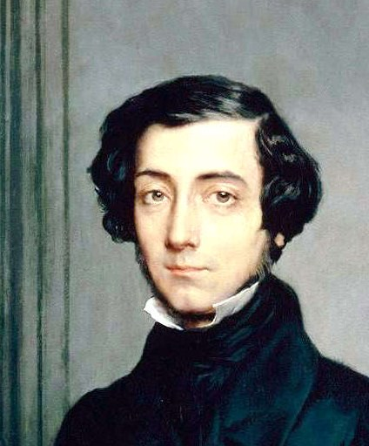
Liberalism & Religion
Is classical liberalism hostile to religion?
Religious toleration & disestablishment
Rationalism & anticlericalism
Dreyfus Affair (1894-1906)

Slide 4
Liberalism & Religion
Raico on religious liberals
  Benjamin Constant (1767-1830)
  Alexis de Tocqueville (1805-1859)
  Lord Acton (1834-1902)

Slide 5
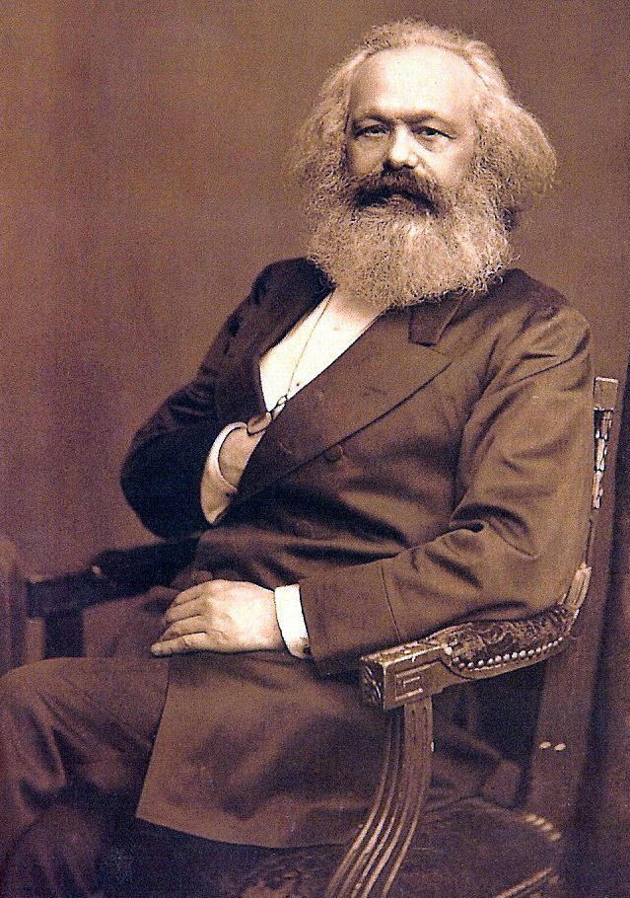
Challenge of Marxism
Most rigorous form of socialism
Rise of working-class politics, e.g., Social Democrats
Relation to liberal heritage (class analysis, value theory)
Casey: FP II, 30-33

Slide 6
Responses to Socialism
Theoretical replies
Attempts at repression
Attempts at co-opting
Defense of property makes strange allies

Slide 7
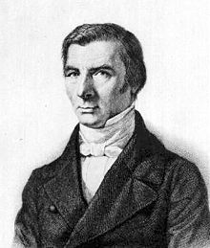
Frédéric Bastiat (1801-1850)
Businessman, landowner, legislator, ally of Cobden
Economic Sophisms (1844)
The Law (1850)
What Is Seen and What Is Unseen” (1850)

Slide 8
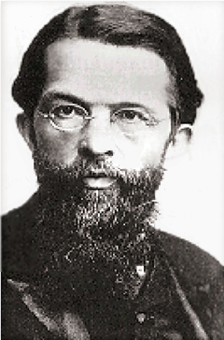
Marginal Revolution
Labor theory of value ➔ subjective theory of value
William Stanley Jevons (1835-1882)
Léon Walras (1834-1910)
Carl Menger (1840-1921)

Slide 9
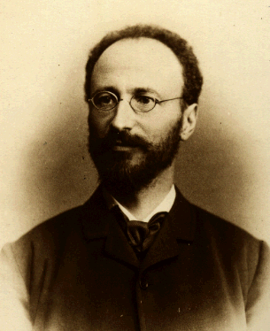
Austrian School
Friedrich von Wieser (1851-1926)
  “Marginal utility”
  “Opportunity cost”
Eugen von Böhm-Bawerk (1851-1914)
  Capital and Interest (3 vol., 1884-1890)
  Karl Marx and the Close of His System 1896)

Slide 10
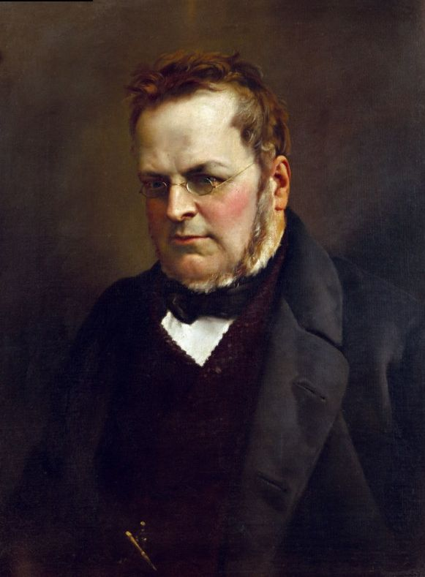
Conservative Nationalism
Failure of liberal nationalism in 1848
Italian Unification (1861-1870)
German Unification (1864-1871)

Slide 11
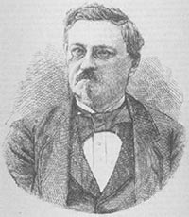
Classical Anarchists
Pierre-Joseph Proudhon (1809-1865)
Mikhail Bakunin (1814-1876): anarcho-collectivism
Pyotr Kropotkin (1842-1921): anarcho-syndicalism
Gustave de Molinari (1819-1912) and “The Production of Security” (1849)
Casey: FP II, 37-40

Slide 12
Summary
Liberalism often, not always in tension with religion
Advent of Marxism and mass politics evokes new arguments and tactics
Nationalism more closely identified with conservatism

