Slide 1
Lecture 9: Northern Conservatives and Liberals, 1800-1860
Liberty Classroom: History of Conservatism and Libertariansim

Slide 2
Overview
Abolitionism
Cultural conservatism
Bank crisis
Whig Party

Slide 3
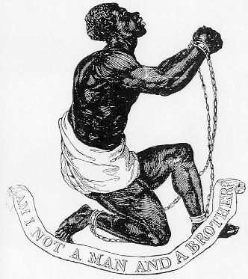
Abolitionism
Arguments
Theological
Humanitarian
Economic

Slide 4
Abolitionism
British anti-slavery from 1780s
William Wilberforce
1807 – Slave Trade Act
1833 – Slavery Abolition Act
Peaceful emancipations elsewhere (TWS 302)

Slide 5
Abolitionism
Northern emancipation, 1777-1804; slaves sold “down the river”
1807 – Act Prohibiting Importation of Slaves
ACS, Free Soil, etc.

Slide 6
Abolitionism
Social Reformers
William Lloyd Garrison & the Liberator (1831)
Frederick Douglass & Narrative (1845)
Harriet Beecher Stowe & Uncle Tom’s Cabin (1852)

Slide 7
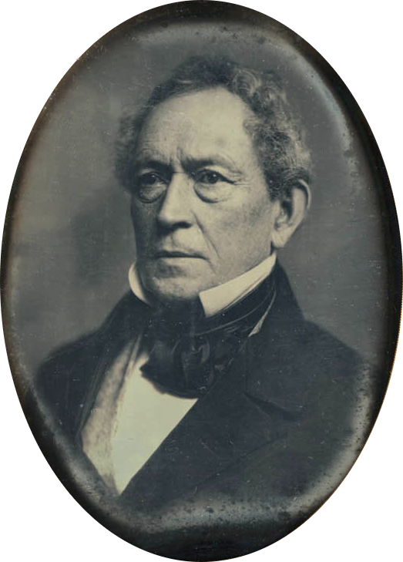
Cultural Conservatism
Import British/Euro civilization
Edward Everett (1794-1865)
Alexis de Tocqueville’s Democracy in America (1835, 1840)

Slide 8
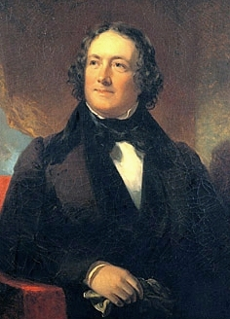
Bank Crisis
Second Bank of the United States
Symbol of class conflict
Andrew Jackson vs. Nicholas Biddle (Gutzman, Con. 18)

Slide 9
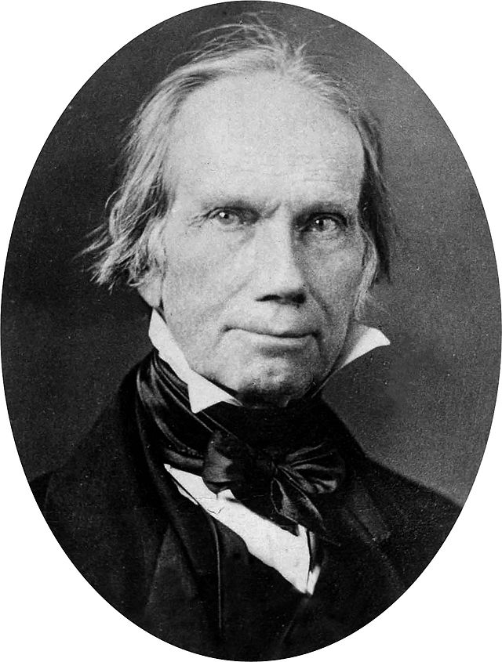
Whig Party
Anti-Jackson party
Hierarchy
Social stability (but not traditional society)
Centralized power (in Congress)
Henry Clay (1777-1852) & the “American System”

Slide 10
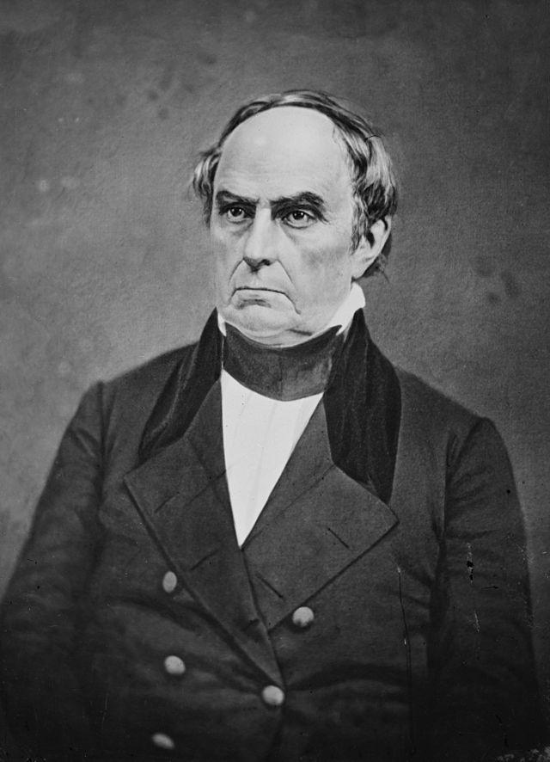
Nature of Union
Nationalist narrative
John Marshall (1755-1835)
Joseph Story (1779-1845)
Webster-Hayne Debates (1830)

Slide 11
Summary
Abolitionism the most radical expression of liberalism
Cultural conservatives question mass culture
Andrew Jackson a pivotal figure
Northern conservatives more nationalist, statist

