Slide 1
Lecture 8: Southern Conservatives and Liberals, 1800-1860
Liberty Classroom: History of Conservatism and Libertariansim

Slide 2
Overview
U.S. vs. Europe
Defense of traditional (American) society
  Agrarian
  Decentralized
  Slavery
Free trade & Anti-slavery

Slide 3
U.S. and Europe
U.S. situation increasingly diverging from European situation in particulars
  No monarchy or federally established church
  Industrialization not as prominent as in W. Eur.
U.S. conservatives still value tradition, hierarchy
Liberal ideas: free trade, anti-slavery, democracy

Slide 4
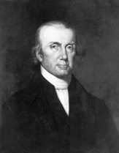
Virtuous Farmers
Jefferson on the farmer
John Taylor of Caroline (1753-1824) and Arator
Expansionist
  Louisiana Purchase
  War of 1812

Slide 5
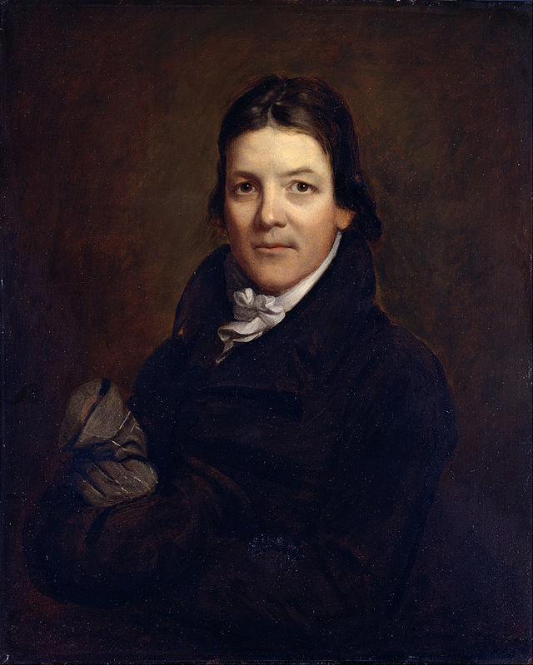
Southern Aristocracy
Feudal/gentry tradition
Code of chivalry
Classical education
Orthodox religion

Slide 6
Strict Construction
John Randolph of Roanoke (1773-1833)
  Anti-expansion (McClanahan, Con. 17)
  On internal improvements
John Taylor of Caroline
  Construction Construed
  Tyranny Unmasked
  Stressed institutional constraints vs. private virtue

Slide 7
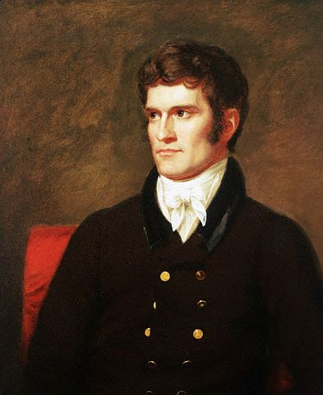
Nullification
“Principles of ‘98”
John C. Calhoun (1782-1850)
  Congress, VP
  “Tariff of Abominations”
  South Carolina Exposition and Protest
  Disquisition on Government
  Gutzman, Con. 18
Later nullifiers

Slide 8
Slavery Defended
Southerners’ mixed feelings on slavery
  Ubiquity in world history
  Racial component of Southern slavery
  Inherited problem in 1776/1787
  Obstacles to manumission in South
  Proposals for gradual emancipation
Prominent southerners & their slaves
  George Washington
  Thomas Jefferson
  John Randolph
  Robert Carter III

Slide 9
Slavery Defended
Rise of abolitionism
Positive defenses
  Slavery consistent with Christianity—high standards for both slaves & masters (Genovese)
  Slavery more humane than free labor
    Emancipation would be cruel
    George Fitzhugh: expand slavery to whites

Slide 10
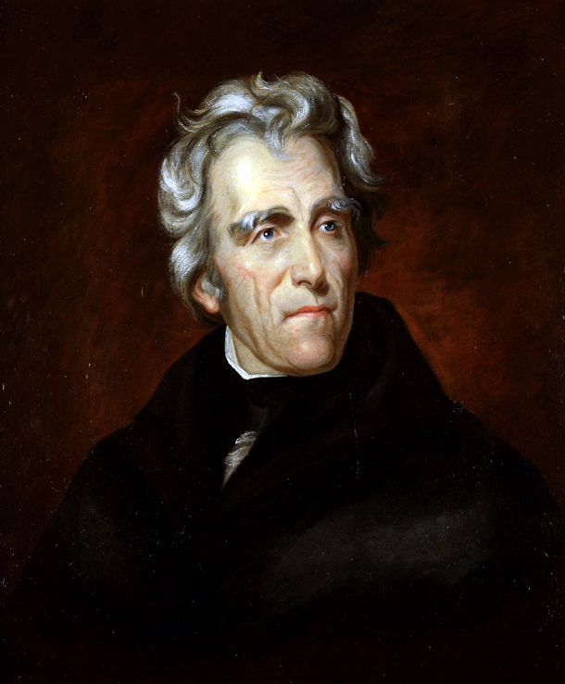
Jacksonian Democracy
Parallel to British democratic tendency
Erosion of Electoral College (Holcombe)
Populist resentment of elite privilege
“King Mob”

Slide 11
Summary
Southern conservatives and traditional society
Strict construction for conservative and liberal ends
Necessary preoccupation with slavery
Democratic tendencies as in Britain

