Slide 1
Lecture 7: British Liberalism, 1800-1848
Liberty Classroom: History of Conservatism and Libertariansim

Slide 2
Overview
Utilitarianism
Liberalism and political economy
Liberalism and democracy

Slide 3
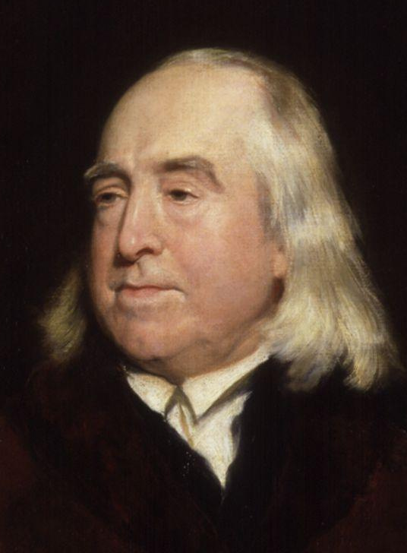
Utilitarianism
Jeremy Bentham (1748-1832)
Social utility
Introduction to the Principles of Morals and Legislation (1789)
Hedonistic calculus

Slide 4
Utilitarianism
Recommended liberal policies
  Free trade
  Civil liberties
  Legal equality of women
Scott: Bentham as bad as Jacobins

Slide 5
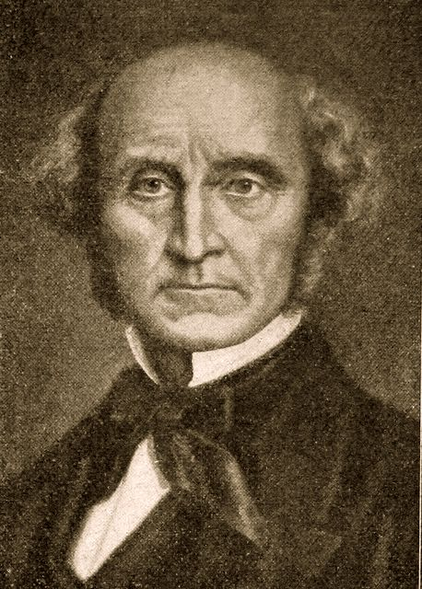
Utilitarianism
James Mill (1773-1836)
  B.E.I.C. official
  Bentham’s ally
John Stuart Mill (1806-1873)
  Utilitarianism
  Higher/lower happiness
  Religion of humanity

Slide 6
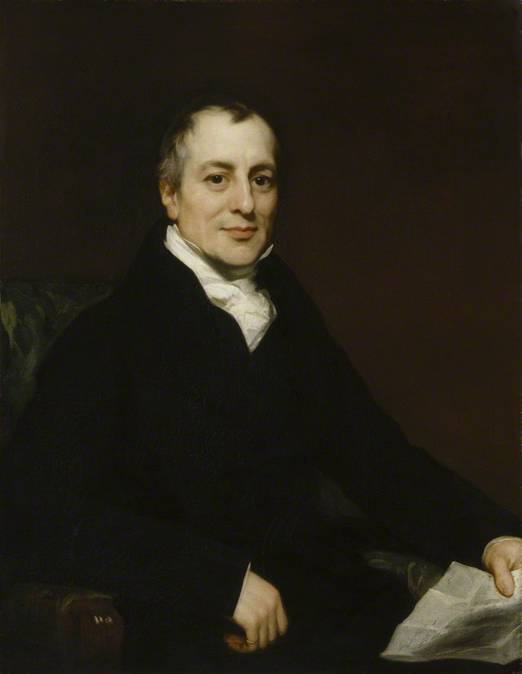
Classical Economists
Adam Smith
David Ricardo (1772-1823)
  Principles of Political Economy and Taxation (1817)
  Comparative advantage

Slide 7
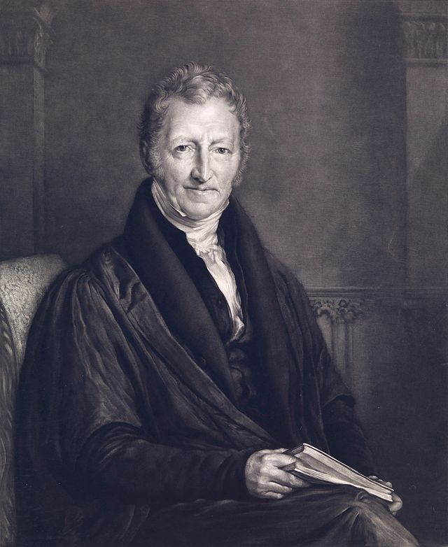
Classical Economists
Thomas Malthus (1766-1834)
Essay on the Principle of Population (1798)
“Iron Law of Wages”
James & J.S. Mill

Slide 8
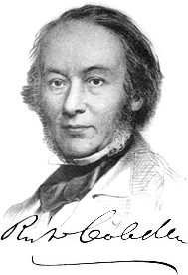
Manchester Liberalism
Richard Cobden (1804-1865) & John Bright (1811-1889)
Anti-Corn Law League (1838-1846)
Cobden-Chevalier Treaty (1860)
Raico on Cobden

Slide 9
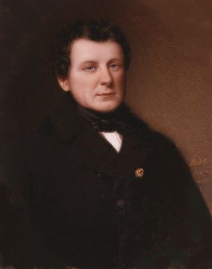
Catholic Emancipation
Anti-Catholicism and British identity
Daniel O’Connell
Roman Catholic Relief Act of 1729

Slide 10
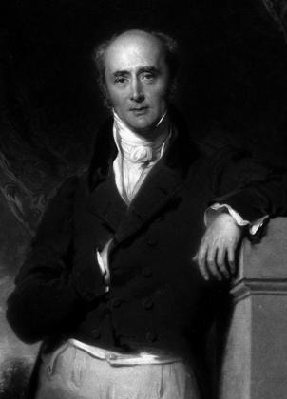
Reform Act of 1832
Liberal support for democracy
Charles Grey (1764-1845) and Whig ministry, 1830-1834
  Reform Act
  Abolition of slavery

Slide 11
Chartism
Democratic movement, 1830-1850s
Key planks
  Universal manhood suffrage
  Secret ballot
  Salary, no property qualification for MPs
  Equal constituencies
  Annual elections

Slide 12
Summary
Utilitarian philosophy resulted in liberal prescriptions.
Classical economists favored liberal tax/trade policies.
Liberals favored democratic reforms as a means of reducing privilege.

