Slide 1
Lecture 6: British Conservatism, 1800-1848
Liberty Classroom: History of Conservatism and Libertariansim

Slide 2
Overview
Relationship to continental conservatism
Romanticism and conservatism
Toryism ➔ Conservatism
Robert Peel and pragmatic conservatism

Slide 3
British and Continental Conservatism
Overlap of concerns
  Support for monarchy and social position of aristocracy and gentry
  Support for established church
  Fear of revolution
“Peterloo Massacre” (1819)

Slide 4
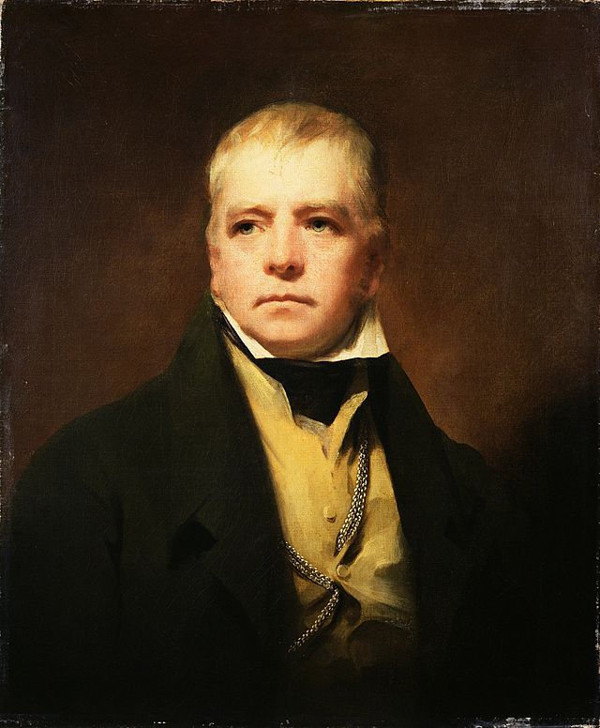
Romantic Conservatism
Overview of Romanticism
Sir Walter Scott (1771-1832)
  Novels “enflesh” Burke’s traditionalism
  Waverley novels
  Medieval novels
  Anti-utilitarian

Slide 5
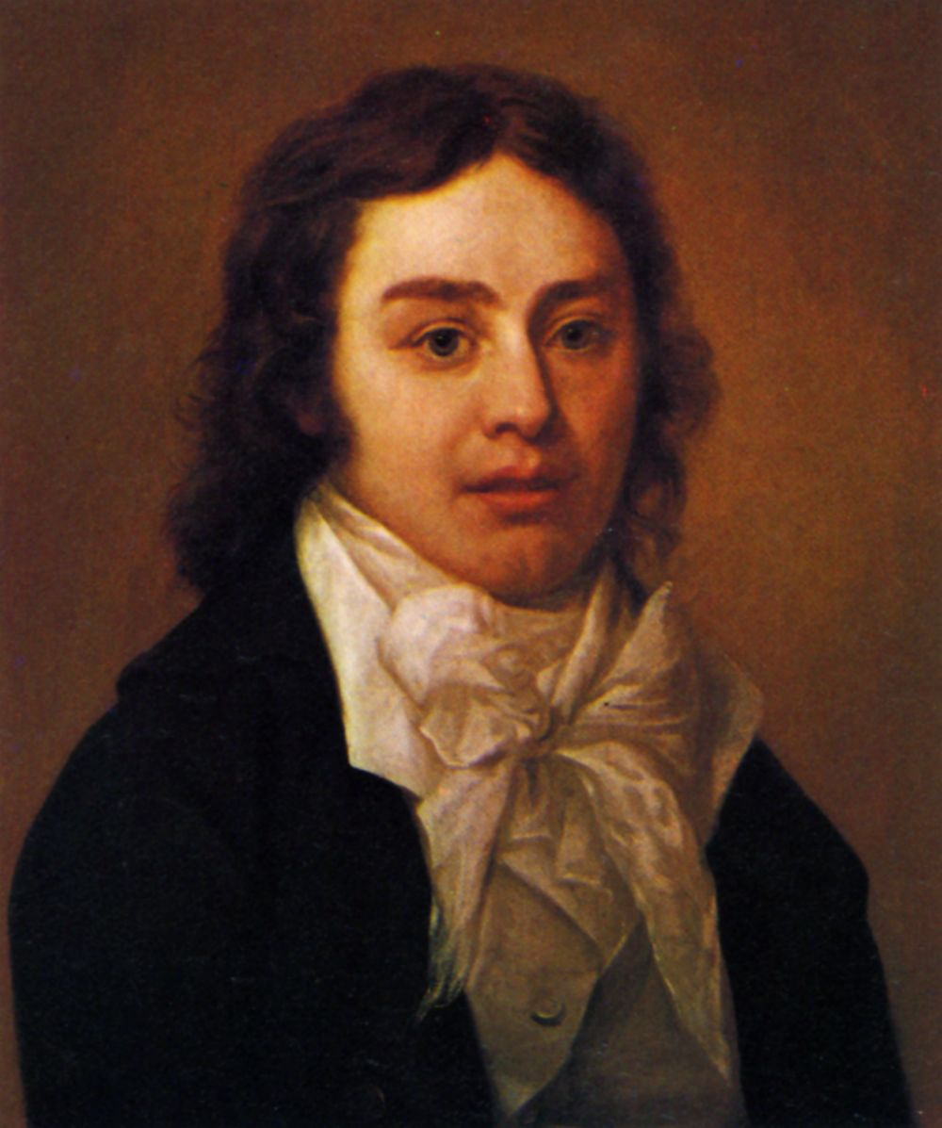
Romantic Conservatism
William Wordsworth (1770-1850)
  Abandoned support for French Revolution
Samuel Taylor Coleridge (1772-1834)
  Constitution of Church and State (1830)

Slide 6
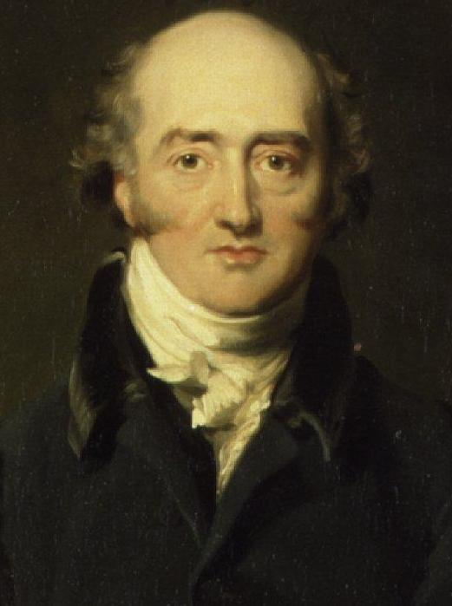
George Canning (1770-1827)
Editor of the Anti-Jacobin (1797-1798)
Rose under Pitt
Catholic Emancipation
“Old Tory” resistance
Kirk on Canning

Slide 7
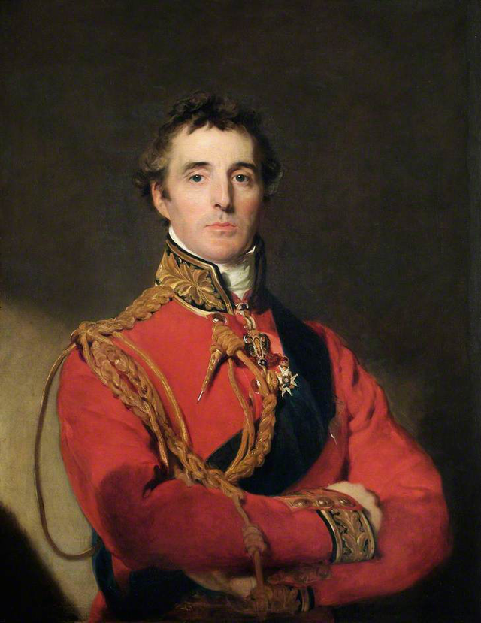
Duke of Wellington (1769-1852)
Arthur Wellesley
Hero of Waterloo
Prime Minister 1828-1830 and 1834
Catholic Emancipation

Slide 8
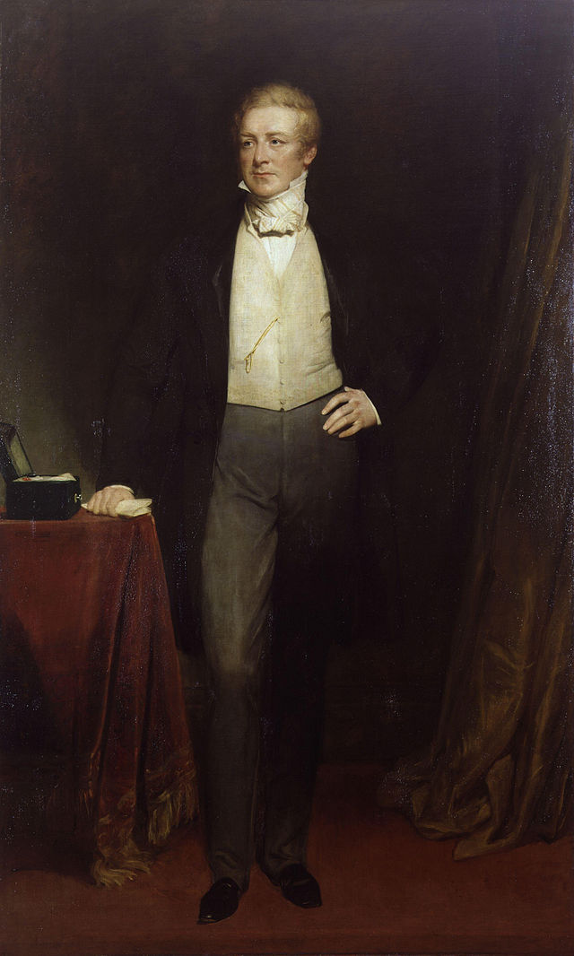
Robert Peel (1788-1850)
A.J.P. Taylor: Peel “created the modern Conservative Party on the ruins of the Old Toryism.”
Metropolitan Police
Commons leader under Wellington

Slide 9
Robert Peel (1788-1850)
Twice P.M. (1834-1835, 1841-1846)
Drew moderate Whigs after 1832
Concessions alienated many Conservatives, split party

Slide 10
Summary
Similar concerns to continental conservatives, but British constitutional system more flexible
Romantic conservatism & imagination
Preserve essentials of traditional order while making prudent concessions to zeitgeist

