Slide 1
Lecture 5: Continental Conservatism and Liberalism, 1800-1848
Liberty Classroom: History of Conservatism and Libertariansim

Slide 2
Overview
Gelling of conservatism and liberalism
Major thinkers
Post-Napoleonic reaction
Liberalism and nationalism

Slide 3
Impact of French Revolution
Destruction of ancien regime in France
War with the rest of Europe
Stimulated theoretical responses

Slide 4
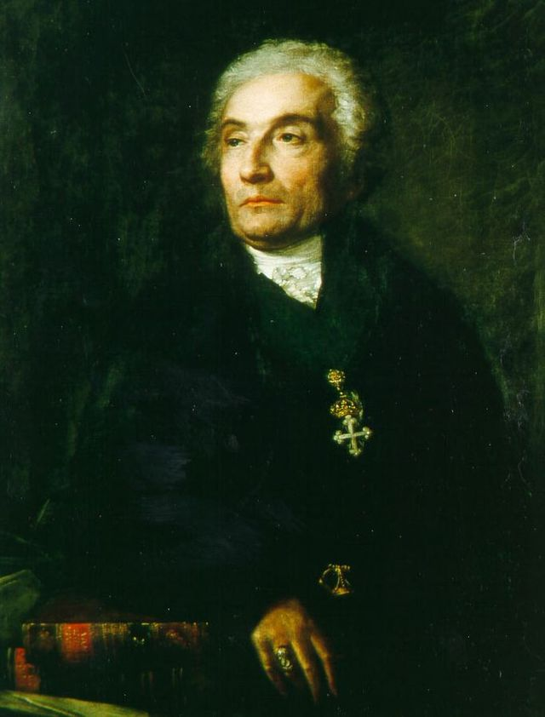
Joseph de Maistre (1753-1821)
Savoyard philosopher
“Counter Enlightenment”
Considerations on France (1797)
Essay on the Generative Principle of Political Constitutions (1809)

Slide 5
Joseph de Maistre (1753-1821)
Key ideas
  Monarchy & R.C. Church divine
  Unique role of France
  Revolution a providential judgment
  Constitutions come from God
  State unjustifiable on rational grounds
  Bourbon restoration

Slide 6
Congress of Vienna (1814-1815)
Begun at Napoleon’s first defeat; continued through the Hundred Days
Principles of settlement
  Compensation for victors
  Legitimacy (e.g., Bourbon restoration)
  Balance of power

Slide 7
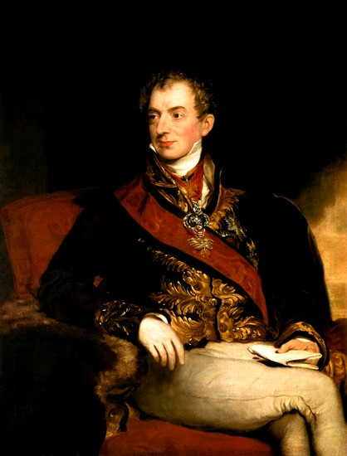
Klemens von Metternich (1773-1859)
Austrian foreign minister from 1809
Key figure at Congress of Vienna
Worked for stability, balance of power
“Age of Metternich”

Slide 8
Concert of Europe
Holy Alliance
  Austria, Prussia, Russia, minor powers
  Uphold monarchy and Christianity
Quadruple Alliance
  Austria, Prussia, Russia, Great Britain
  Uphold Vienna settlement, prevent revolutions
  France joins in 1818
  Counter-revolutionary measures

Slide 9
Conservative Domestic Policy
Aimed to restore pre-1789 conditions
Counter-revolutionary policies
  Carlsbad Decrees (1819) in German Confederation
  Decembrist Revolt (1825) in Russia

Slide 10
Liberalism and Revolution
Support for revolutions promising greater individual liberty
Greek revolt vs. Ottoman Empire (1820s)
July Revolution in France (1830)

Slide 11
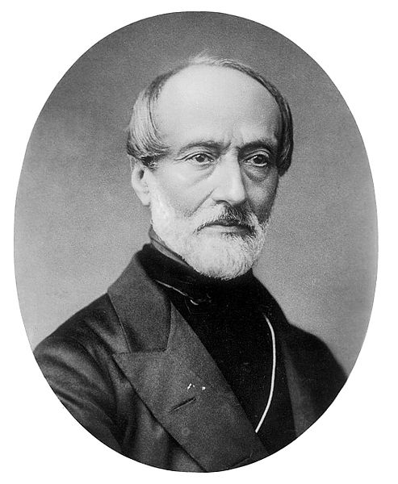
Liberalism and Nationalism
Johann Gottfried Herder’s tribalism vs. French nationalism
Benedict Anderson’s simultaneity
Liberal nationalism ascendant to 1848
  Burschenschaften
  Young Italy

Slide 12
Liberalism and Nationalism
Failure of liberal nationalism in 1848
  Frankfurt Parliament
  Giuseppe Mazzini in Rome
  Louis Kossuth in Hungary

Slide 13
Summary
French Revolution is the central event to which conservatives react.
Defenses of monarchy and established churches
Repressive measures against revolutionary ideas

Slide 14
Summary
Liberals attempt to preserve some of the French Revolution’s changes.
Liberal support for some revolutions
Liberal alignment with nationalism in central Europe

