Slide 1
Lecture 4: Roots (18th-c. America)
Liberty Classroom: History of Conservatism and Libertariansim

Slide 2
Overview
Caveat: Some U.S. history knowledge assumed
Constitutional theories, 1760s-1780s
Constitution: ratification debates
Federalist and Republican parties

Slide 3
Colonial Mind
Proud of “rights of Englishmen.”
  Heirs of Glorious Revolution and earlier English constitutional tradition
  Abstract “natural rights” not as influential
Drenched in classical history/literature
  Admired Roman Republic (not democracy)
  Cicero and Cato the Younger
  Washington and Cincinnatus

Slide 4
Colonial Dissatisfaction
“Salutary neglect”
French and Indian War (1754-1763) and Aftermath (Gutzman: AR 3)
  Proclamation of 1763
  Statutes of taxation
Can Parliament tax the colonies?
  Tax to regulate trade
  Tax for revenue

Slide 5
Loyalists
The most conservative Americans?
Numbers and socio-cultural position
Motivations
  Rejection of Patriot constitutional theories, e.g. contract theory of society
  Royal abuses more palatable than democratic abuses

Slide 6
Patriots
Many radicals (e.g., Thomas Paine)
Leadership more conservative
  Men of property wanting to preserve social order
  Viewed George III and Parliament as innovators
Declaration of Independence: radical and conservative? (Gutzman AR 11)

Slide 7
Philadelphia Convention
Articles of Confederation: success or failure?
Role of Shays’s Rebellion
Restraining democracy
  Monarchical and aristocratic elements (classical models)

Slide 8
Ratification Debates
Federalists and Anti-federalists: who are the conservatives?
Role of the Federalist
The Bill of Rights as an echo of 1688

Slide 9
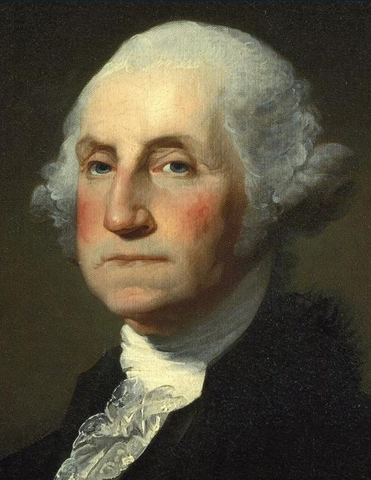
Washington & Federalist Party
Washington & presidential prestige (Cincinnatus again); Whiskey Rebellion
Alexander Hamilton: conservative?
John Adams: Alien/Sedition Acts

Slide 10
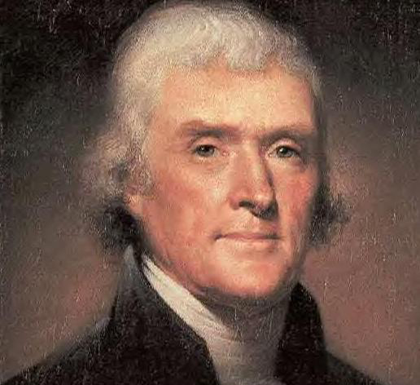
Jefferson and Republicans
Attitudes toward French Revolution
Virginia and Kentucky Resolutions (1798)
“Revolution of 1800”

Slide 11
Summary
Colonial Whiggism
Importance of Loyalists
“Conservatism” and “Liberalism” in the founding documents and earliest political parties

