Slide 1
Lecture 2: Roots of Conservatism (18th-c. Britain)
Liberty Classroom: History of Conservatism and Libertariansim

Slide 2
Whigs and Tories
Civil Wars and Restoration; Court/Country division
Exclusion Controversy (1679-1681)
  Whigs: pro-Exclusion
  Tories: anti-Exclusion
Impact of Glorious Revolution (1688)
  Parliamentary sovereignty (e.g., Triennial Act)
  Bill of Rights

Slide 3
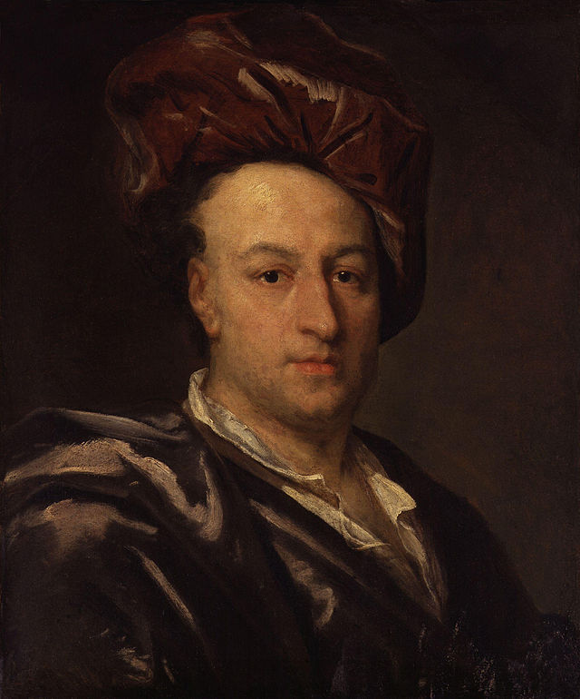
Bolingbroke
Henry St. John, Viscount Bolingbroke (1678-1751)
Jacobite Rebellion of 1715; return in 1723
Court/Country; essays for Craftsman
Influence: Voltaire, Adams

Slide 4
Bolingbroke
Family is the basic unit of society
Church of England
Realism in politics
Landed property = good; “moneyed interest” = bad

Slide 5
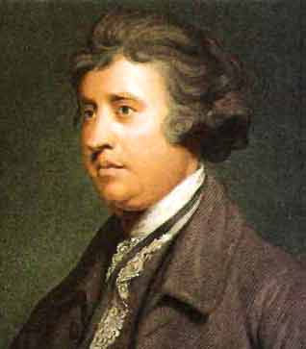
Edmund Burke (c. 1729-1797)
Whig M.P. from 1765
  Support for American colonists
  Impeachment of Warren Hastings
  Support for Ireland and Roman Catholics
Vindication of Natural Society (1756)
  Engages Bolingbroke
  Cf. Gerard Casey lecture (FP II, 22)

Slide 6
Edmund Burke (c. 1729-1797)
Reflections on the Revolution in France (1790)
  Political change must be gradual
  Society as organism
  Abstraction = bad; particular, concrete = good
  Prescription and prejudice
  Cf. Gerard Casey (FP II, 23-24)
Influenced conservatives and liberals

Slide 7
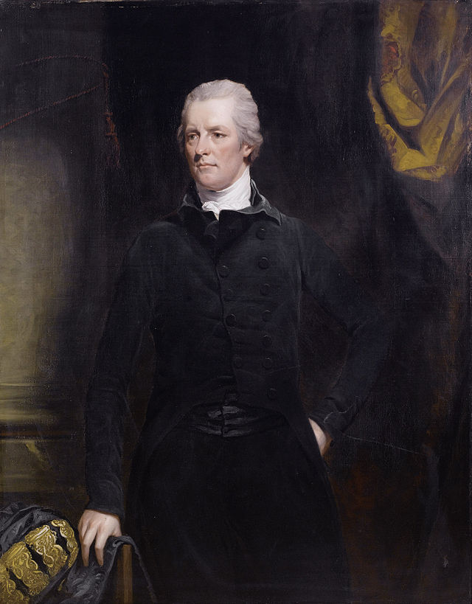
Pitt the Younger (1759-1806)
Youngest P.M.
Parliamentary reform
War with France
  Coalitions
  Irish Rebellion (1797)
  Act of Union (1800)

Slide 8
Pitt the Younger (1759-1806)
Fear of revolution
  Industrial Revolution
Repression
  Sedition laws
  Suspension of habeas corpus
  Ban on trade unions

