Slide 1
Lecture 1: Definitions and Foundations
Liberty Classroom: History of Conservatism and Libertariansim

Slide 2
Scope of Course
Chronological Treatment
  Roots in the 18th century and before
  19th century: conservatism and classical liberalism
  20th century: libertarianism

Slide 3
Scope of Course
Thematic Treatment
  Major political thinkers
  Ideas plus institutions
  Cultural attitudes

Slide 4
Definitions
Conservatism
Classical liberalism
Libertarianism

Slide 5
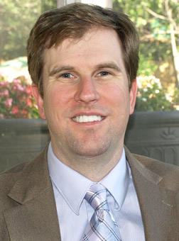

Jefferson a Conservative?

Slide 6
Jefferson a Conservative?
YES (McClanahan)
  Small-R republican
  Constitutionalist
  Federalist
  Agrarian
NO (Gutzman)
  Anti-Christian
  Anti-aristocratic
  Civil liberties
  Wide-ranging legal reforms

Slide 7
Conservatism Defined
“Conservatism is a philosophy that seeks to maintain and enrich societies characterized by respect for inherited institutions, beliefs and practices, in which individuals develop good character by cooperating with one another in primary, local associations such as families, churches and social groups aimed at furthering the common good in a manner pleasing to God.” (Bruce Frohnen, American Conservatism: An Encyclopedia)

Slide 8
Conservatism Defined
“Conservatism in politics is an attitude that favors cautious and prudential changes rather than opposing change at all costs.” (Patrick Allitt)
Conservatism defends “old modernity” against “new modernity.” (George Nash)

Slide 9
Classical Liberalism Defined
“‘Classical liberalism’ is the term used to designate the ideology advocating private property, an unhampered market economy, the rule of law, constitutional guarantees of freedom of religion and of the press, and international peace based on free trade.” (Ralph Raico, American Conservatism: An Encyclopedia)

Slide 10
Libertarianism Defined
“Libertarianism is the view that each person has the right to live his life in any way he chooses so long as he respects the equal rights of others.” (David Boaz, Libertarianism: A Primer)

Slide 11
Libertarianism Defined
“Libertarianism is a political philosophy. It is concerned solely with the proper use of force. Its core premise is that it should be illegal to threaten or initiate violence against a person or his property without his permission; force is justified only in defense or retaliation.” (Walter Block, “Libertarianism and Libertinism”)

Slide 12
Lecture Topics
18th-19th century foundations
Old Right
Distributism and Agrarianism
Anti-communism
Neoconservatism
Paleo movement
Ron Paul presidential campaigns
Current Issues

