Slide 1
Austrian Economics
Hampered Market Economy:
Booms and Busts 2

Slide 2
Hampered Market Economy
Topic 1: Booms and Busts
Claims that B-B Are Inherent to the UME
Psychological
Optimism leads to more spending which
generates a boom
• No additional money stock to bid prices up
• Decline in money demand will lead to
higher prices, but no overall
stimulus to production

Slide 3
Hampered Market Economy
Topic 1: Booms and Busts
Claims that B-B Are Inherent to UME
Psychological
Pessimism leads to less spending which
generates a bust
• No reduction in money stock to bid prices
down overall
• Rise in money demand will lead to lower
prices, but no overall
discouragement to production

Slide 4
Hampered Market Economy
Topic 1: Booms and Busts
Psych. Explanation of the Great Depression
1920s was sustainable economic progress
Investors became pessimistic: stock crash
Stock crash reduced wealth and thus spending
Reduced spending caused unemployment
Unemployment caused further cuts in spending
Downward spiral
War spending ended G.D.

Slide 5
Hampered Market Economy
Topic 1: Booms and Busts
Response to Psych. Exp. of the Great Depression
Markets balance pessimism and optimism
Were the 1920s sustainable?
Annualized return in DJIA
• 30%: 4/1924 – 10/1929
• 5%: 1/1900 – 1/2012
• 12%: 1/1950 – 1/1966
• 14%: 1/1981 – 1/2000
• 25%: 1/1995 – 1/2000

Slide 6
Hampered Market Economy
Topic 1: Booms and Busts
Response to Psych. Ex. of the Great Depression
Stock market declines of 50%, not uncommon
• DJIA fell from 103 (1/1906) to 53 (12/1908)
• DJIA fell from 120 (12/1919) to 64 (6/1921)
One day declines in DJIA have been bigger
• 13% fall (10/28/29); 12% fall (10/29/29)
• 10% fall (10/14/87-10/16/87)
23% fall (10/19/87)

Slide 7
Hampered Market Economy
Topic 1: Booms and Busts
Response to Psych. Ex. of the Great Depression
Overall decline of DJIA is not unprecedented
• 89% fall in DJIA (10/1929 to 6/1932)
• 78% fall in NASDAQ (3/2000 to 10/2002)
• 82% fall in Nikkei (12/1989 to 3/2009)

Slide 8
Hampered Market Economy
Topic 1: Booms and Busts
Response to Psych. Ex. of the Great Depression
Pessimism reversed early in 1930
• 48% fall in DJIA from 10/1929 to 11/1929
• 43% rise in DJIA from 11/1929 to 4/1930

Slide 9
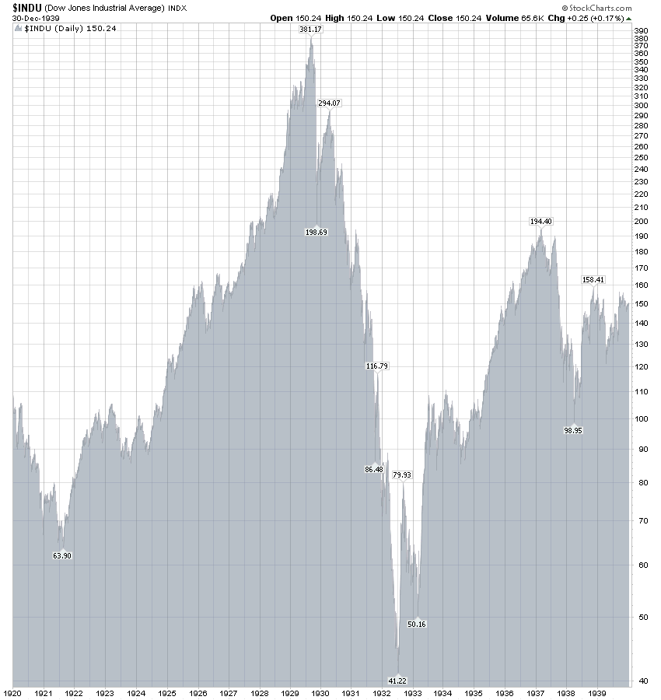

Slide 10
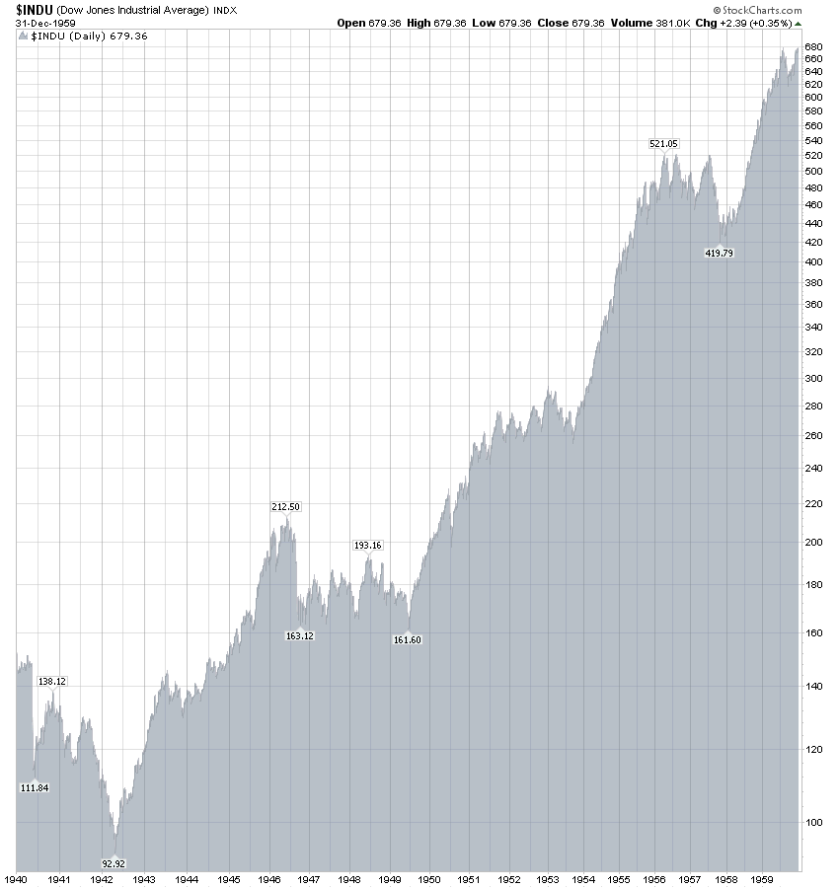

Slide 11
Hampered Market Economy
Topic 1: Booms and Busts
Claims that B-B Are Inherent to the UME
Market Failure: sticky prices and wages
• Increased spending drives up output prices
but not input prices
• Decreased spending drives down output
prices but not input prices

Slide 12
Hampered Market Economy
Topic 1: Booms and Busts
Response to Claim of Sticky Prices and Wages
The stickiness of prices and wages is chosen by
entrepreneurs to satisfy preferences
Entrepreneurs anticipate M-C prices
If some producer goods’ prices are sticky then
capital value of specific assets will adjust

Slide 13
Hampered Market Economy
Topic 1: Booms and Busts
Claims that B-B Are Inherent to the UME
Market Failure: inadequate spending
• Productive capacity and employment built
up in a pattern sustained by total spending
• Decline in total spending leaves excess
capacity and unemployment

Slide 14
Hampered Market Economy
Topic 1: Booms and Busts
Response to Claim of Inadequate Spending
Treats the economy as a single enterprise
Entrepreneurial foresight anticipates any shifts
preferences
The viability of production processes depends
on price spreads not total spending

Slide 15
Hampered Market Economy
Topic 1: Booms and Busts
Claims that B-B Are Inherent to the UME
Market Failure: price deflation
• Falling prices increase expectations of falling
prices which reduce demands and
decrease prices further

Slide 16
Hampered Market Economy
Topic 1: Booms and Busts
Response to Claim of Price Deflation
Goods still have usefulness, so demand is not
delayed indefinitely: prices have M-C levels
Speculation is rewarded for being accurate: not
self-reinforcing process

